Slide 1



Resources for Veterans and Transitioning Service Members

Slide 2
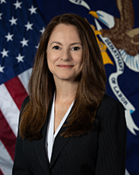
Welcome
Margarita Devlin, MA, CRC
  Deputy Assistant Secretary
    Operations and Management
    Veterans’ Employment and Training Service (VETS)
    U.S. Department of Labor

Slide 3


Agenda
Brief CareerOneStop Overview
Veteran and Military Transition Center
Questions

Slide 4


CareerOneStop
CareerOneStop is sponsored by the U.S. Department of Labor, Employment and Training Administration

Slide 5
Screenshots

Slide 6
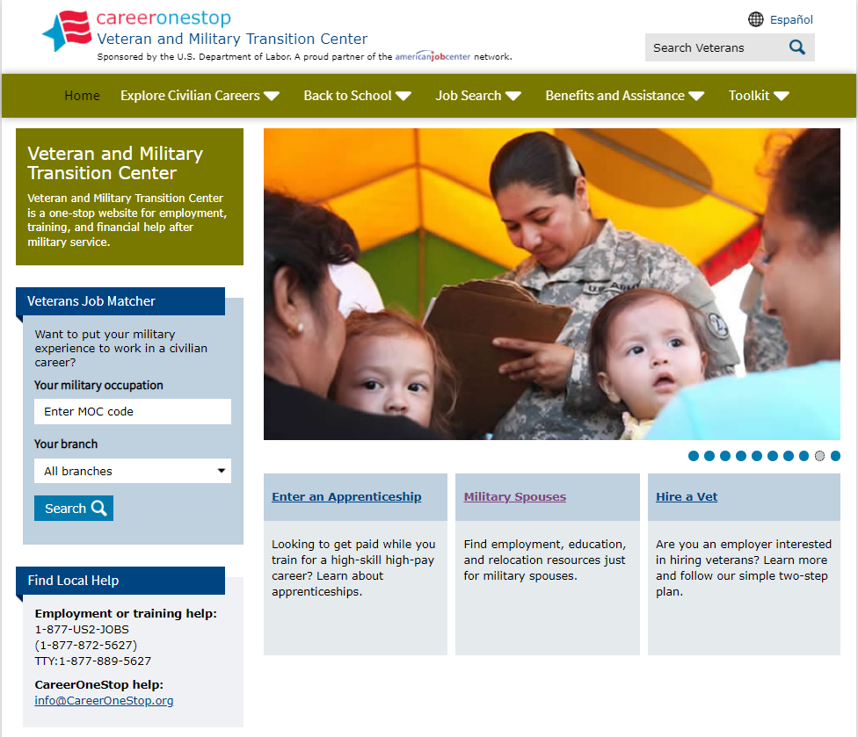
Veteran and Military Transition Center

Slide 7
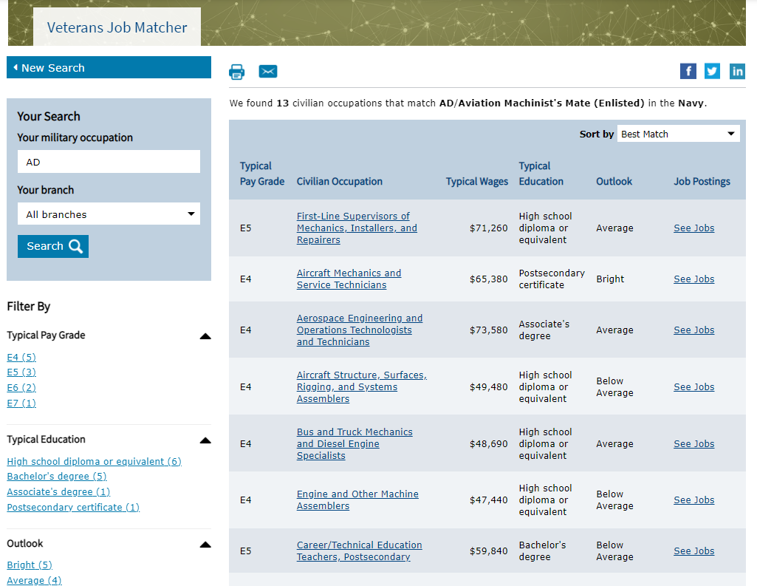
Veterans Job Matcher

Slide 8
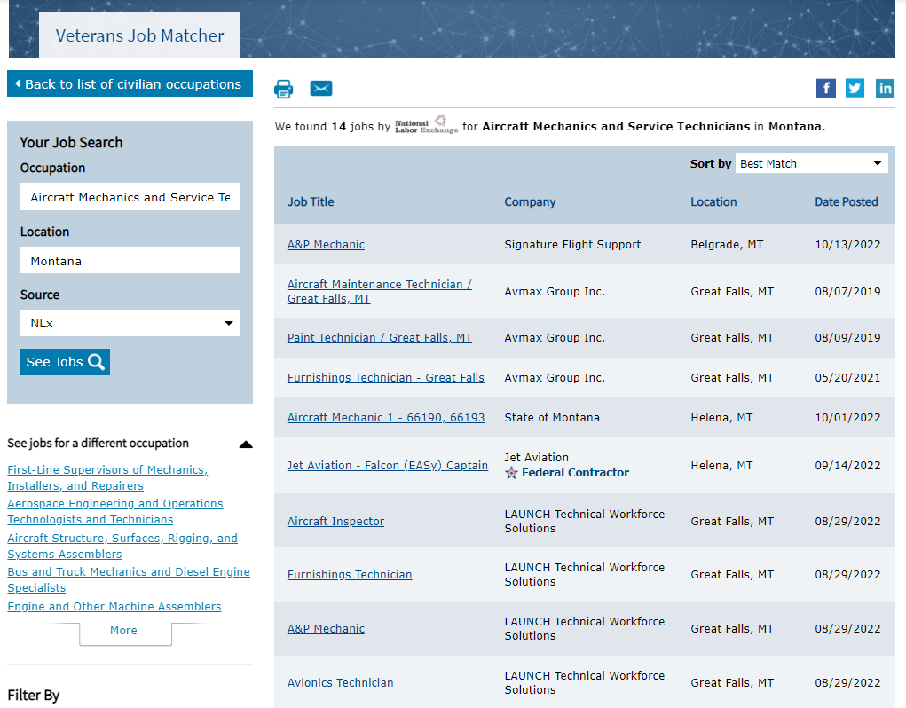
Veterans Job Matcher2

Slide 9
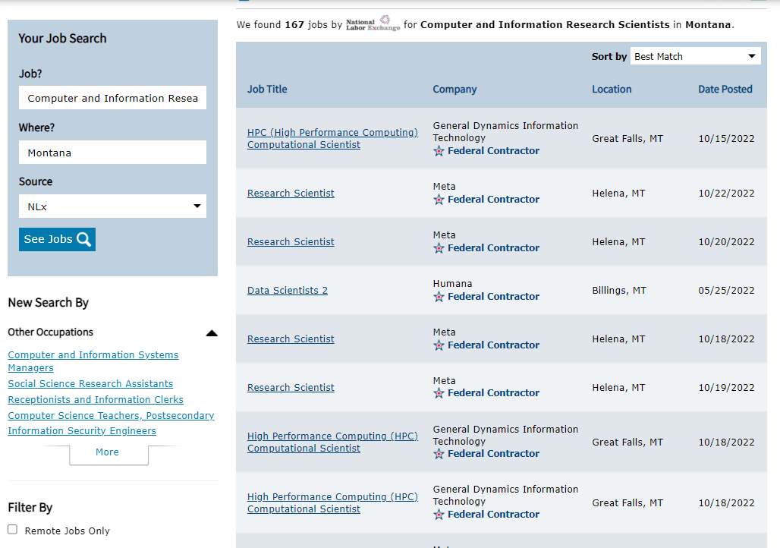
Job Finder

Slide 10
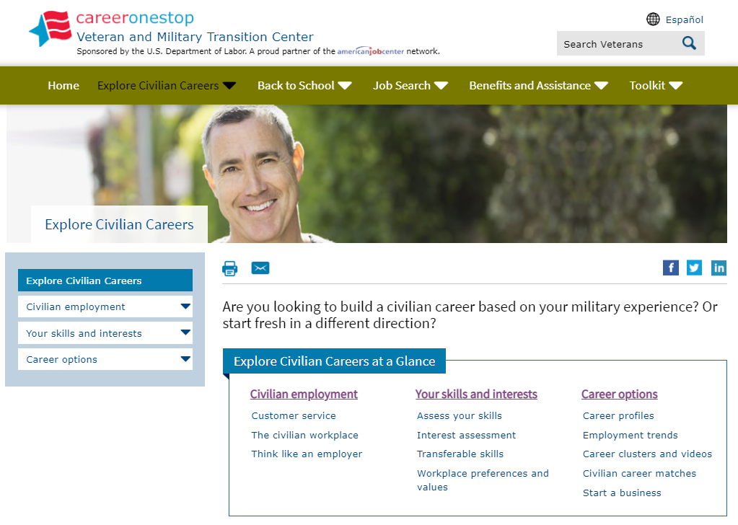
Explore Civilian Careers

Slide 11
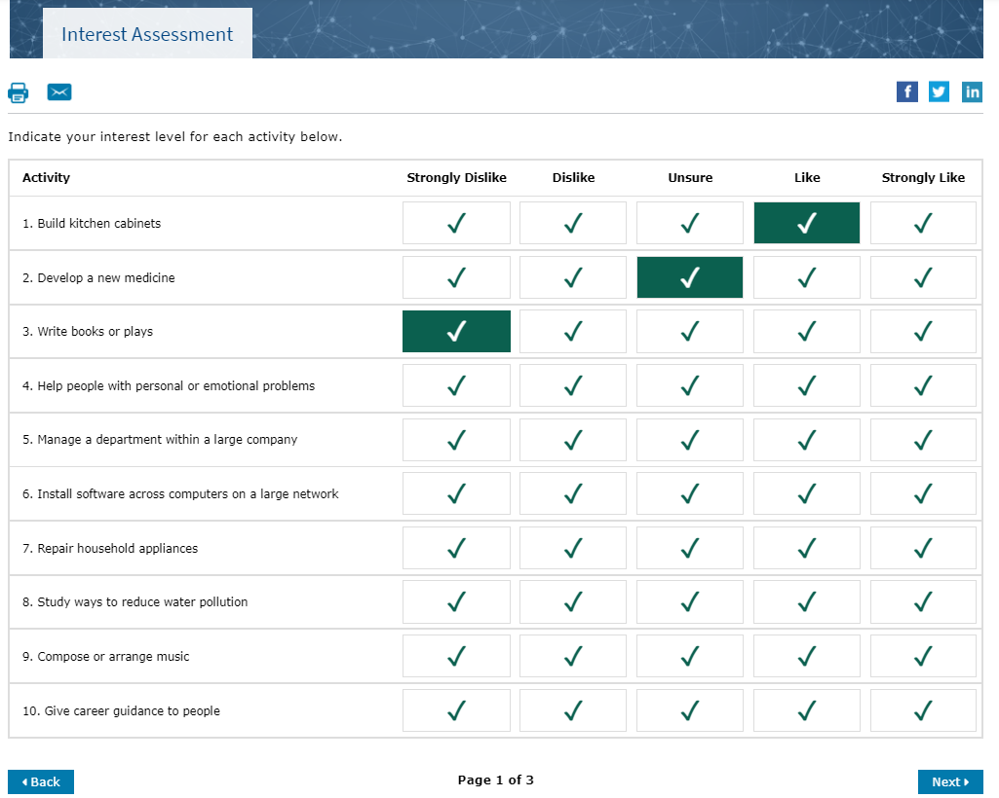
Interest Assessment

Slide 12
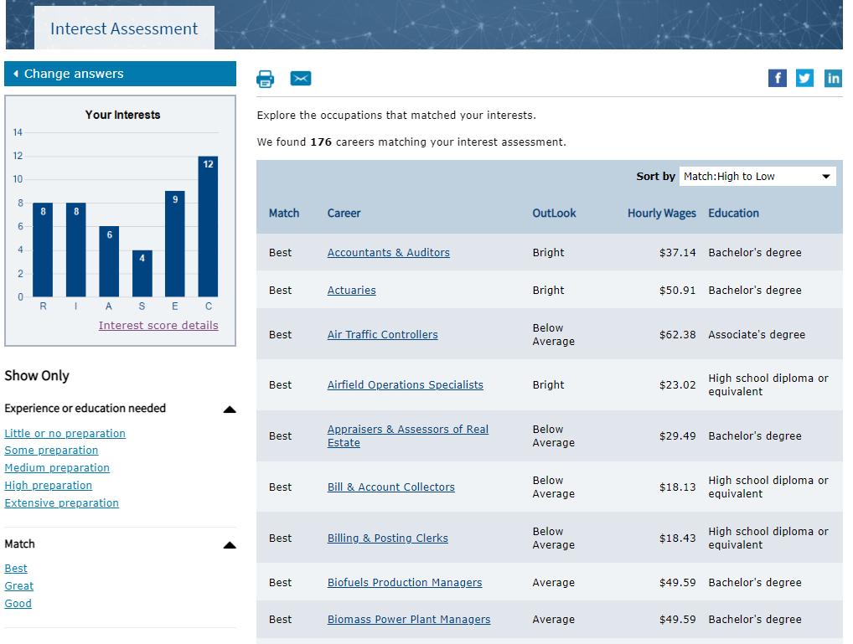
Interest Assessment Results

Slide 13
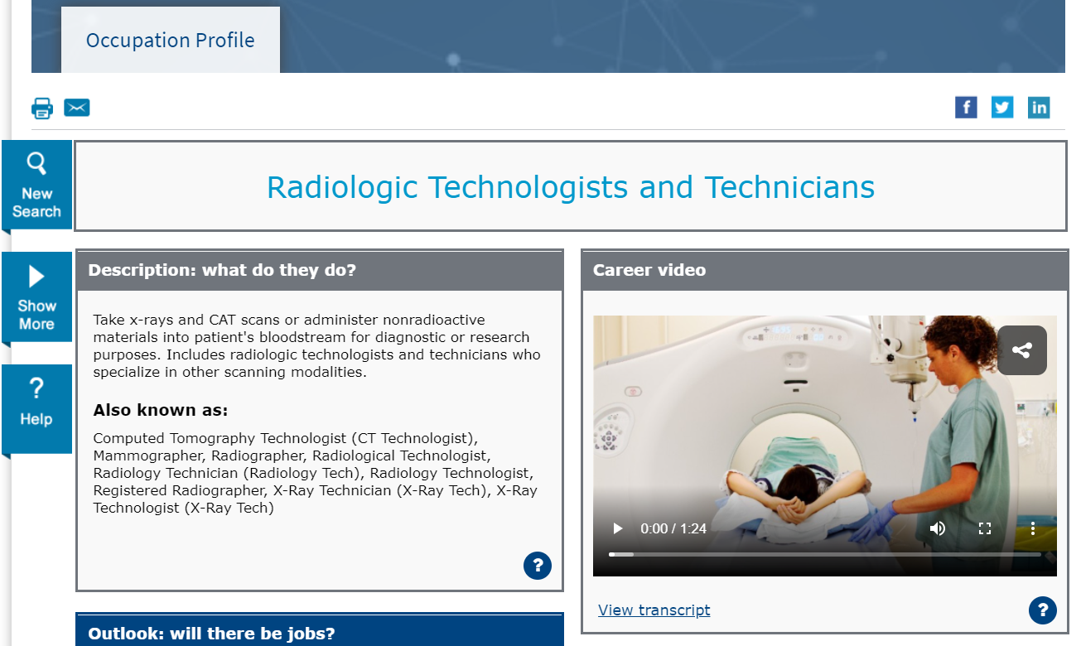
Occupation Profile

Slide 14
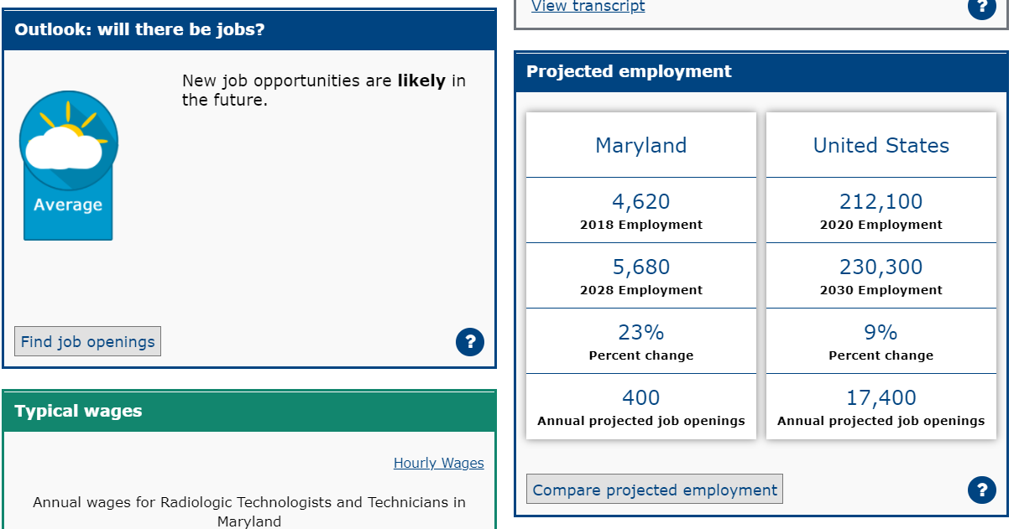
Occupation Profile2

Slide 15
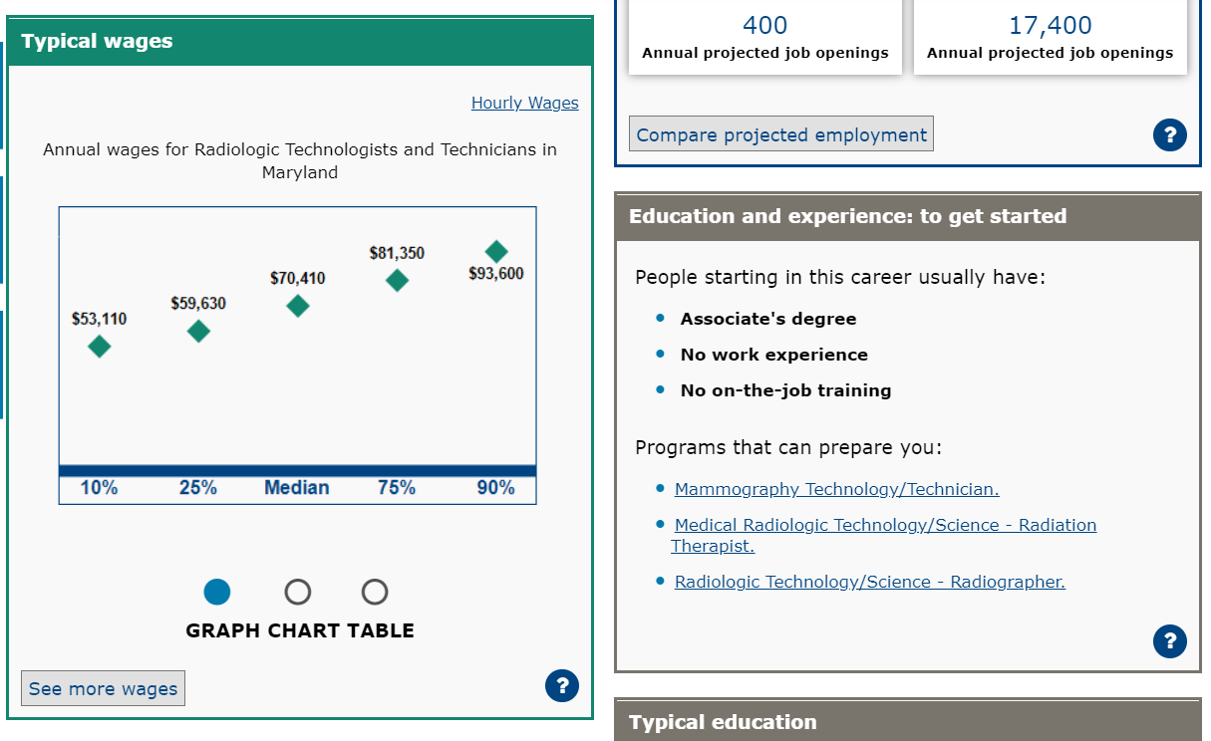
Occupation Profile3

Slide 16
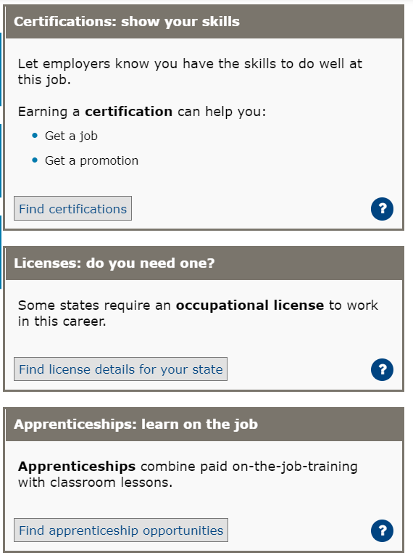
Occupation Profile4

Slide 17
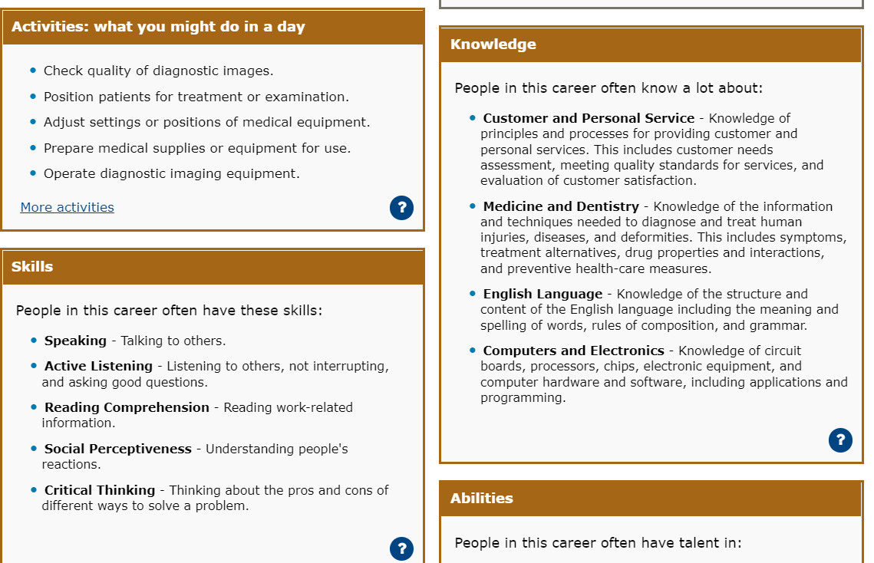
Occupation Profile5

Slide 18

Career Clusters

Slide 19

Back to School

Slide 20
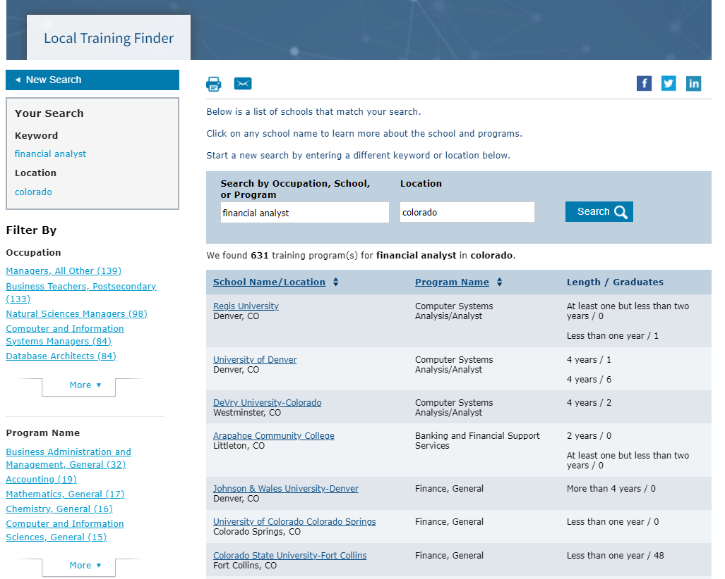
Local Training Finder

Slide 21
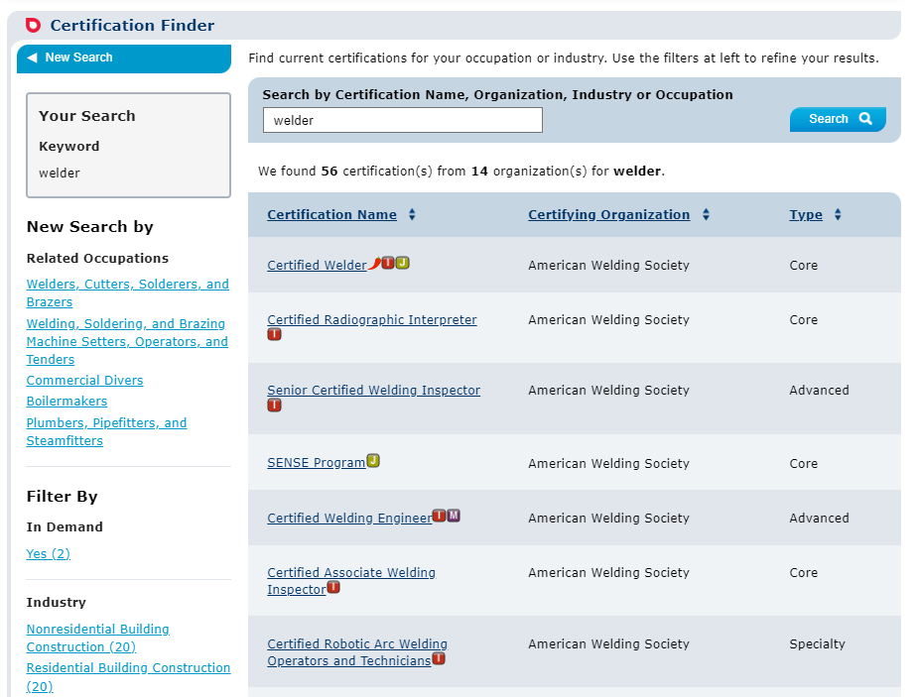
Certification Finder

Slide 22
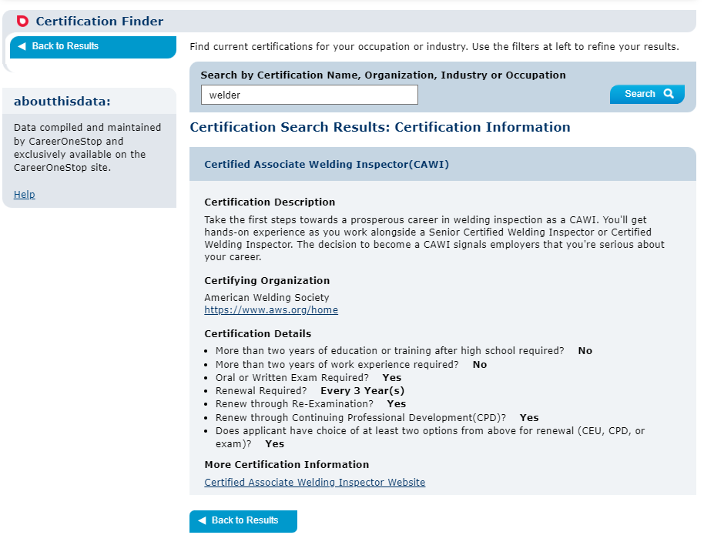
Certification Finder Detail Page

Slide 23
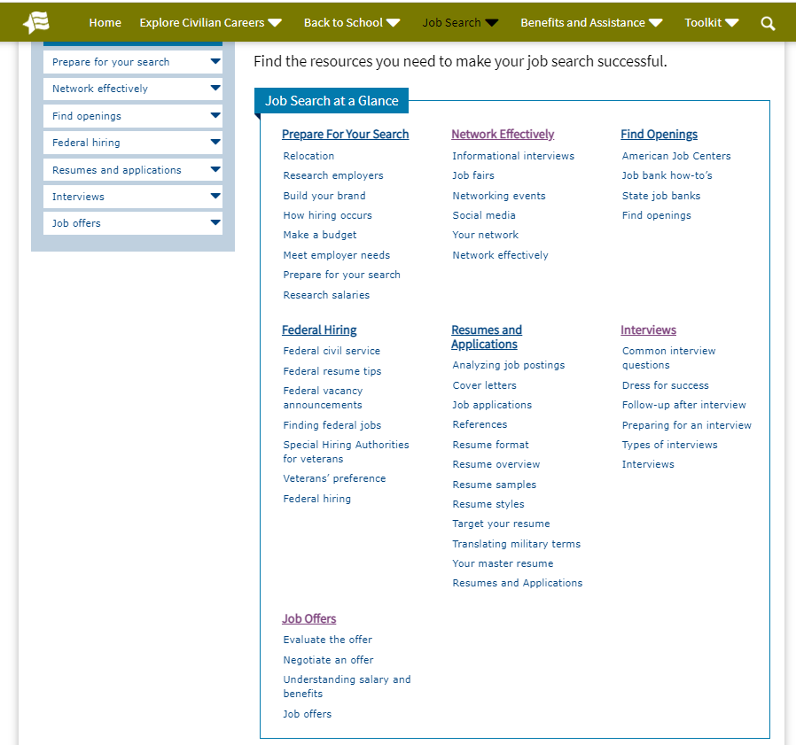
Job Search

Slide 24
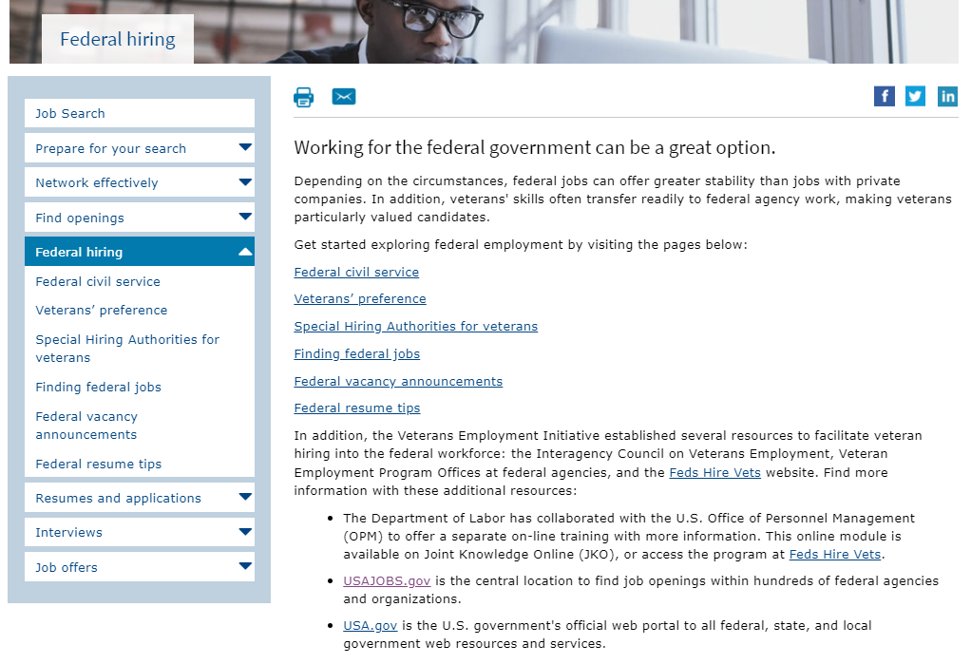
Federal Hiring

Slide 25
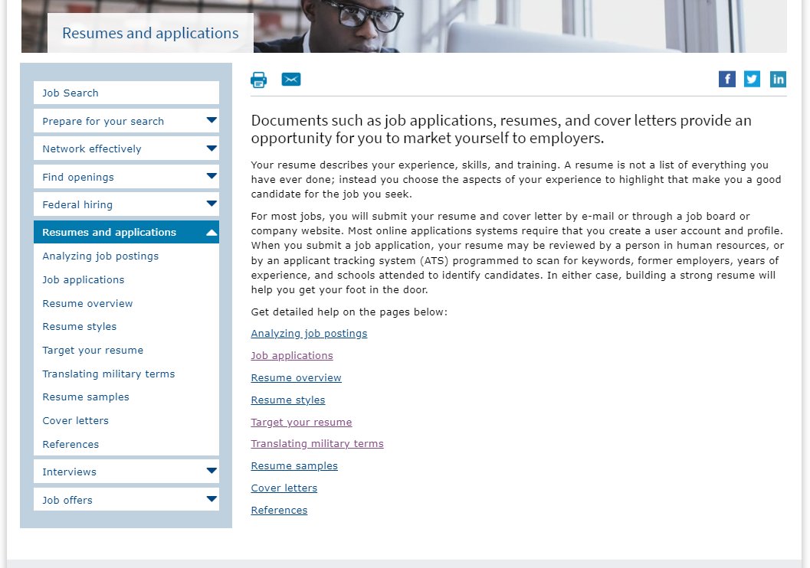
Resumes and Applications

Slide 26
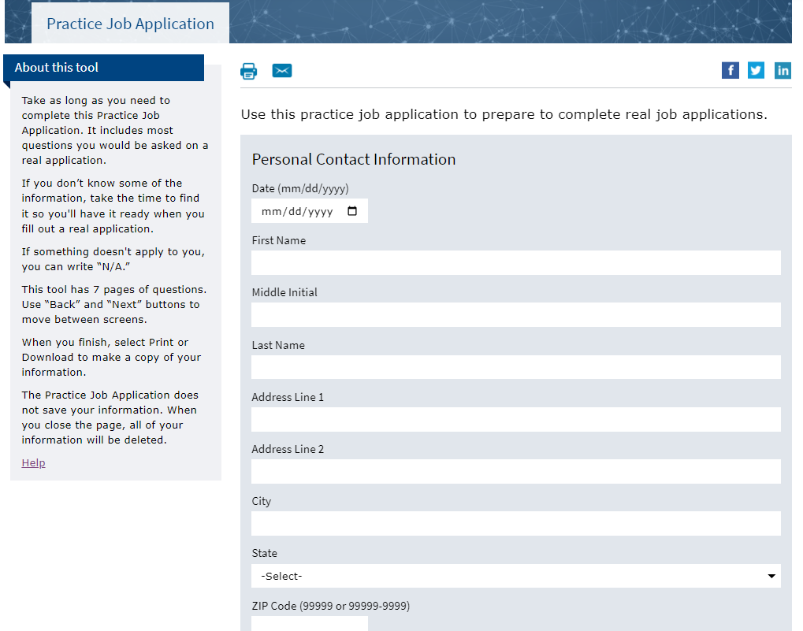
Practice Job Application

Slide 27
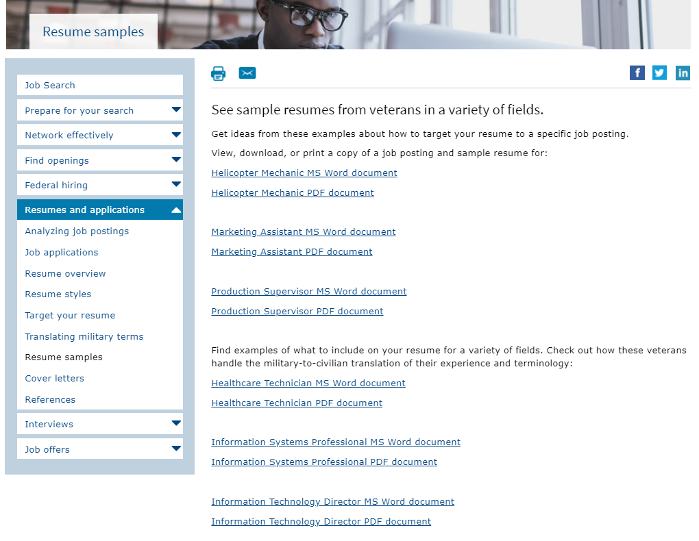
Resume Samples

Slide 28
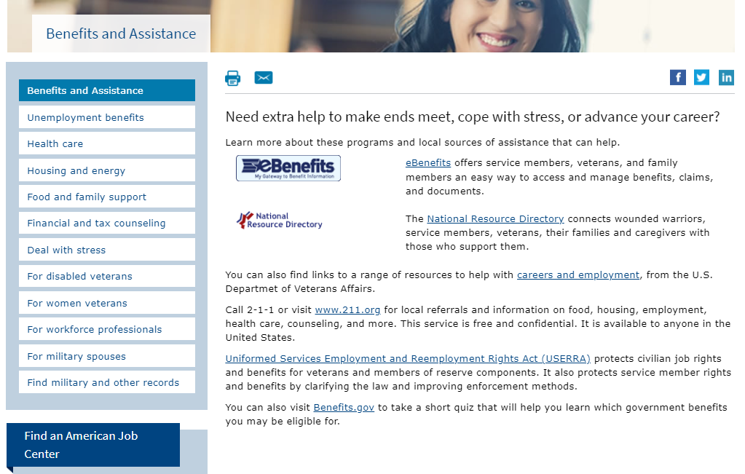
Benefits and Assistance

Slide 29
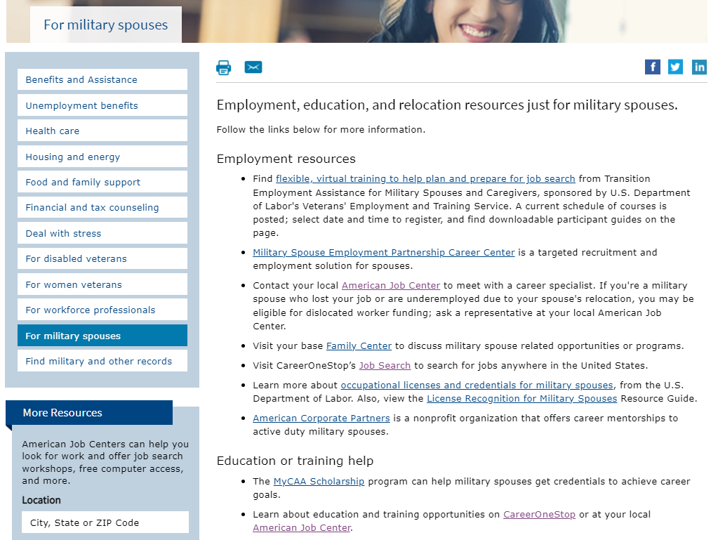
For Military Spouses

Slide 30
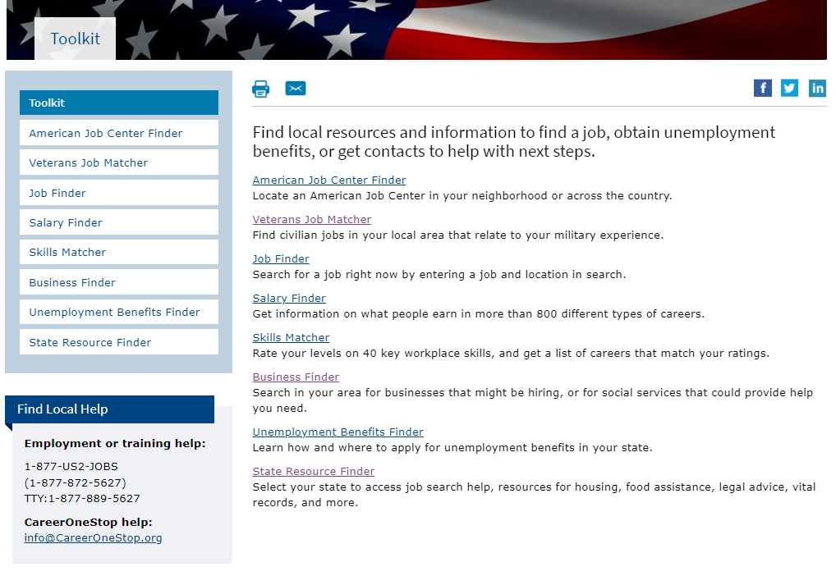
Toolkit

Slide 31
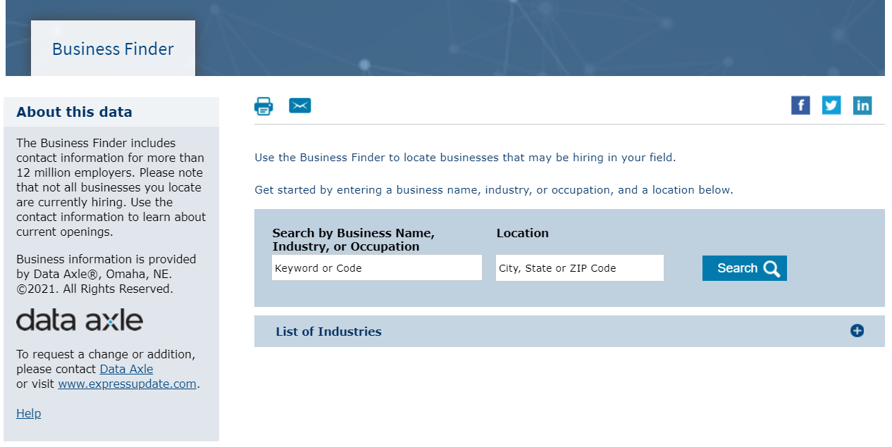
Business Finder

Slide 32
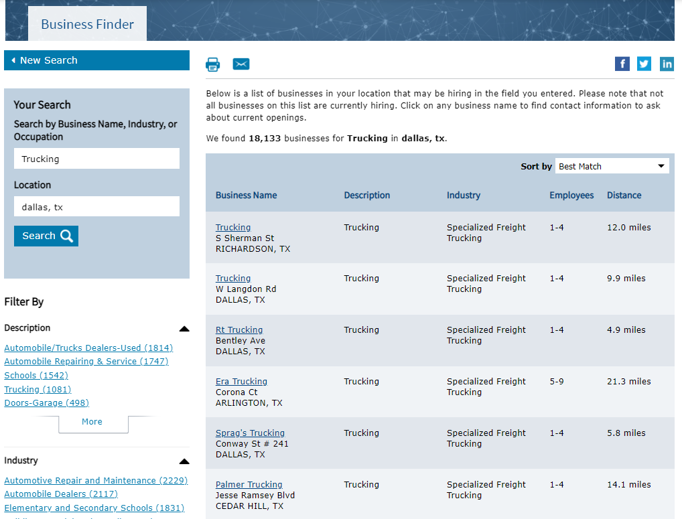
Business Finder Results Page

Slide 33
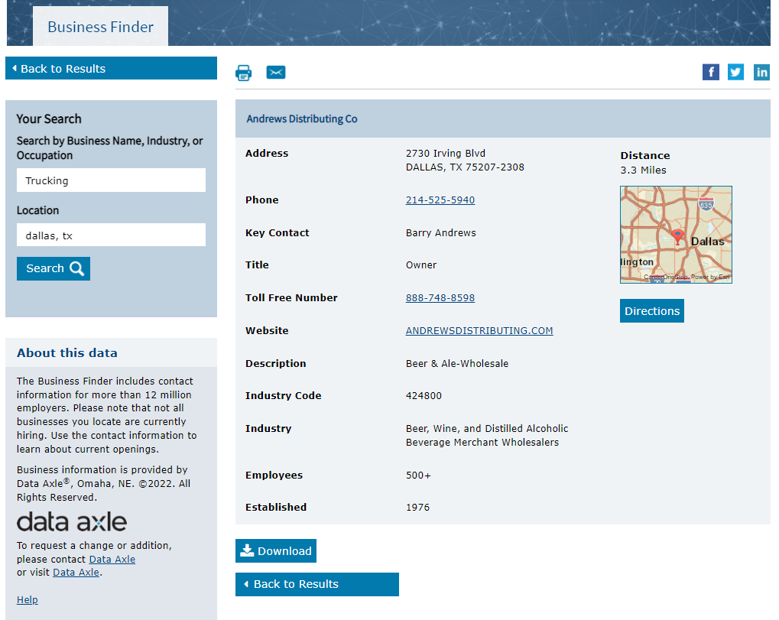
Business Finder: Detail Page

Slide 34
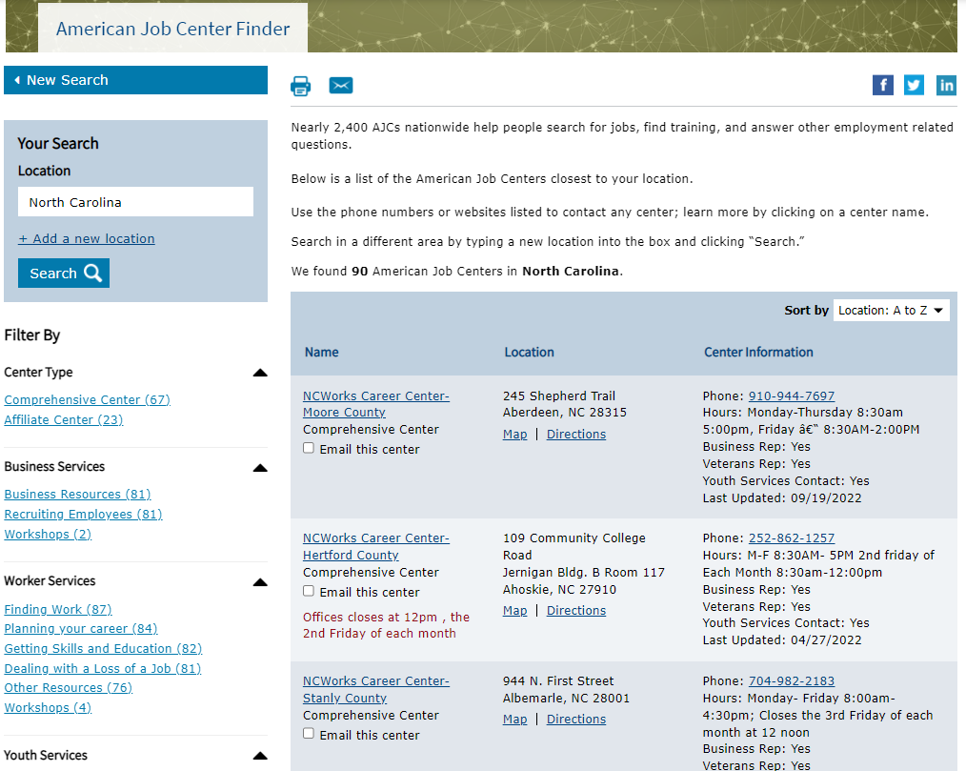
American Job Center Finder

Slide 35
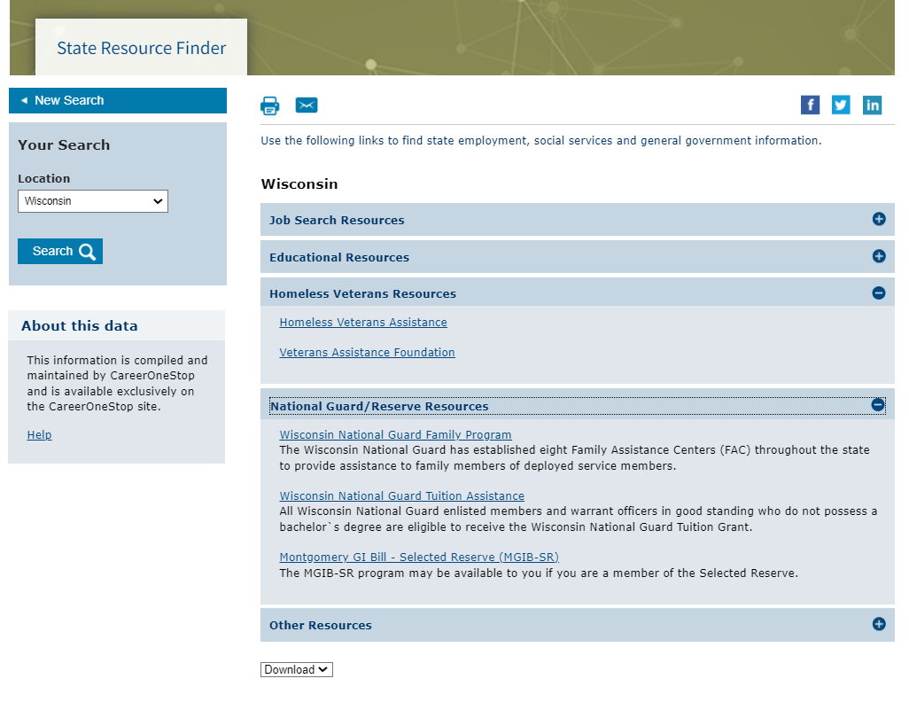
State Resource Finder

Slide 36
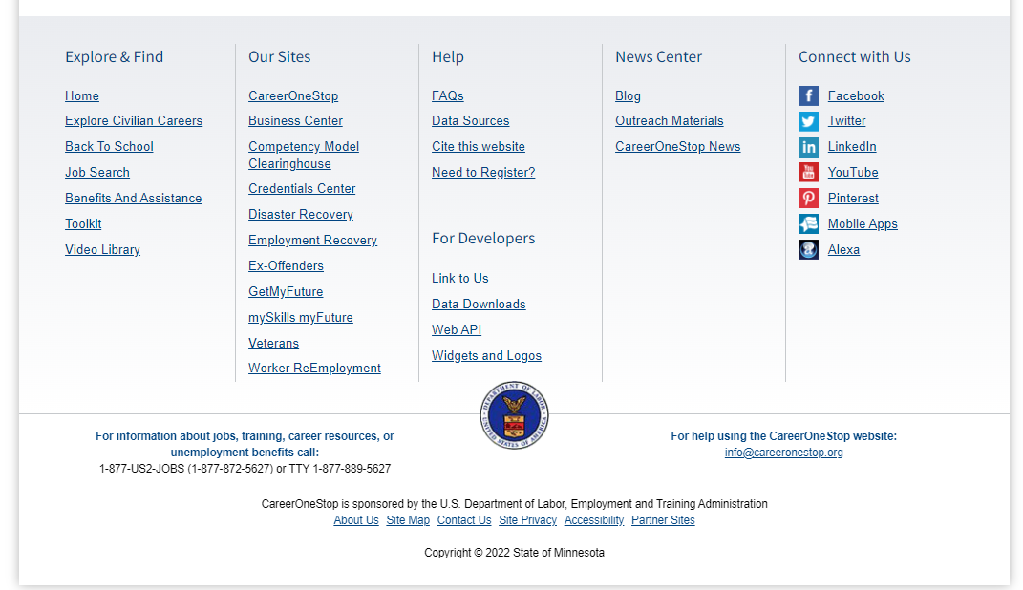
Footer

