Slide 1



CareerOneStop Tools for Older Job Seekers
CareerOneStop Tools for Older Job Seekers

Slide 2

The Senior Community Service Employment Program
U.S. Department of Labor, Employment & Training Administration,
Office of Workforce Investment

Slide 3

Senior Community Service Employment Program Overview
A community service and work-based training program for low-income, unemployed persons aged 55 or older with poor employment prospects
  Enrollment priority: veterans; over age 65; have a disability, limited English proficiency, or low literacy skills; reside in a rural area; have low employment prospects; formerly incarcerated individuals; homeless or at risk for homelessness
SCSEP Goals
  Help participants obtain unsubsidized employment, improve their economic situation, and become self-sufficient
  Support useful part-time opportunities in community service assignments for unemployed low-income seniors
Currently, there are 75 SCSEP grantees: 56 units of state and territorial governments and 19 national nonprofit organizations

Slide 4

Traditional SCSEP Activities
Through community service assignments (CSAs) provided by nonprofit and public entities, participants receive subsidized, part-time community service training to help them obtain work experience, skills, or job training to prepare them for subsidized jobs
Some participants also receive paid on-the-job experience with employers that helps to transition them into permanent positions
At the end of the program, SCSEP works with employers to find unsubsidized employment for participants

Slide 5
SCSEP Program Structure
SCSEP provides part-time subsidized work experience through community service assignments before transitioning program participants to unsubsidized employment.
  Part-time = typically 20 hours per week
  Subsidized = paid the higher of federal, state, or local minimum wage
  Community service assignment = work at a host agency delivering community service
Other services include:
  Skill assessment, needs assessment
  Supportive services, case management
  Skill enhancement

Slide 6
Funding Distribution and Authorized Positions
Authorized positions, or “slots,” are distributed across the country, based on Census data on low-income seniors.
National nonprofit grantees
78% of grant funding
Competition every four years determines national nonprofit grantees
Applicants bid on service areas - DOL decides service areas
Award amounts based on authorized positions awarded
State grantees
22% of grant funding
Every state receives a SCSEP grant
Funding awarded by formula
Minority sponsors
Serve Asian American and Pacific Islanders
Serve Indian and Native Americans
Awarded in addition to general competition
Funds awarded to awardees, with set amount per authorized position
  See annual allotment guidance, including positions and funding by grantee

Slide 7
SCSEP
Discretionary Grants
AARP Foundation
Asociación Nacional Pro Personas Mayores
Associates for Training & Development
Center for Workforce Inclusion
Easterseals, Inc
Goodwill Industries International
Institute for Indian Development*
International Pre-Diabetes Center
National Able Network
Natl. Asian Pacific Ctr. on Aging**
Natl Caucus & Center on Black Aging
National Council on Aging
National Indian Council on Aging**
National Experienced Workforce Solutions
National Urban League
Operation A.B.L.E of Greater Boston, Inc.
SER - Jobs for National Progress
The WorkPlace Inc.
Vantage Aging (Formerly Mature Services)
19 national nonprofit grantees
Grant sizes range from $1.6M to $47M
56 state/territorial grantees
Grant sizes range from $425K to $6.85M
* Minority national sponsor
**Minority national sponsor and general grantee

Slide 8

Host Agencies and Community Service
SCSEP participants work at host agencies, which might be:
  Senior centers, outreach to seniors
  Libraries
  Food distribution, clothing distribution sites
  Child enrichment, reading and literacy programs for youth
  Local government entities
Host agency's roles include:
  Formalizing responsibilities in Grantee/Host Agency Agreements
  Providing a training work site and supervision for one or more participants
  Assisting participants in gaining soft skills, and preparing for unsubsidized employment

Slide 9

SCSEP as partner in American Job Centers
SCSEP is a mandatory partner in one-stop centers, better known as American Job Centers
  Sign MOUs with Local Workforce Boards
  Make services available in AJCs
  Share outreach and referral strategies
19 states include SCSEP in their WIOA Combined Plan
SCSEP
Farmworker Program
YouthBuild

Slide 10

SCSEP Tools & Resources
Important SCSEP Links
Senior Community Service Employment Program
Senior Community Service Employment Program | U.S. Department of Labor (dol.gov)
    Older Workers Community of Practice Page
    https://olderworkers.workforcegps.org/home/

Slide 11

Agenda
The Senior Community Service Employment Program (SCSEP)
Brief CareerOneStop Overview
CareerOneStop Tools and Content
Questions

Slide 12
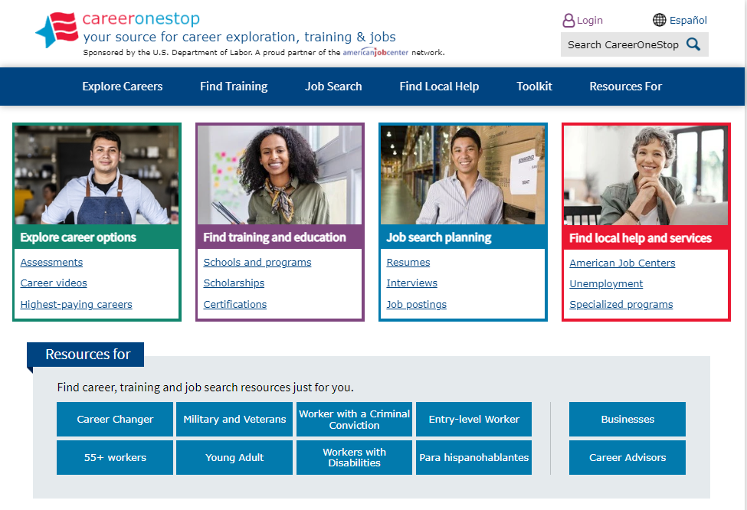

CareerOneStop
CareerOneStop is sponsored by the U.S. Department of Labor, Employment and Training Administration

Slide 13
Contact Information
Tricia Dahlman
Operations & Outreach Manager, CareerOneStop
Patricia.Dahlman@state.mn.us
Julie Remington
Content Strategist, CareerOneStop
Julie.Remington@state.mn.us

Slide 14
Questions

Slide 15
Screenshots

Slide 16
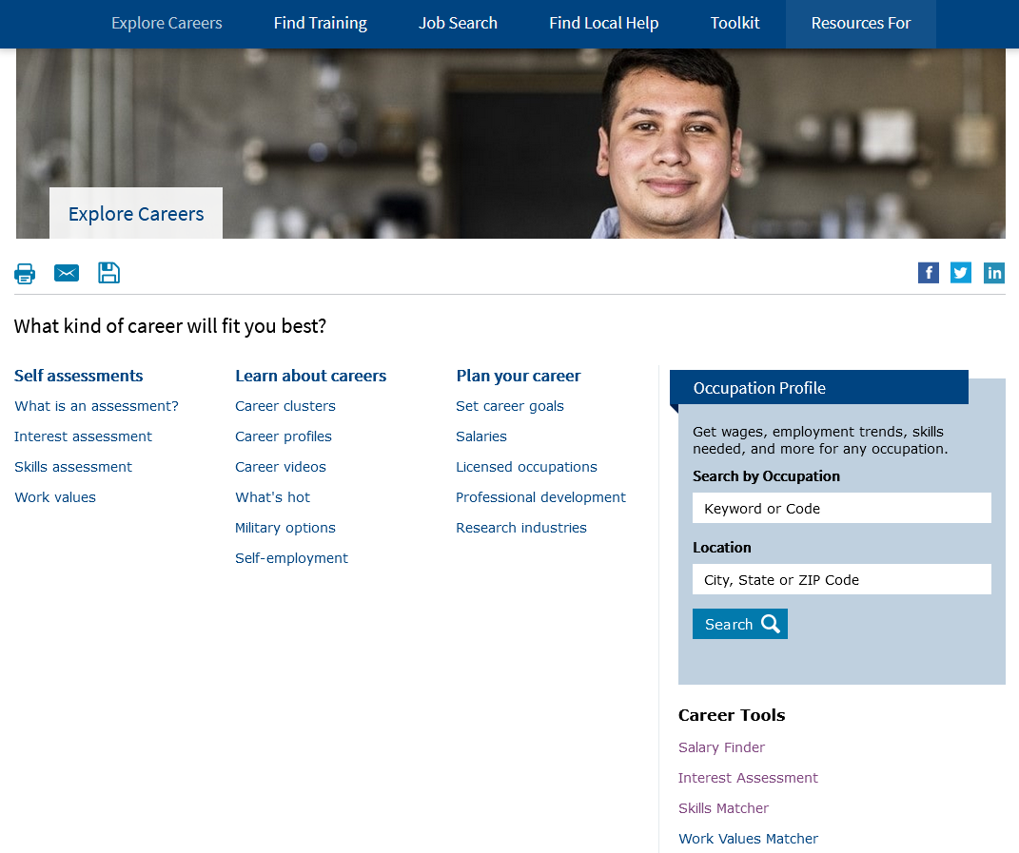
Explore Careers

Slide 17
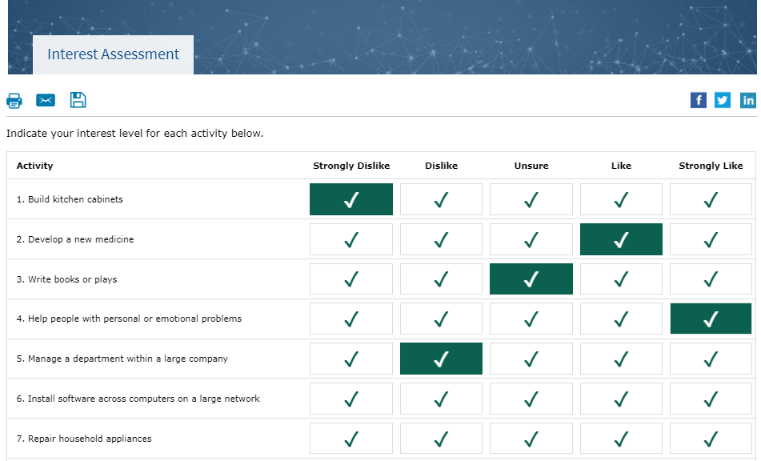
Interest Assessment

Slide 18
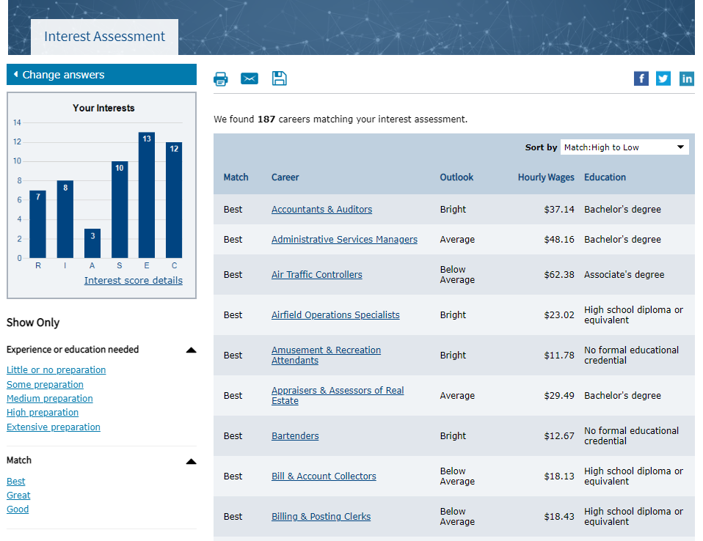
Interest Assessment Results

Slide 19
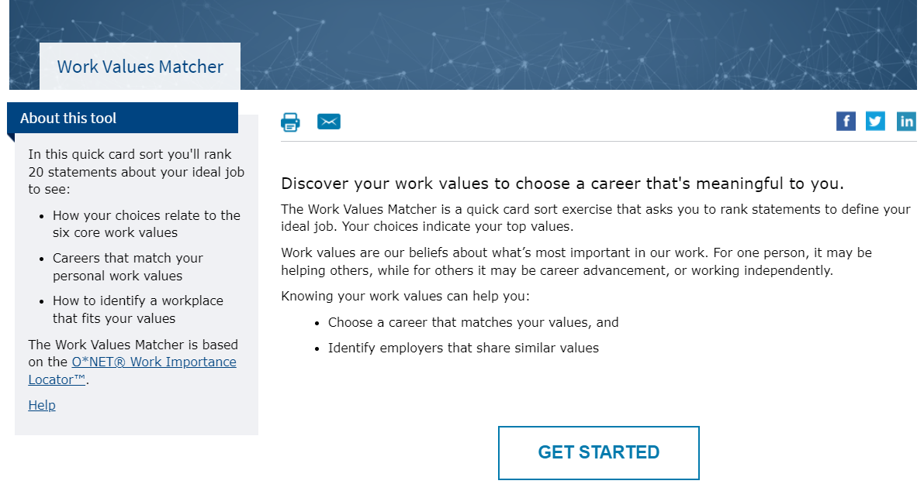
Work Values Matcher

Slide 20
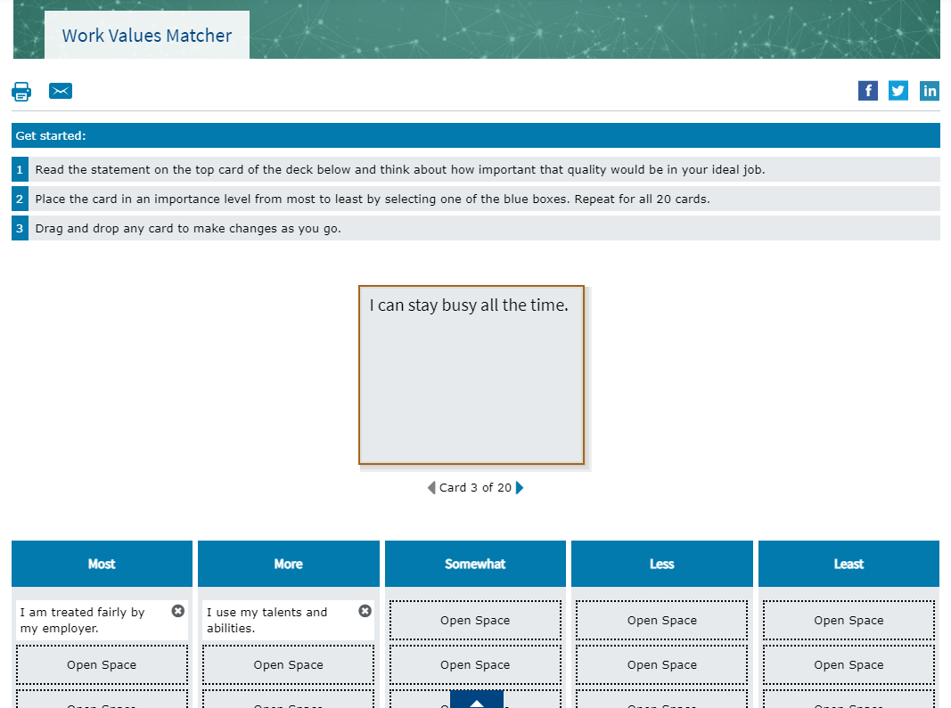
Work Values Matcher Cards

Slide 21
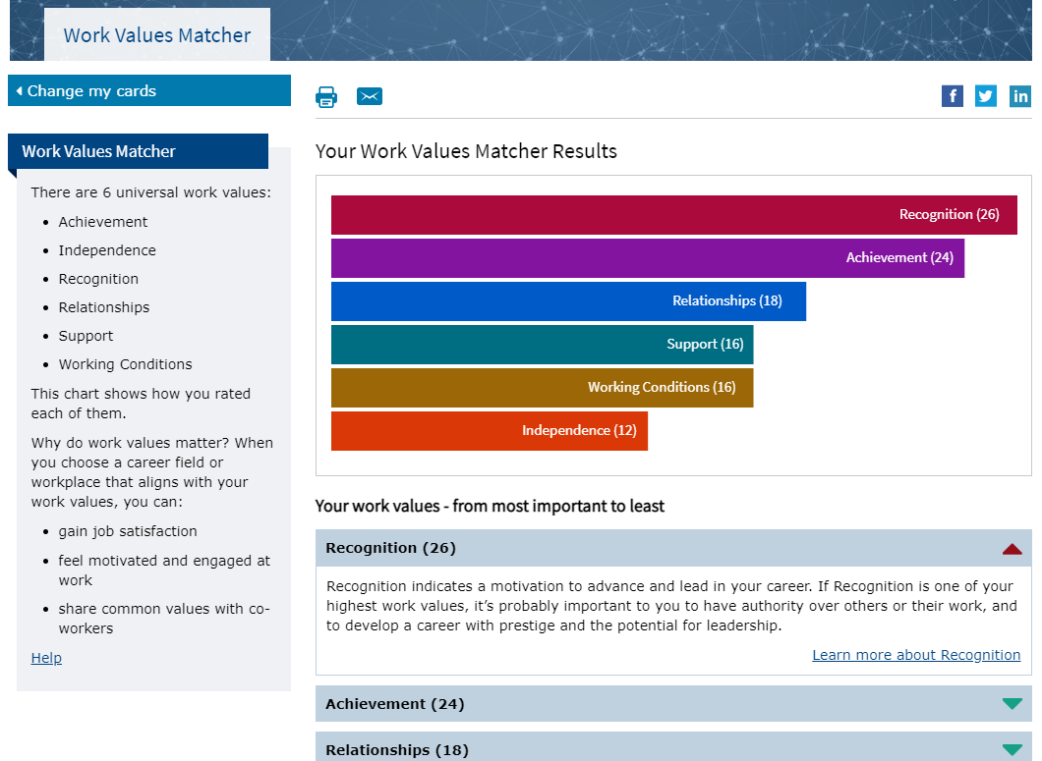
Work Values Matcher Results

Slide 22
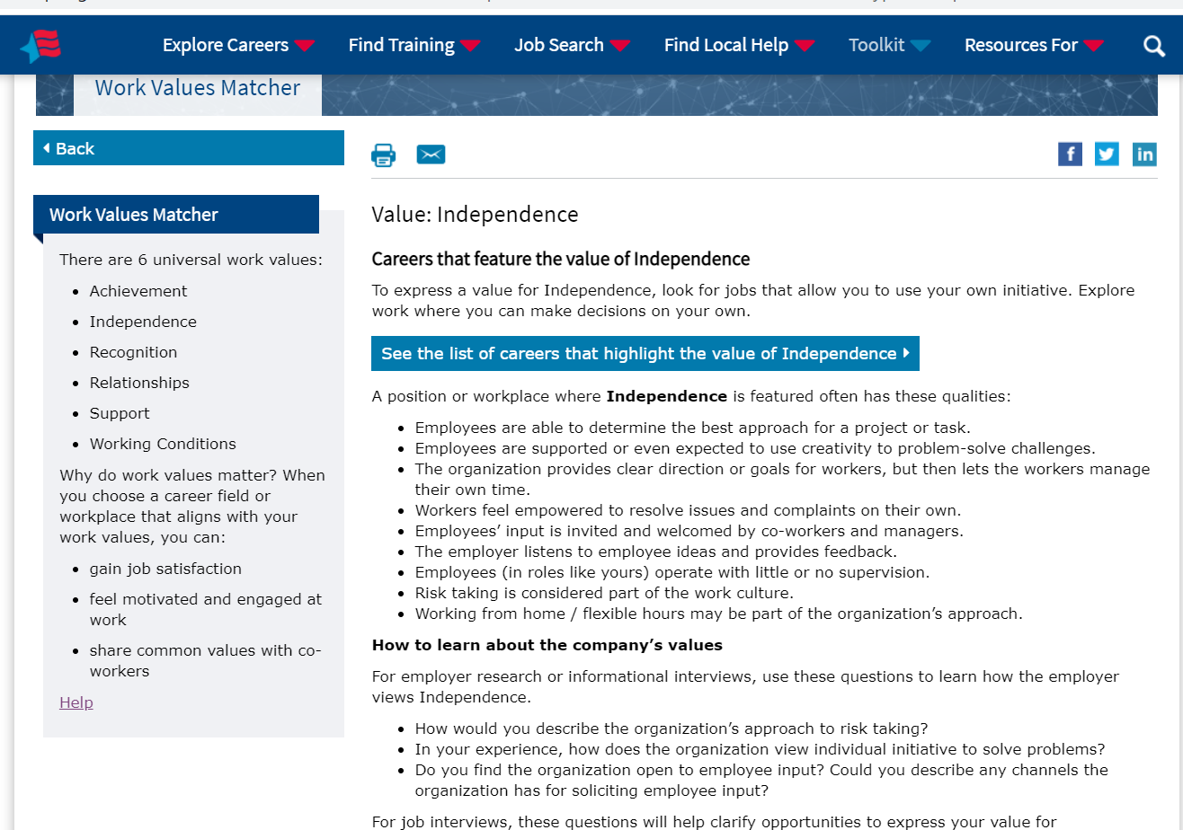
Work Values Matcher Value Description

Slide 23
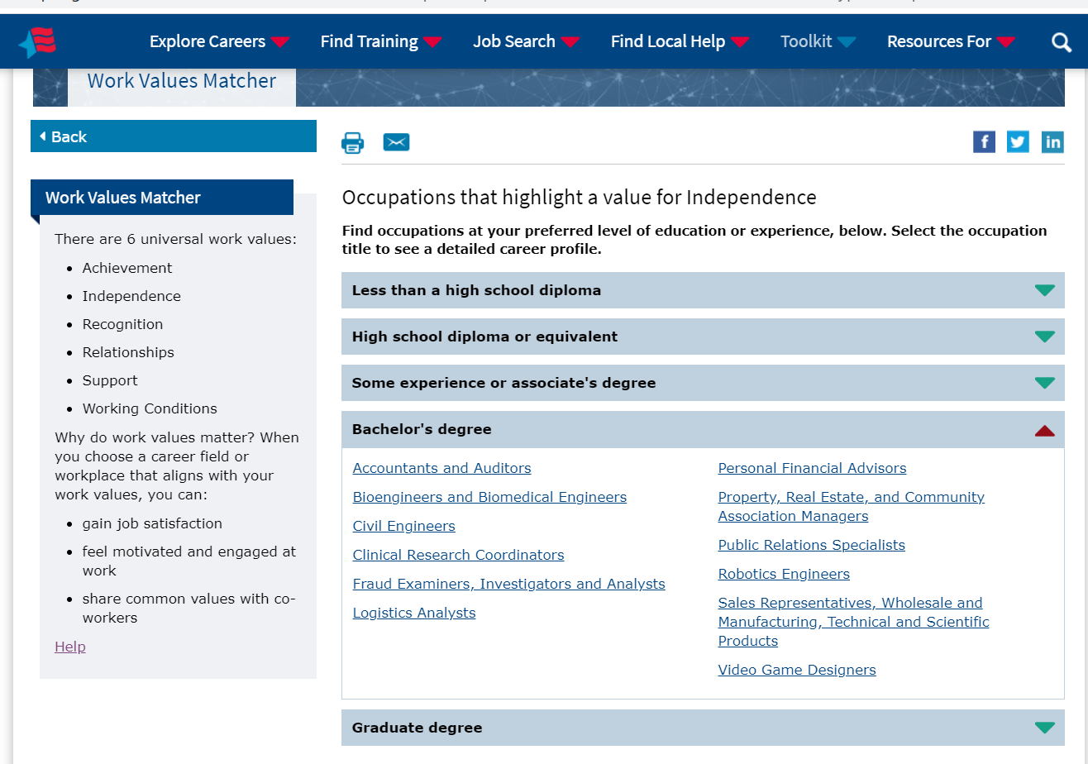
Work Values Matcher Career List

Slide 24
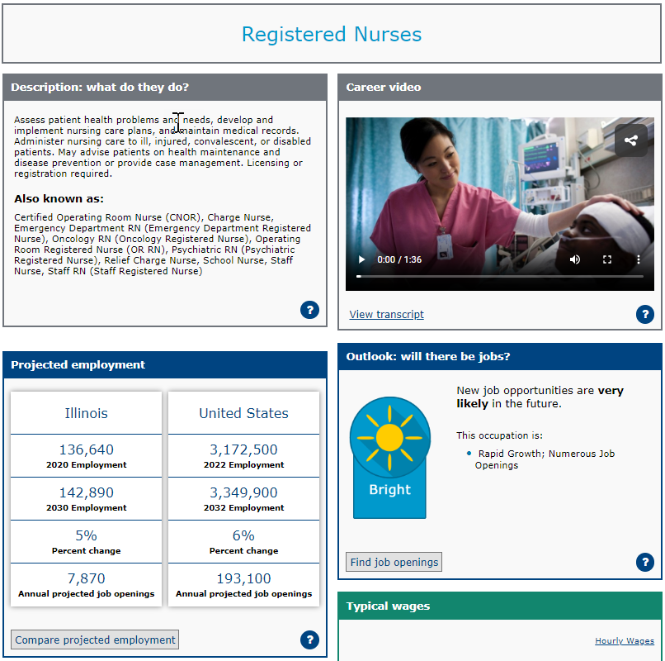
Occupation Profile

Slide 25

mySkills myFuture

Slide 26
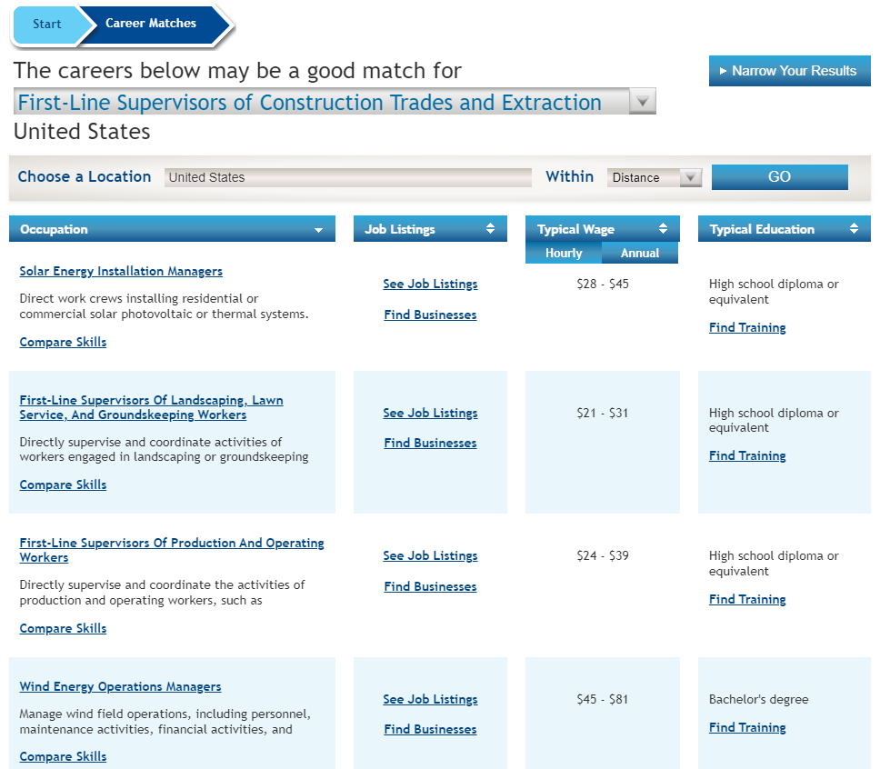
mySkills myFuture: Career Matches

Slide 27
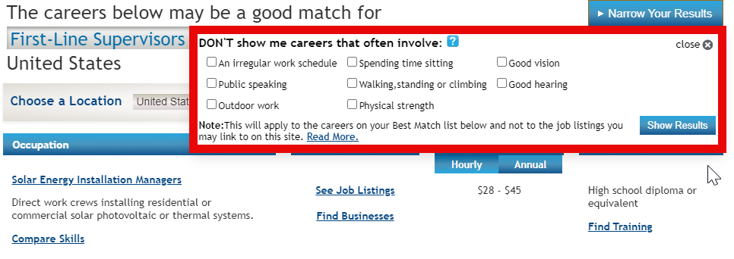
Narrow Your Results?

Slide 28
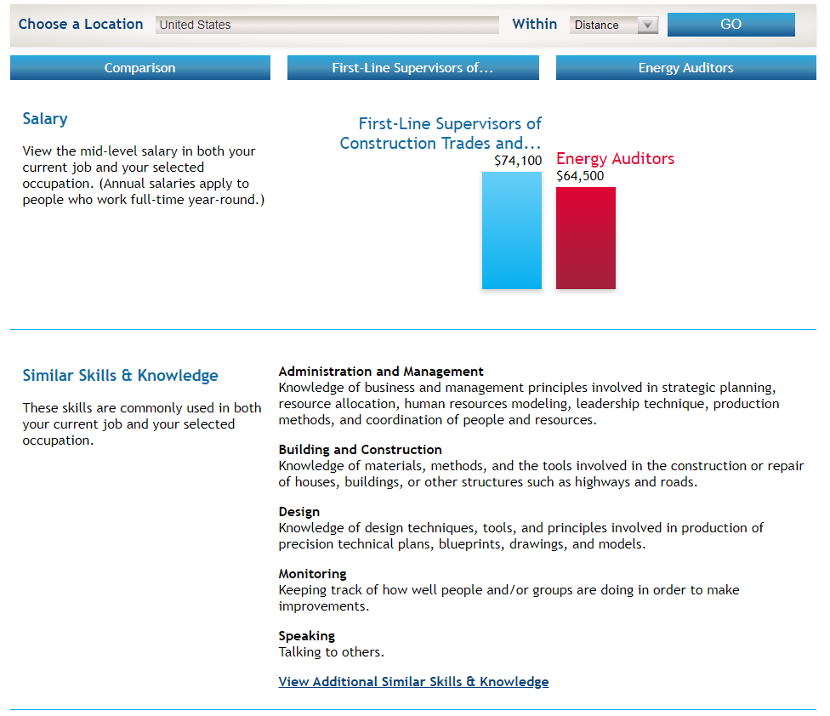
mySkills myFuture: Compare Skills

Slide 29
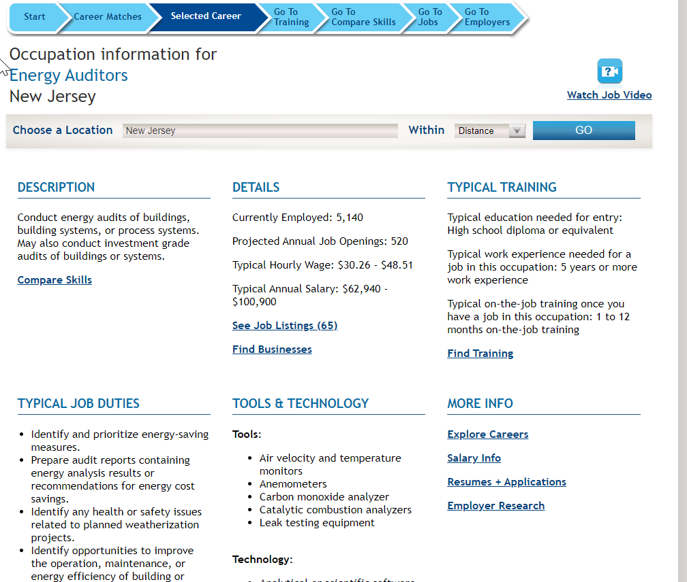
mySkills myFuture: Career Profile

Slide 30
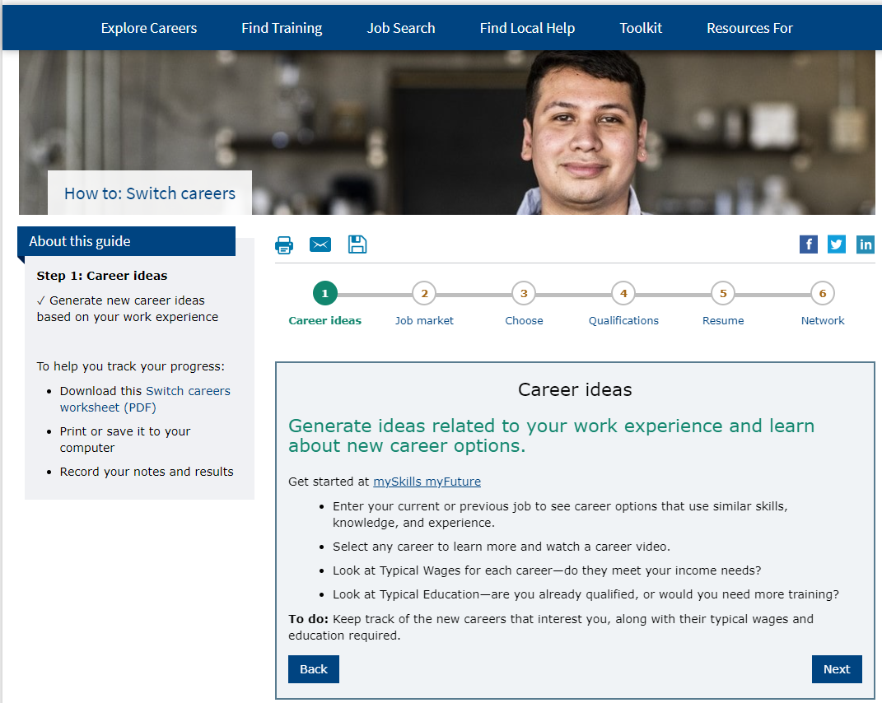
How-to Guide: How to Switch Careers

Slide 31
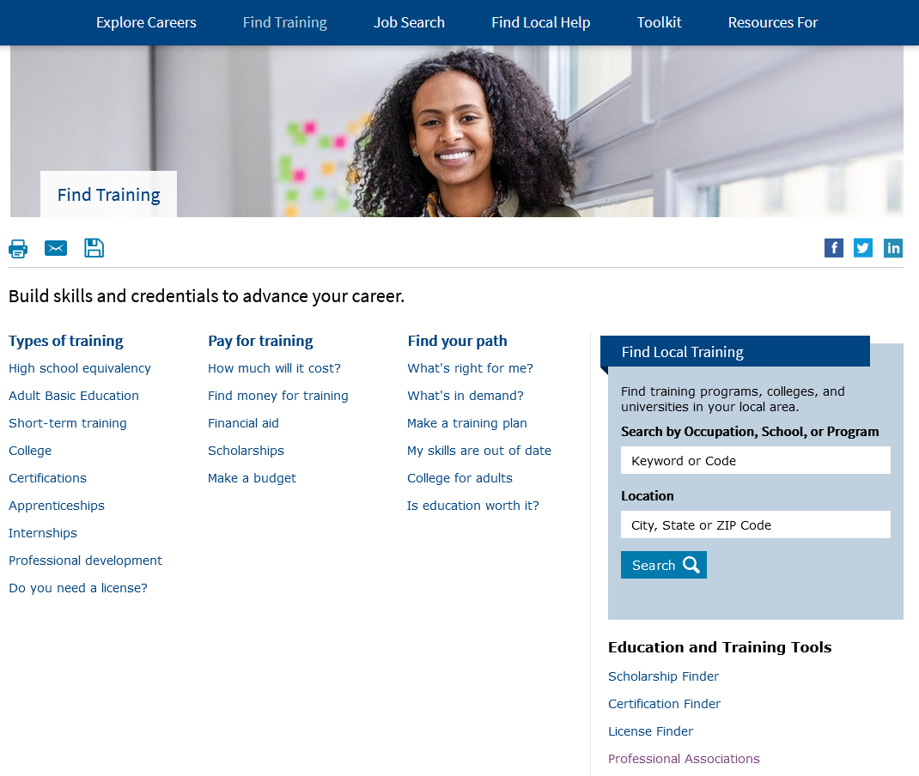
Find Training

Slide 32
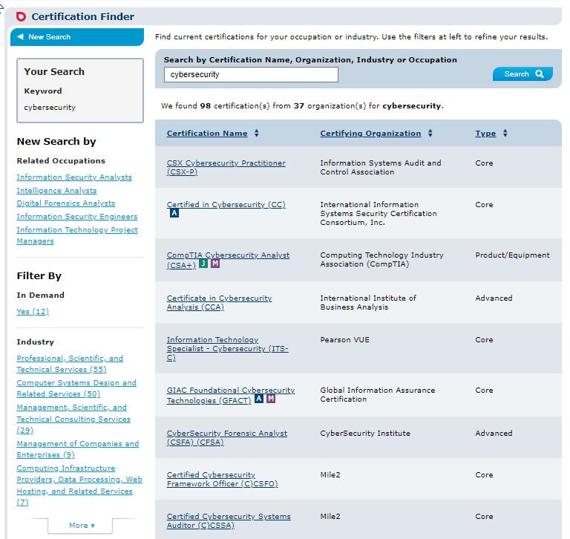
Certification Finder

Slide 33
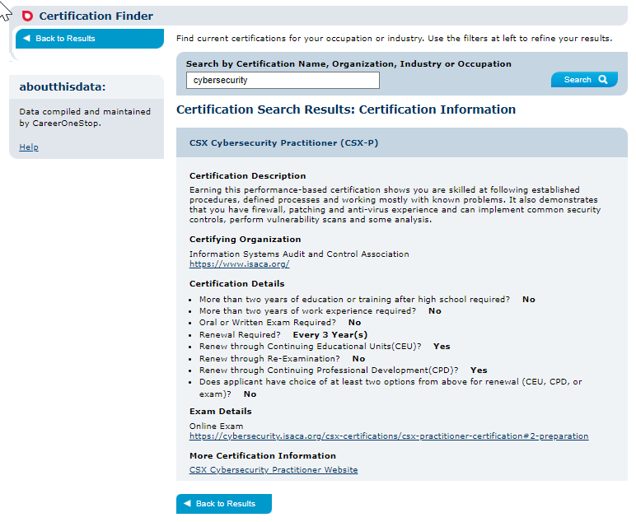
Certification Finder Detail Page

Slide 34
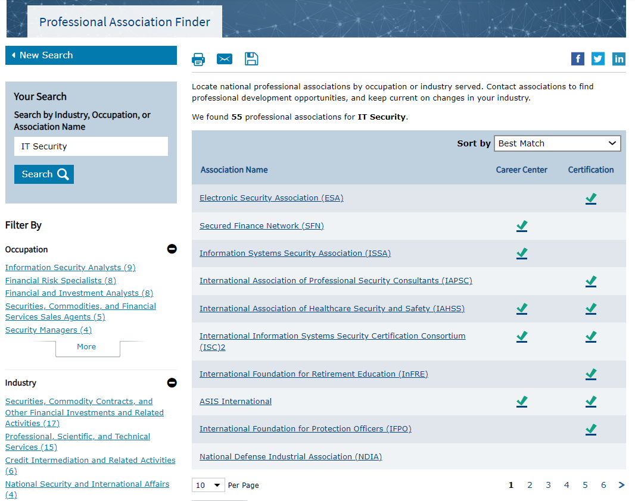
Professional Association Finder

Slide 35

My Skills are Out of Date

Slide 36
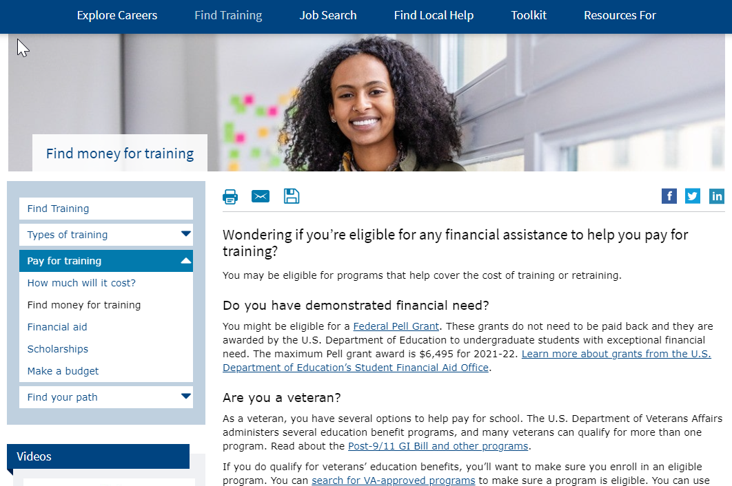
Find Money for Training

Slide 37
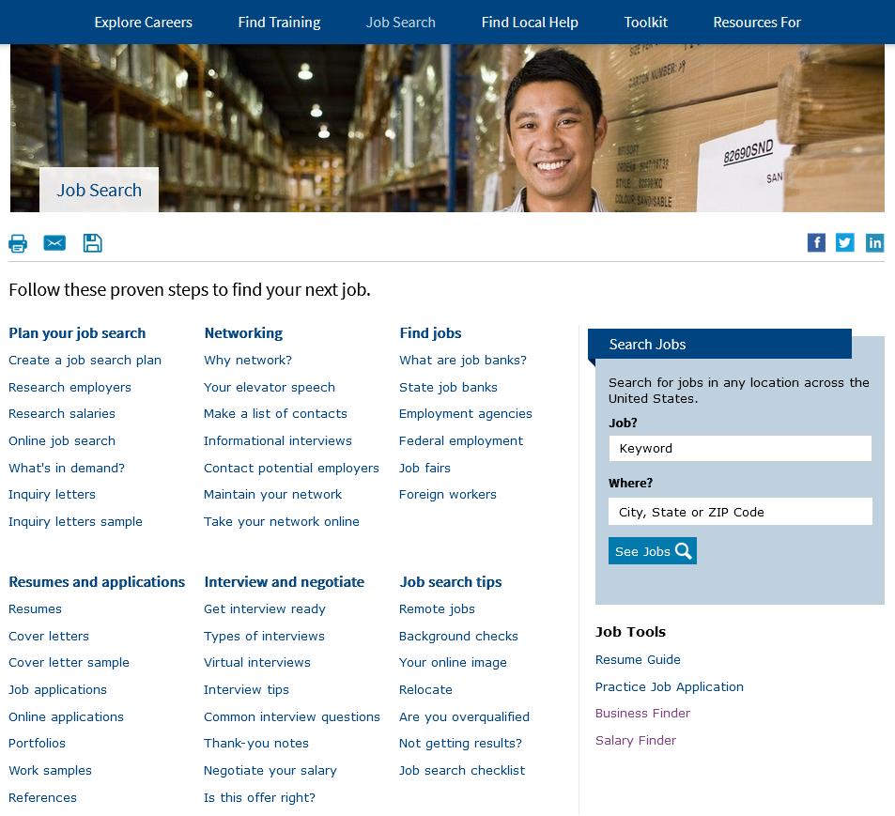
Job Search

Slide 38
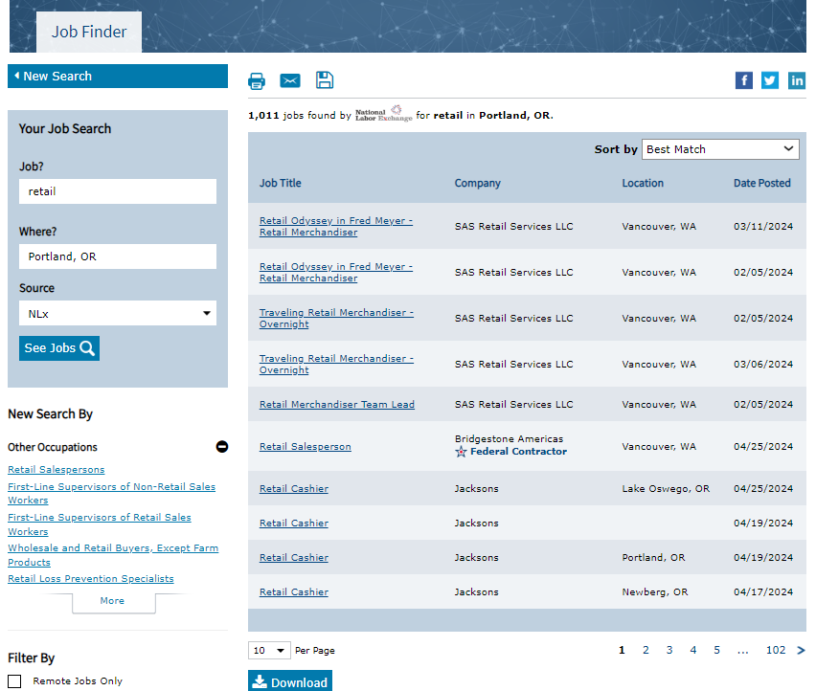
Job Finder

Slide 39
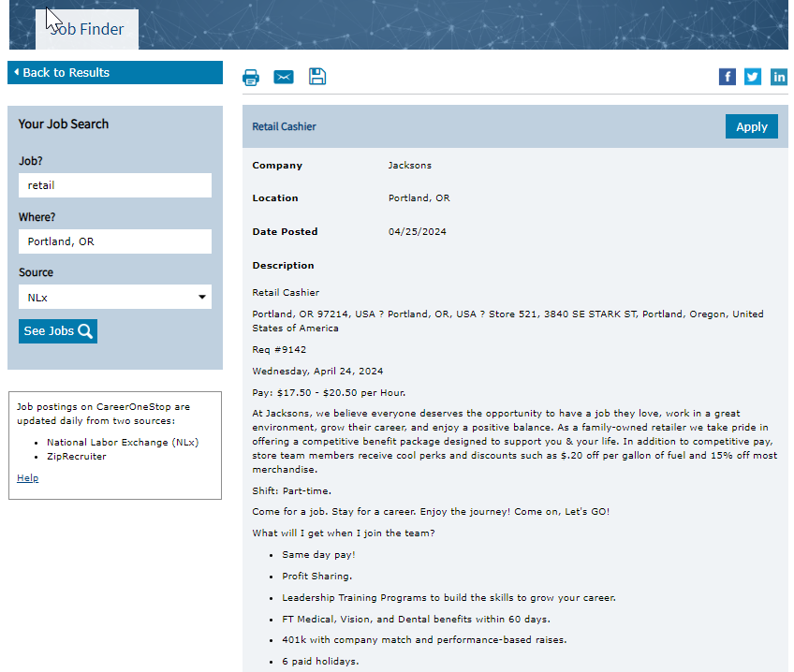
Job Finder Detail Page

Slide 40
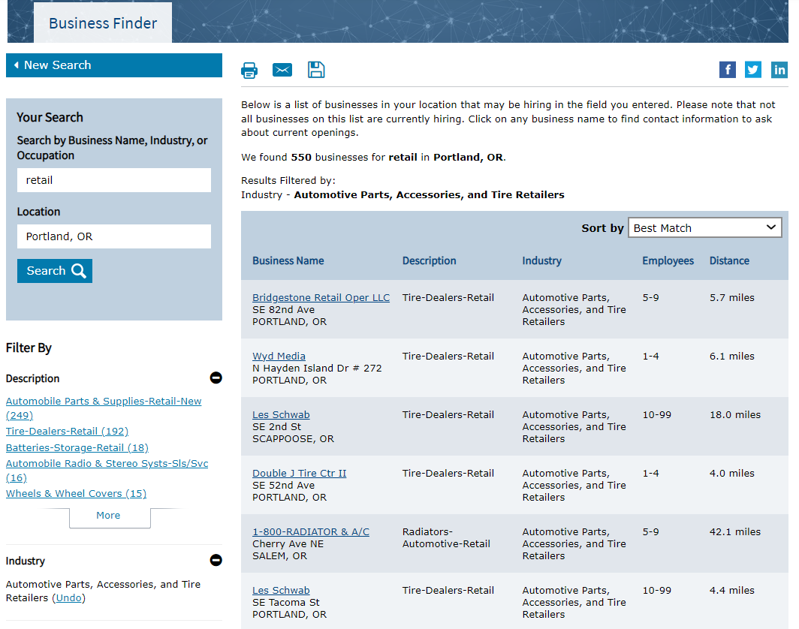
Business Finder

Slide 41
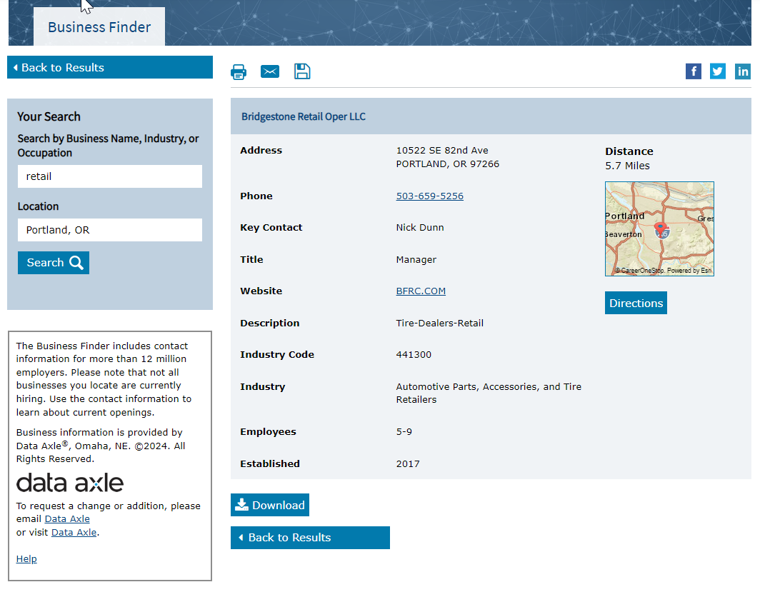
Business Finder Detail Page

Slide 42
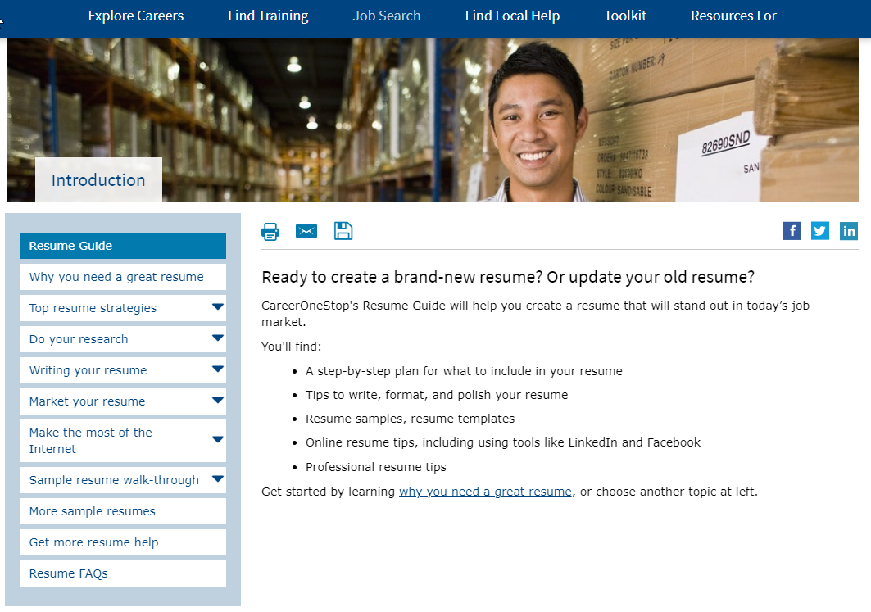
Resume Guide

Slide 43
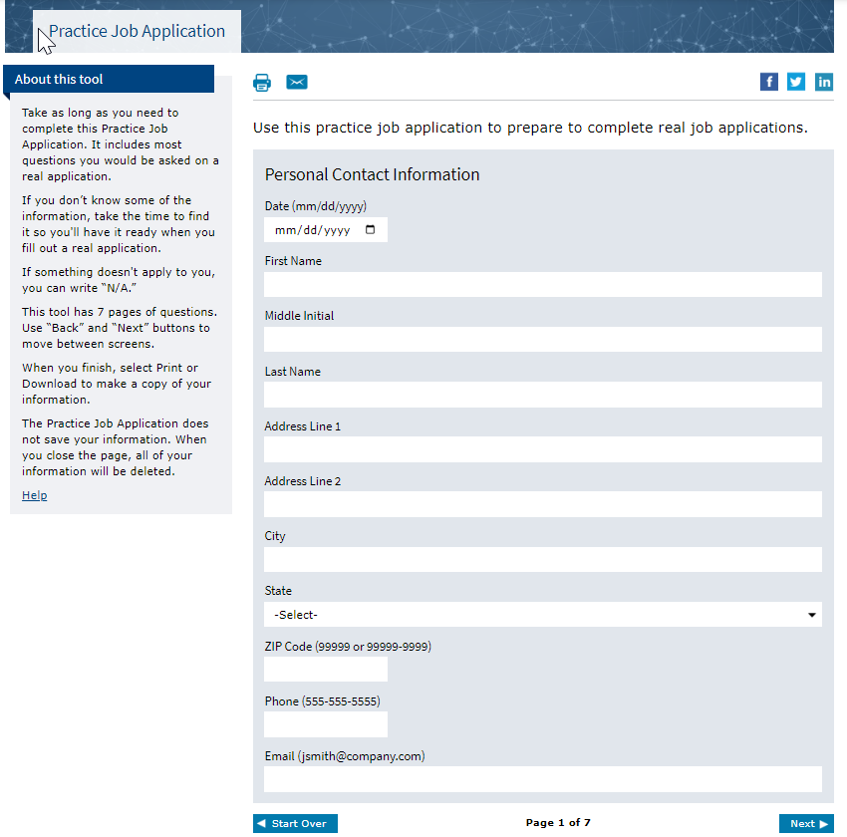
Practice Job Application

Slide 44
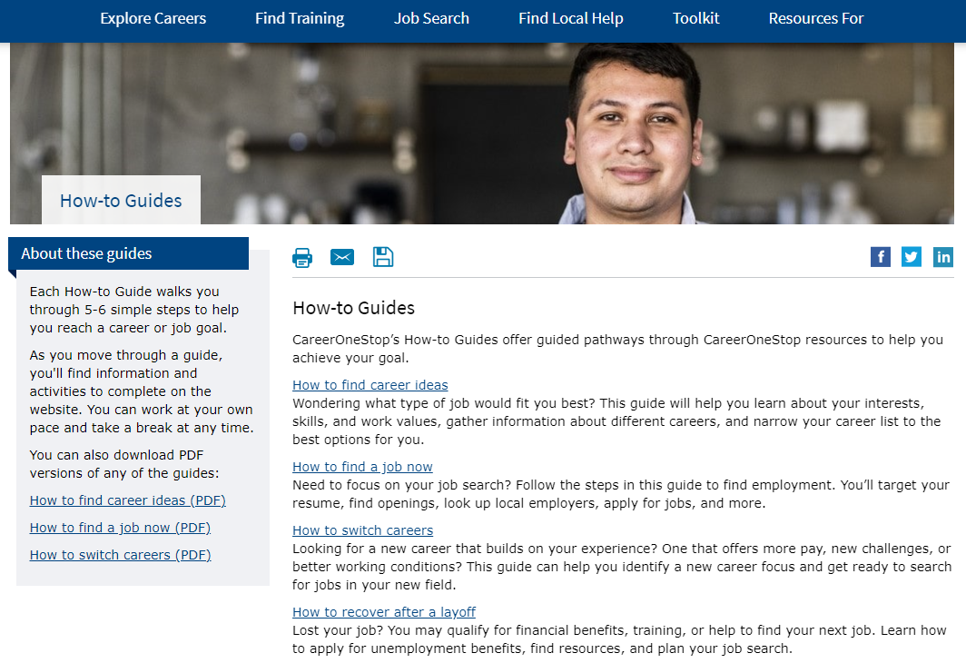
How-to Guide: Find a Job Now

Slide 45
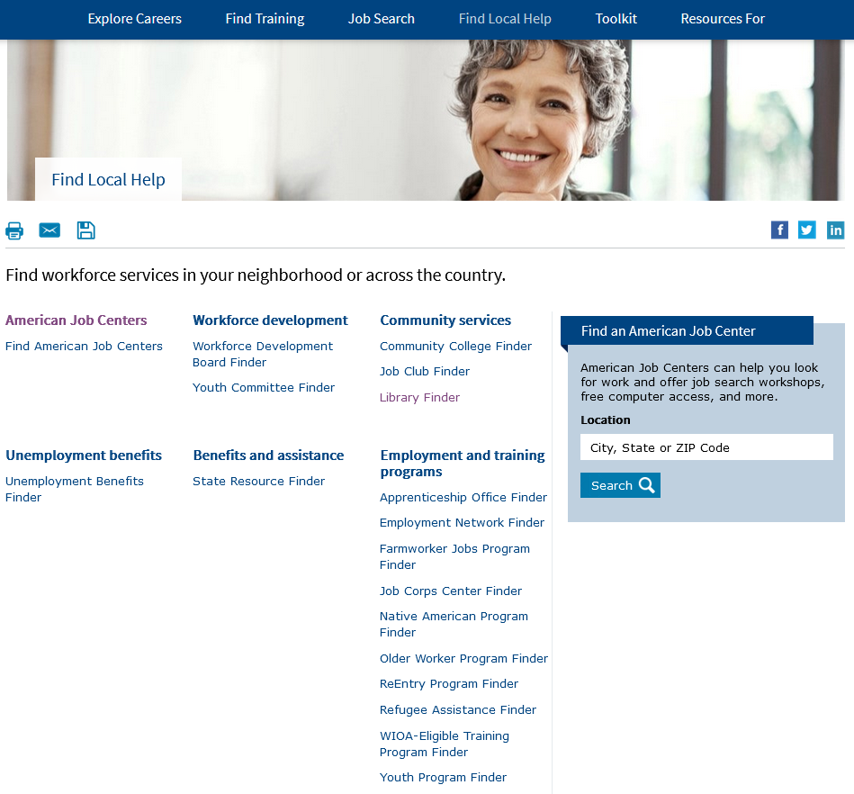
Find Local Help

Slide 46
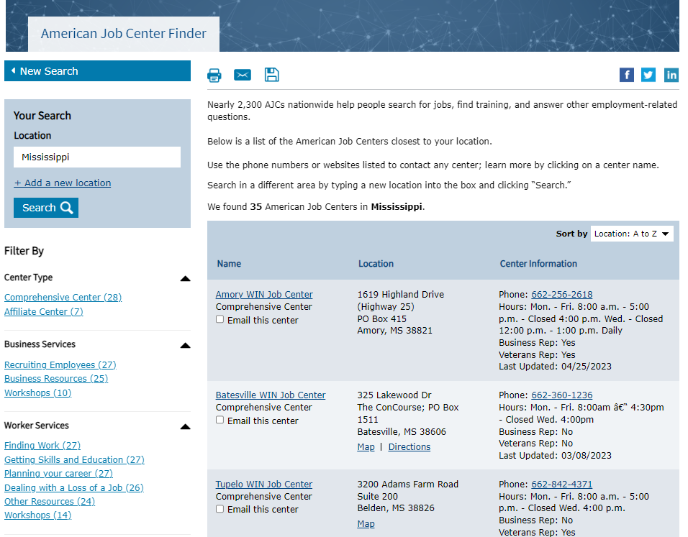
American Job Center Finder

Slide 47
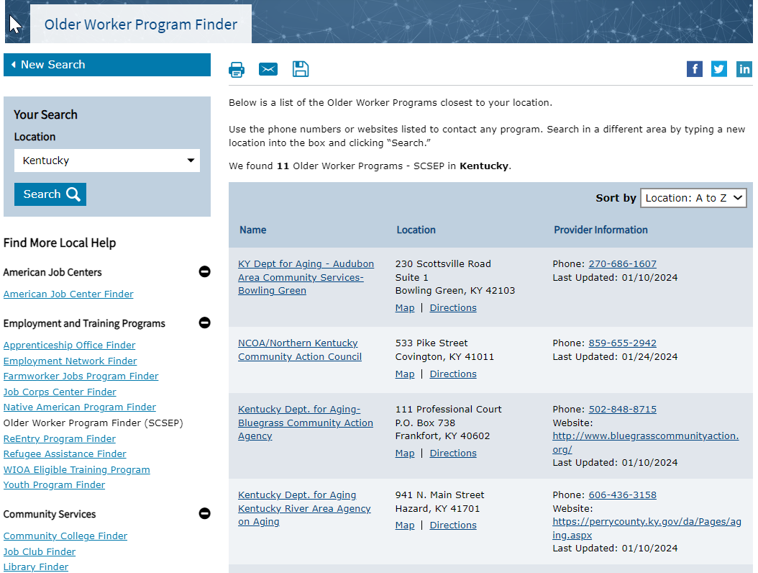
Older Worker Program Finder

Slide 48
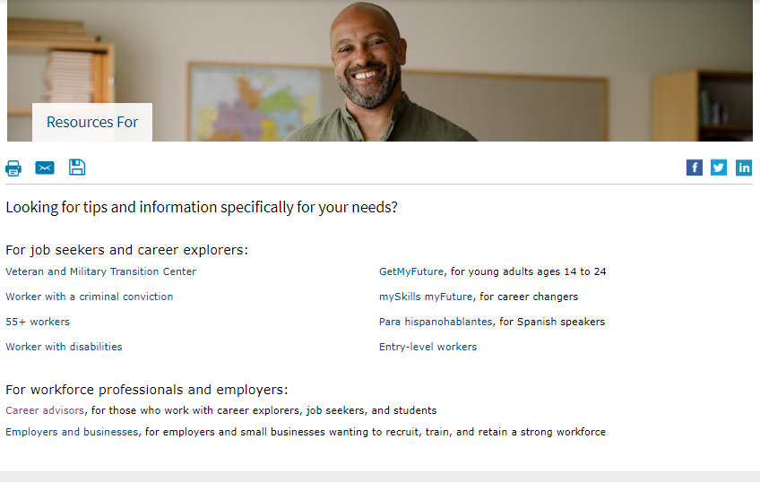
Resources For…

Slide 49
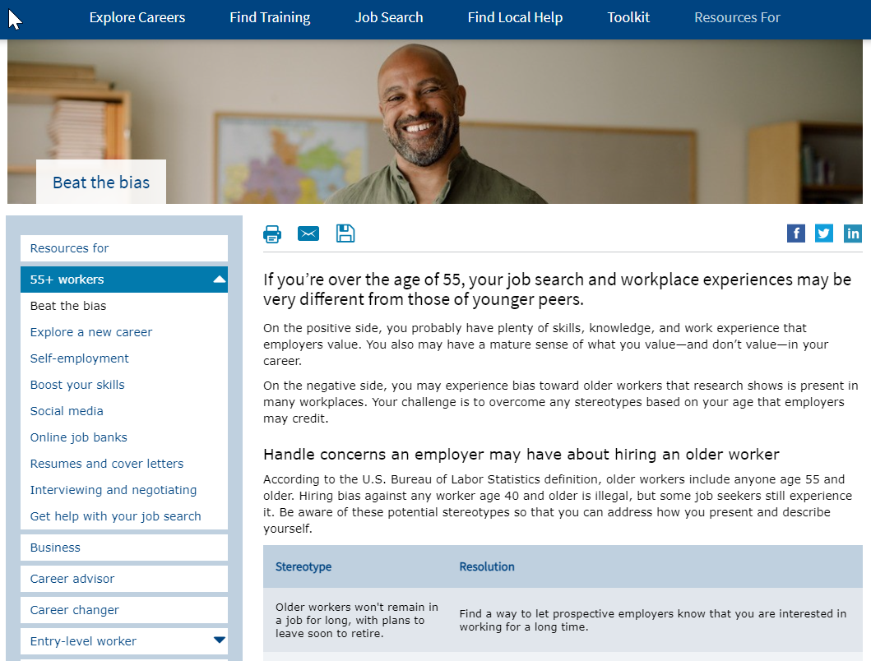
Beat the Bias

Slide 50
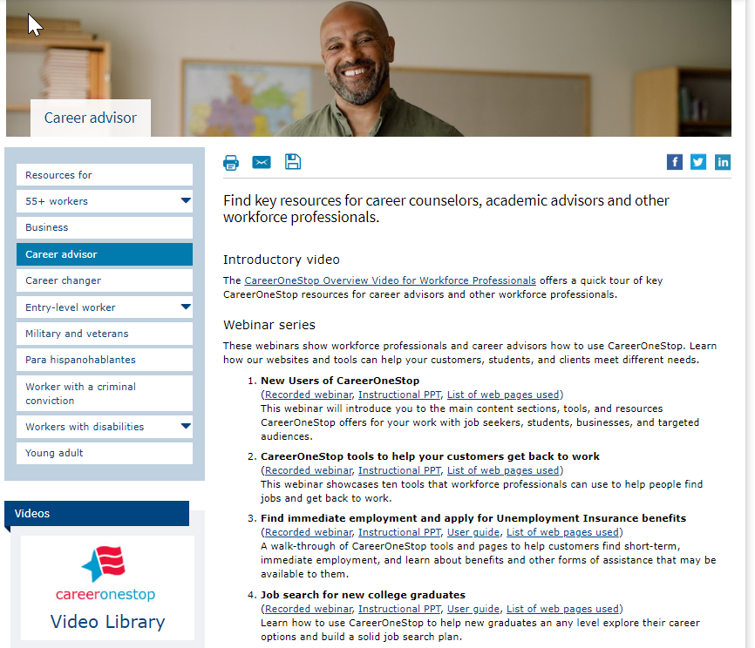
Career Advisors

Slide 51
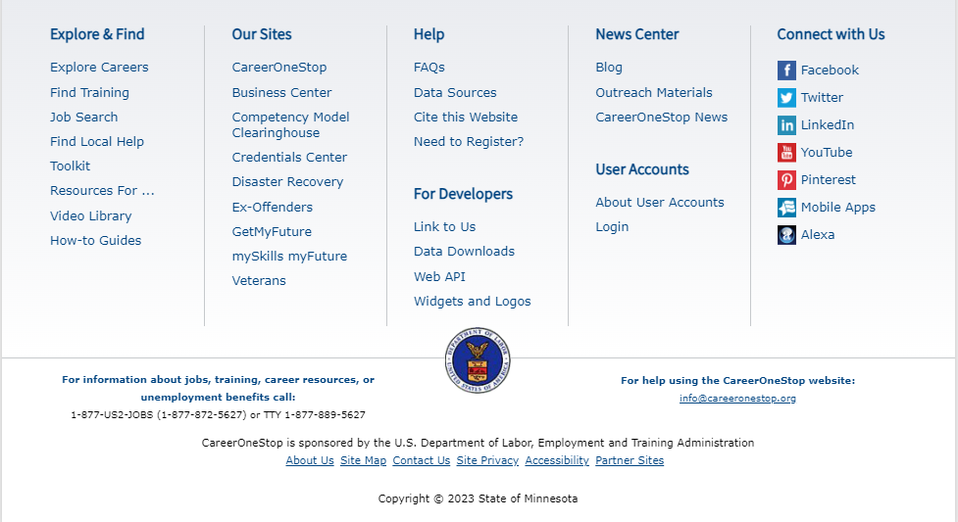
Footer

Slide 52

Thank You!
We look forward to seeing you on WorkforceGPS.
Need Help? Email: Support@WorkforceGPS.org

