Slide 1



CareerOneStop Tools for Youth

Slide 2

Division of Youth Services (DYS)
DYS
REO
YPP
YB

Slide 3
Oversight and Funding of
WIOA Formula Activities
U.S. Department
of Labor
Oversees the public workforce system
State Agency/State Workforce
Development Board
Develops a strategic vision for the State, provides leadership to the local workforce investment boards and informs local strategies
Local Workforce
Development Boards
Provides strategic direction to their areas and sets training priorities
Service Providers, including One Stop Career Centers
Local service providers including community organizations and One Stop Career Centers provide services to youth, adults and dislocated workers.
http://www.servicelocator.org

Slide 4
Workforce Innovation and Opportunity Act (WIOA) Youth 14 Program Elements
  Tutoring;
  Alternative secondary school services;
  Paid and unpaid work experiences, which include: summer and year-round employment opportunities, pre-apprenticeship programs, internships and job shadowing, and on-the-job training;
  Occupational skill training;
  Education offered concurrently with workforce preparation and training;
  Leadership development opportunities

Slide 5
WIOA Youth 14 Program Elements (con’t)
Supportive services;
Mentoring;
Follow-up services;
Comprehensive guidance and counseling;
Financial literacy education;
Entrepreneurial skills training;
Services that provide labor market and employment information; and
Postsecondary education and training preparation activities

Slide 6
For More Information…
  Please visit us here: https://youth.workforcegps.org/

Slide 7

Agenda
Brief CareerOneStop Overview
GetMyFuture Tools and Content
Questions

Slide 8
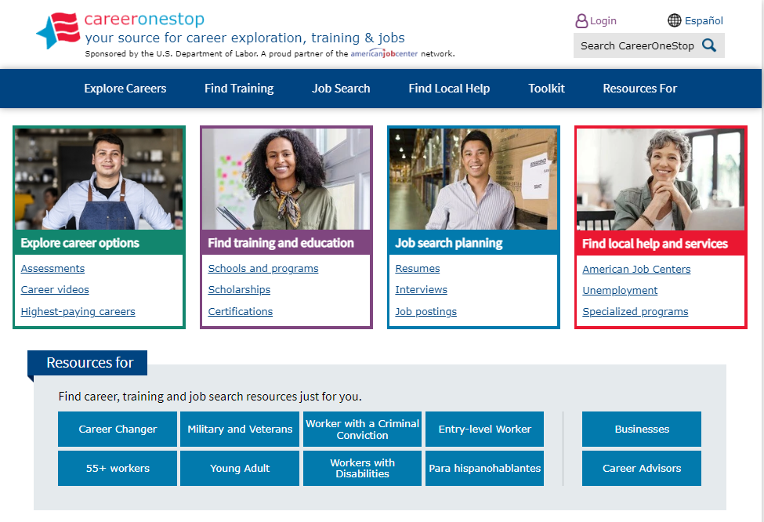

CareerOneStop
CareerOneStop is sponsored by the U.S. Department of Labor, Employment and Training Administration

Slide 9
Contact Information
Youth Services
Maisha Meminger
Manpower Development Specialist
US Dept. of Labor, Employment & Training Administration
meminger.maisha@dol.gov
CareerOneStop.org
Tricia Dahlman
Operations & Outreach Manager, CareerOneStop
Patricia.Dahlman@state.mn.us
Julie Remington
Content Strategist, CareerOneStop
Julie.Remington@state.mn.us

Slide 10
Questions

Slide 11
Screenshots

Slide 12
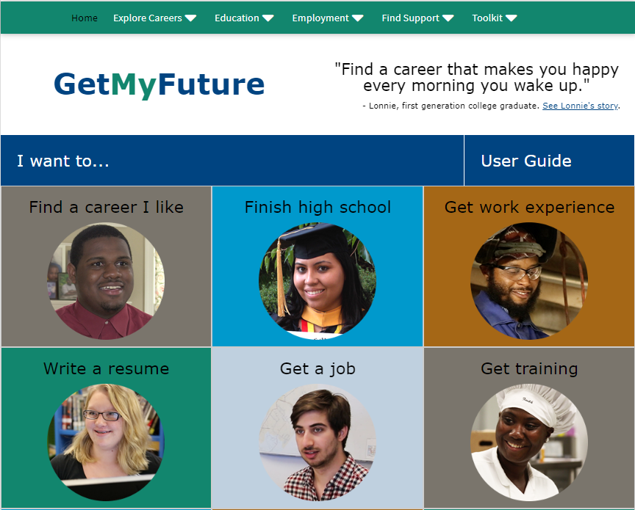
GetMyFuture

Slide 13
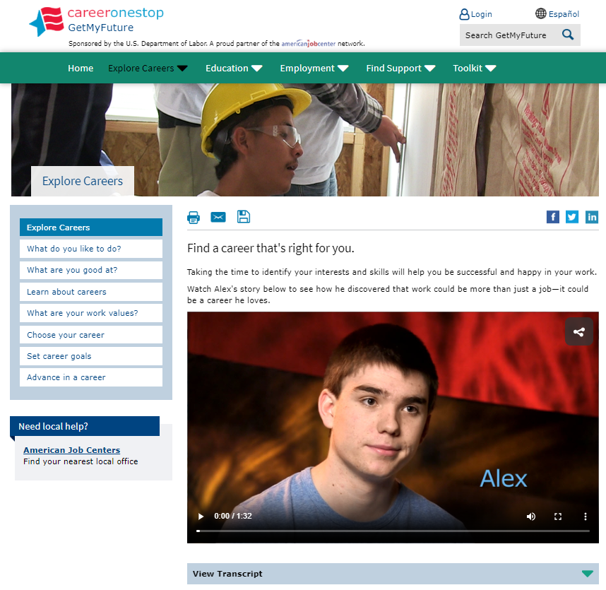
Explore Careers

Slide 14
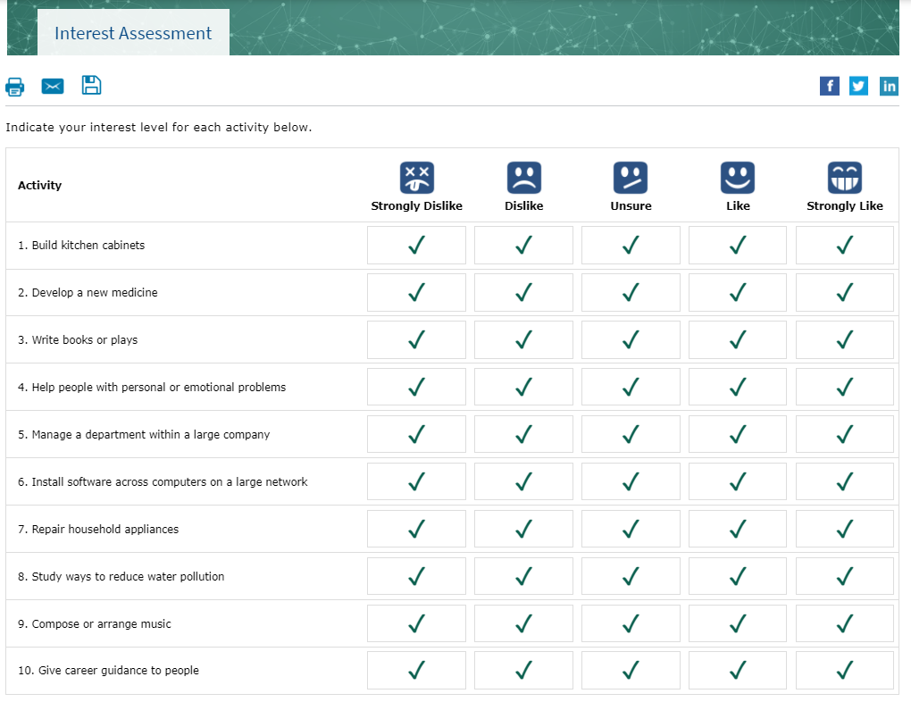
Interest Assessment

Slide 15
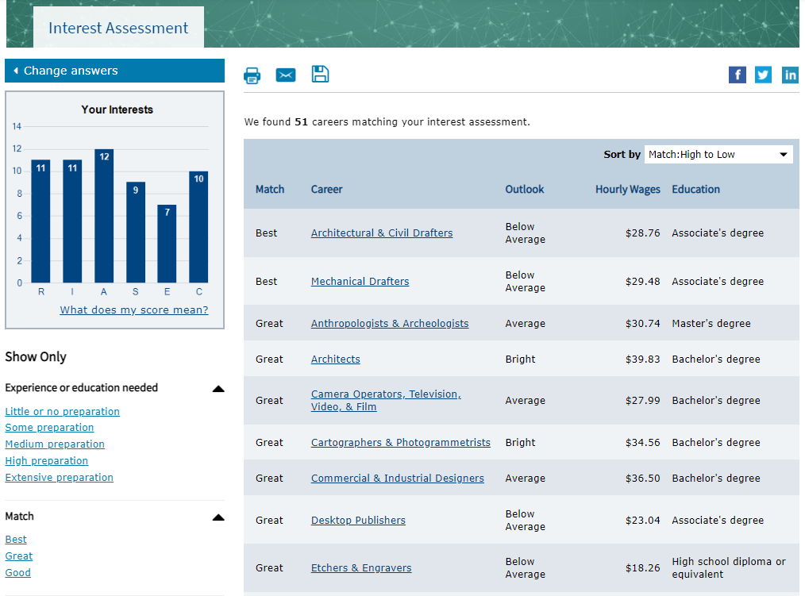
Interest Assessment Results

Slide 16
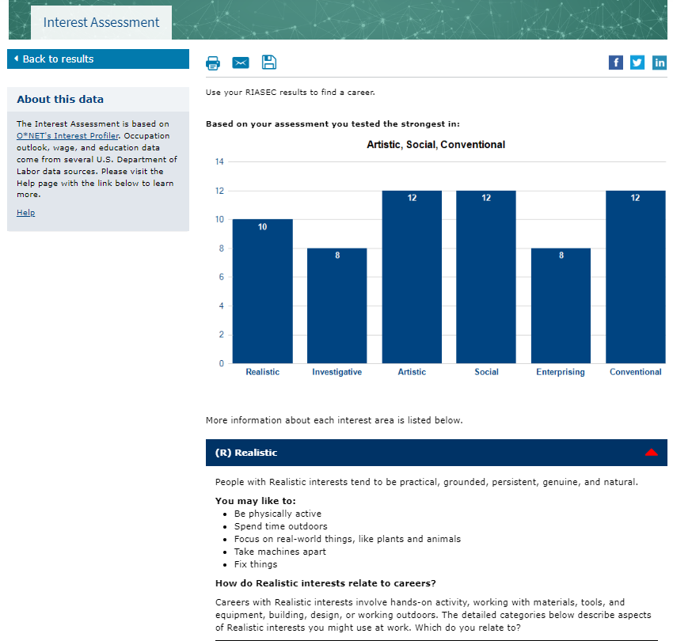
Your Interests

Slide 17
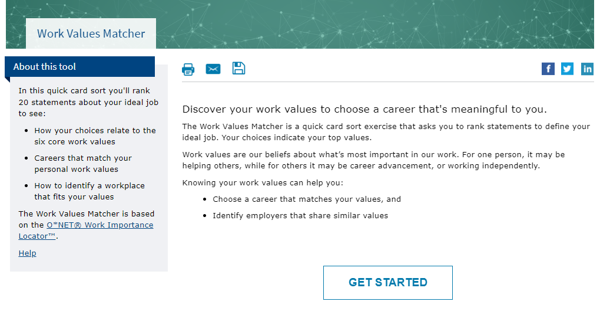
Work Values Matcher

Slide 18
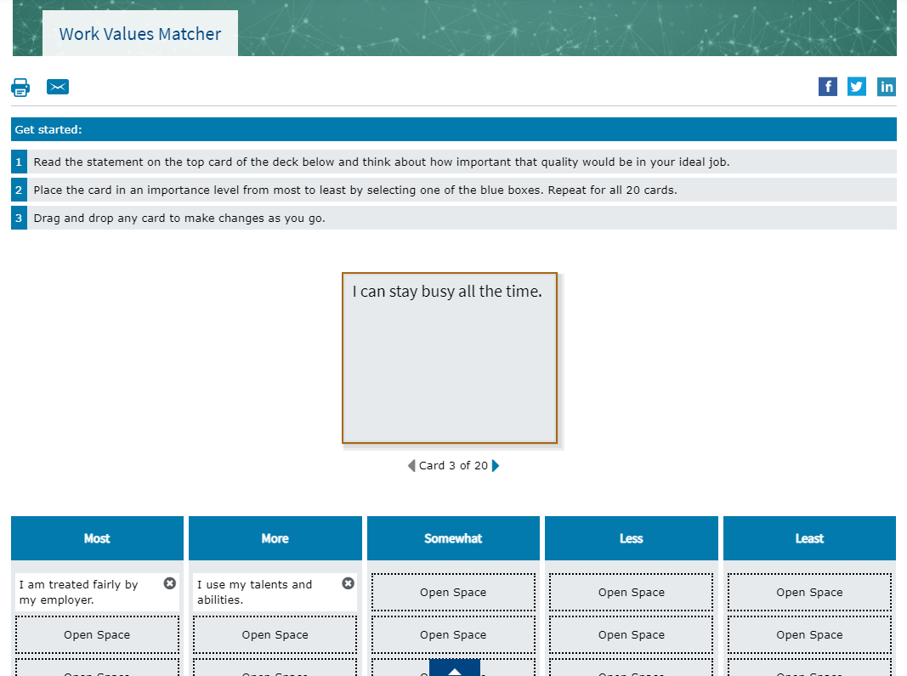
Work Values Matcher 2

Slide 19
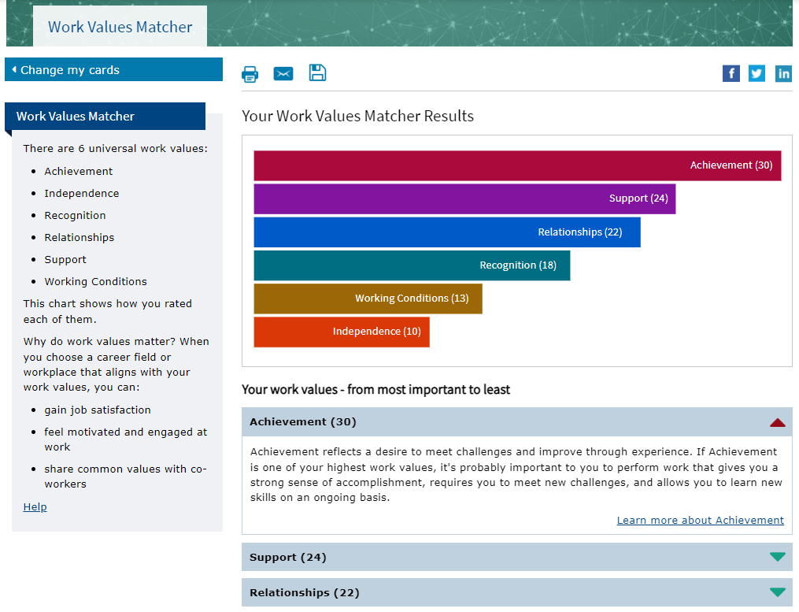
Work Values Matcher Results

Slide 20
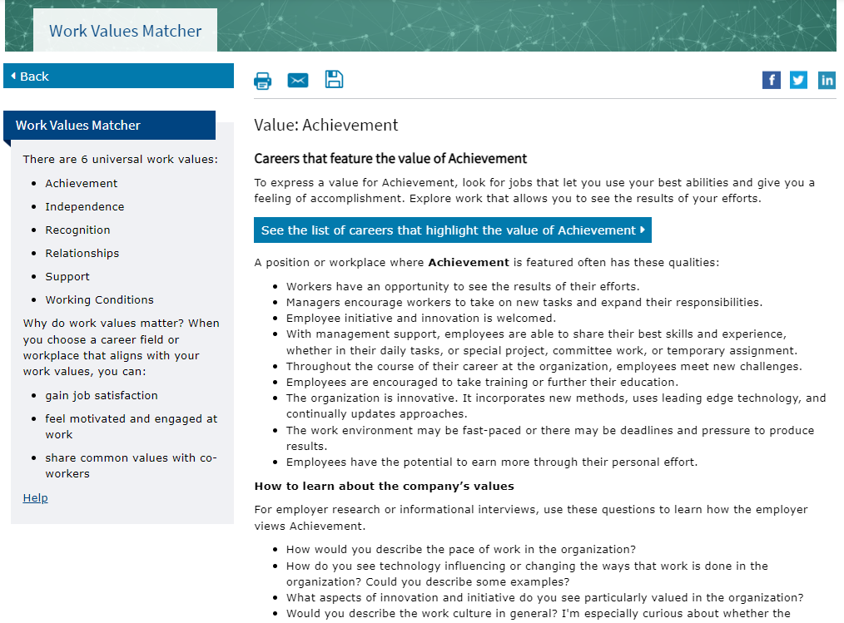
Work Values Matcher Value Description

Slide 21
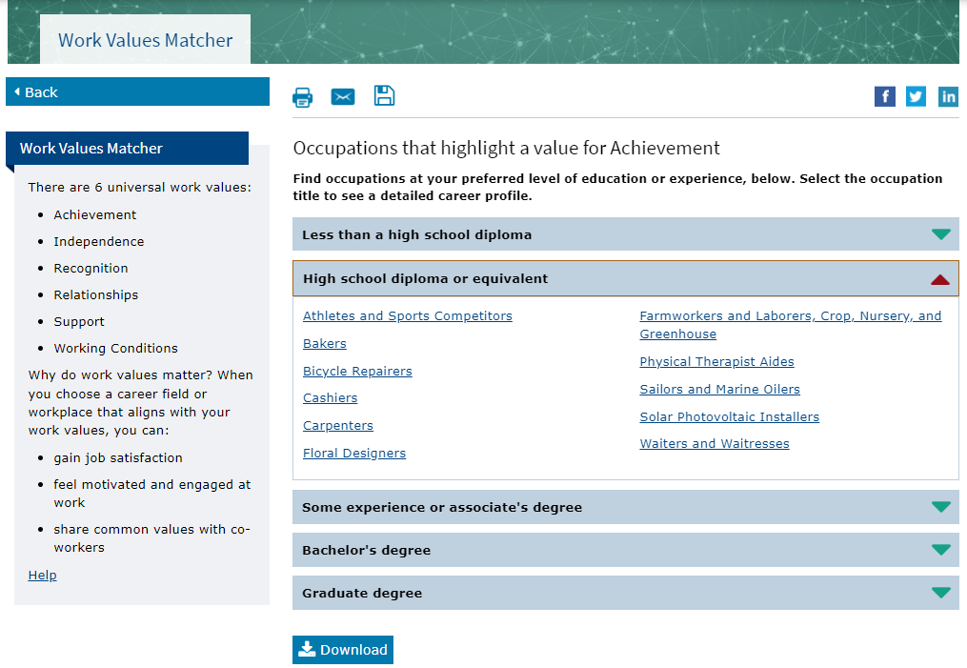
Work Values Matcher Career List

Slide 22
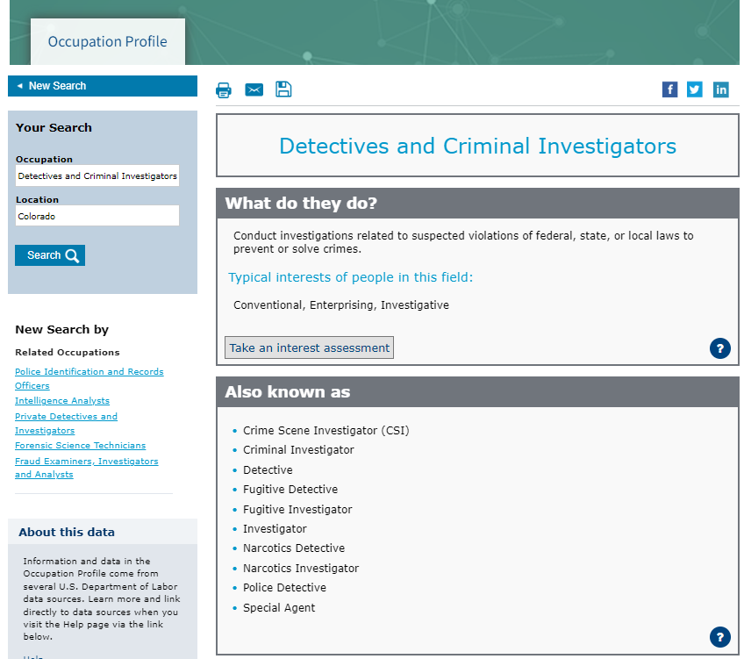
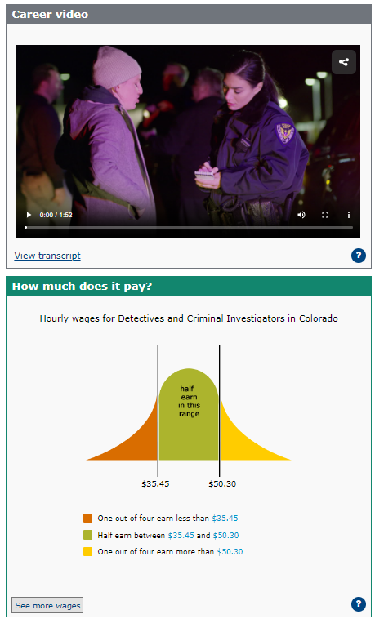
Occupation Profile

Slide 23
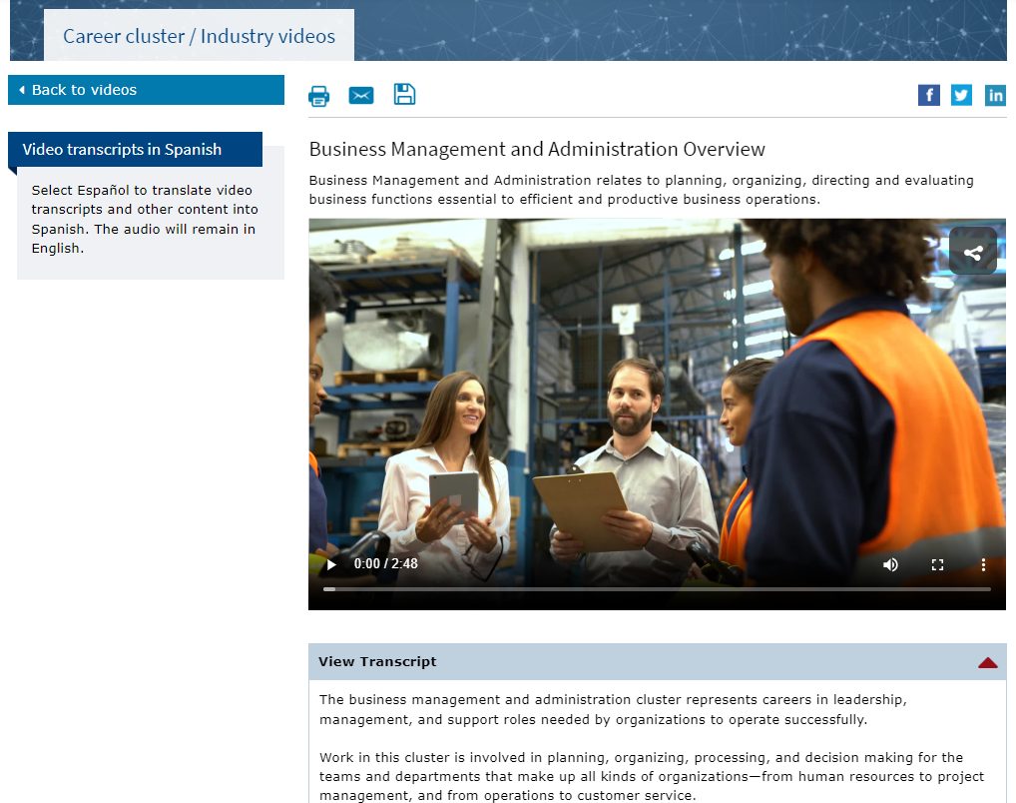
Career Cluster / Industry Videos

Slide 24
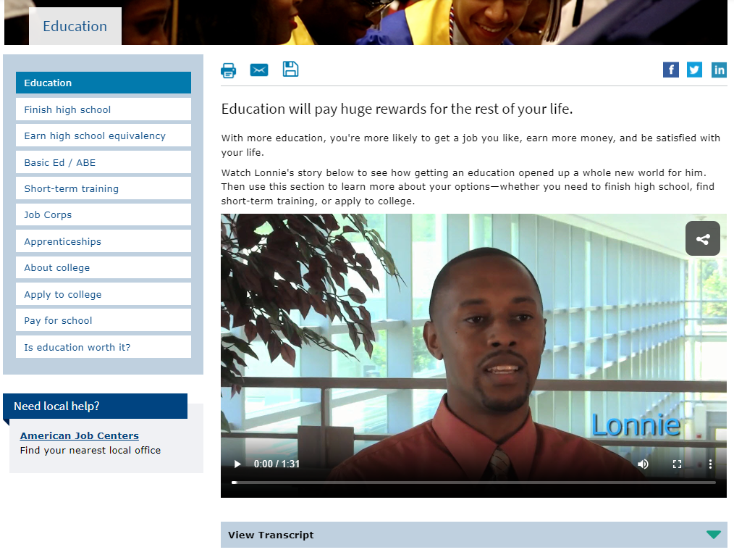
Education

Slide 25
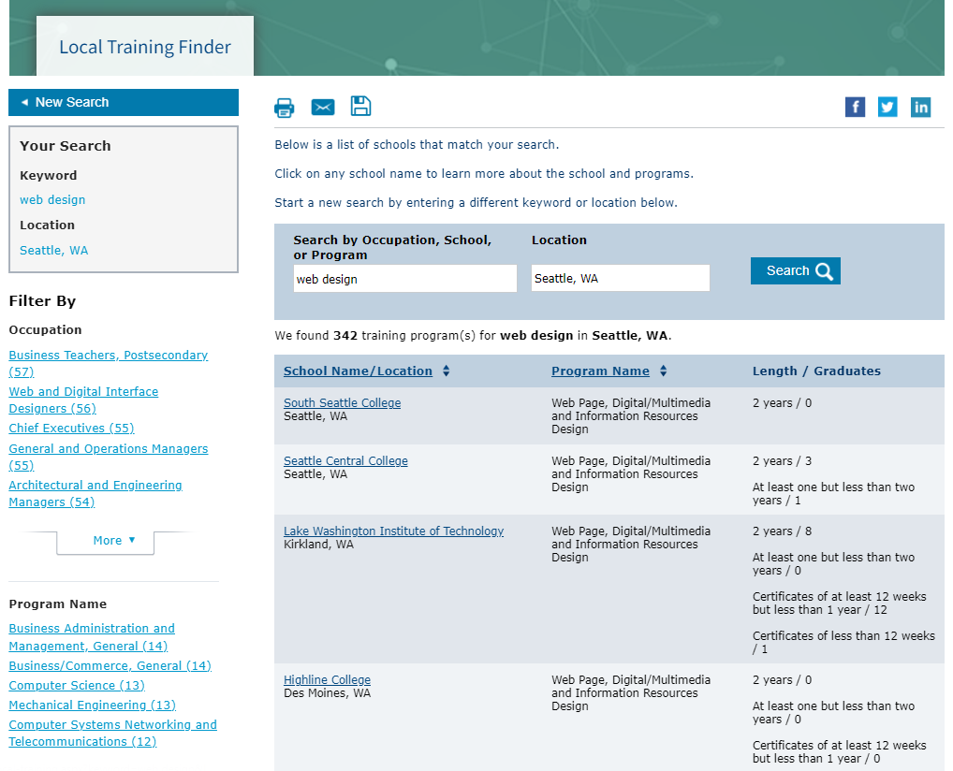
Local Training Finder

Slide 26
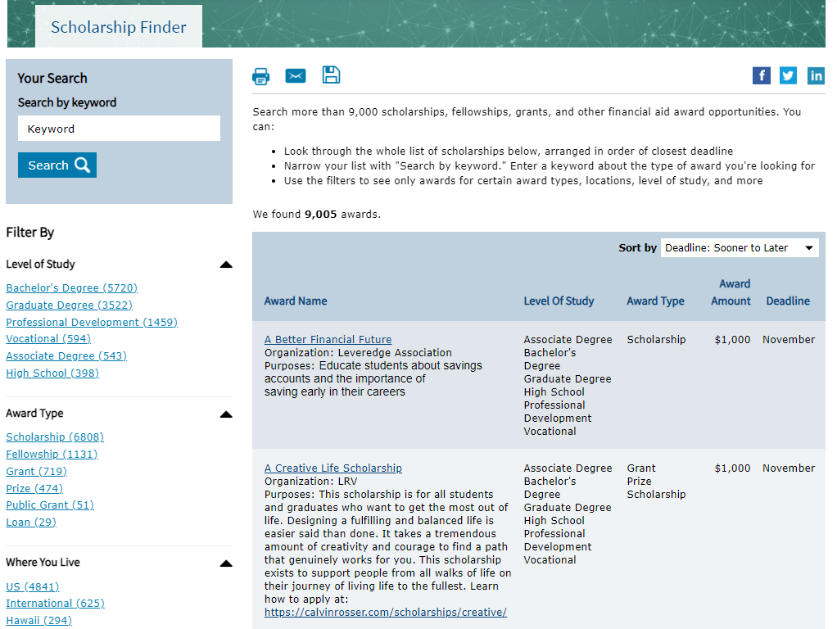
Scholarship Finder

Slide 27
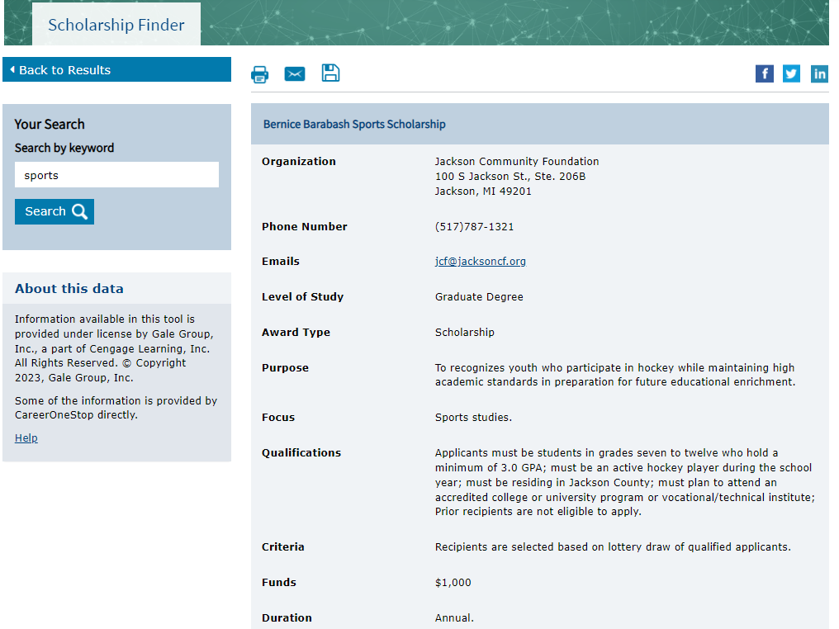
Scholarship Detail

Slide 28
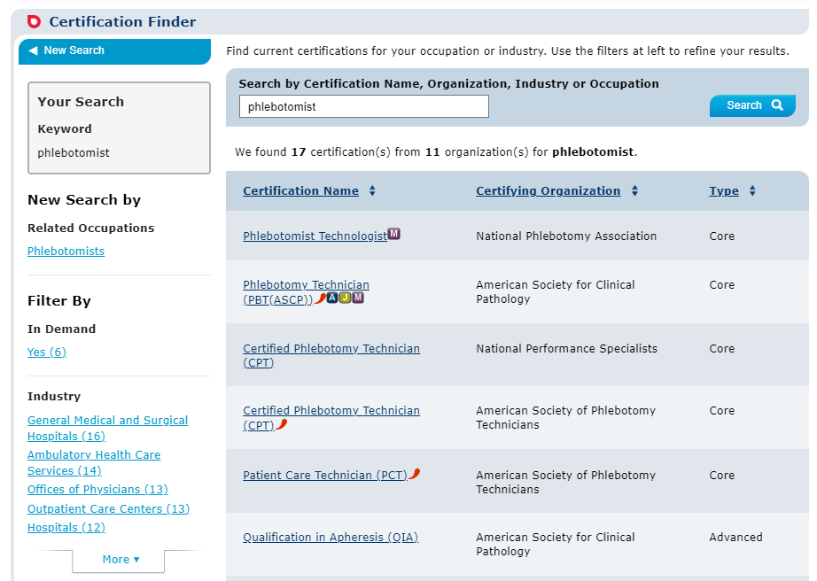
Certification Finder

Slide 29
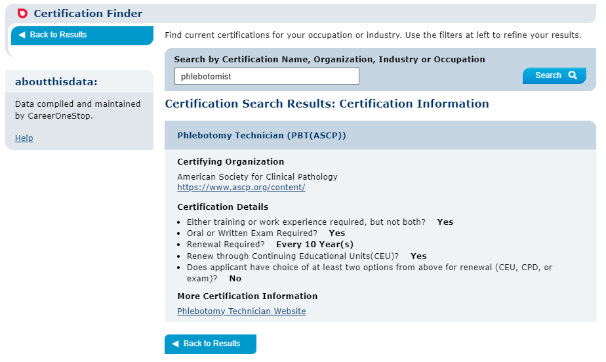
Certification Finder Detail Page

Slide 30
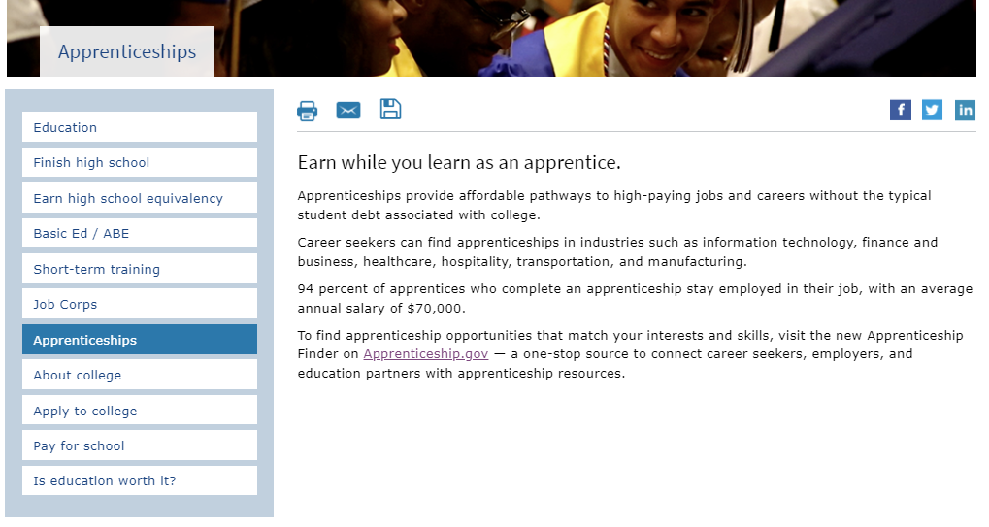
Apprenticeships

Slide 31
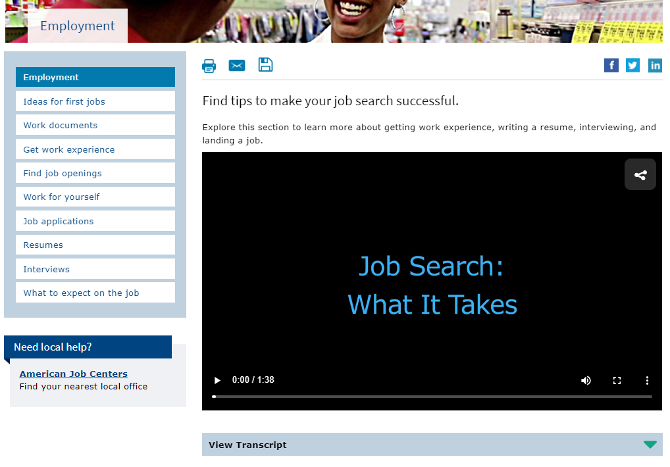
Employment

Slide 32
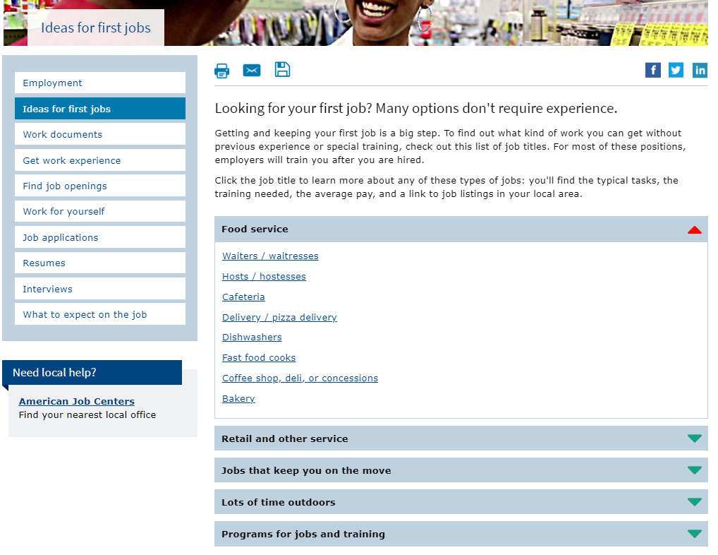
Ideas for first jobs

Slide 33
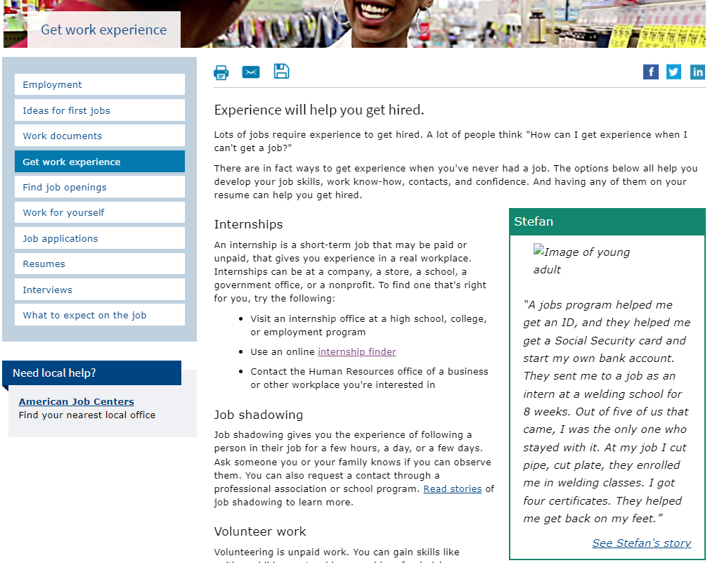
Get work experience

Slide 34
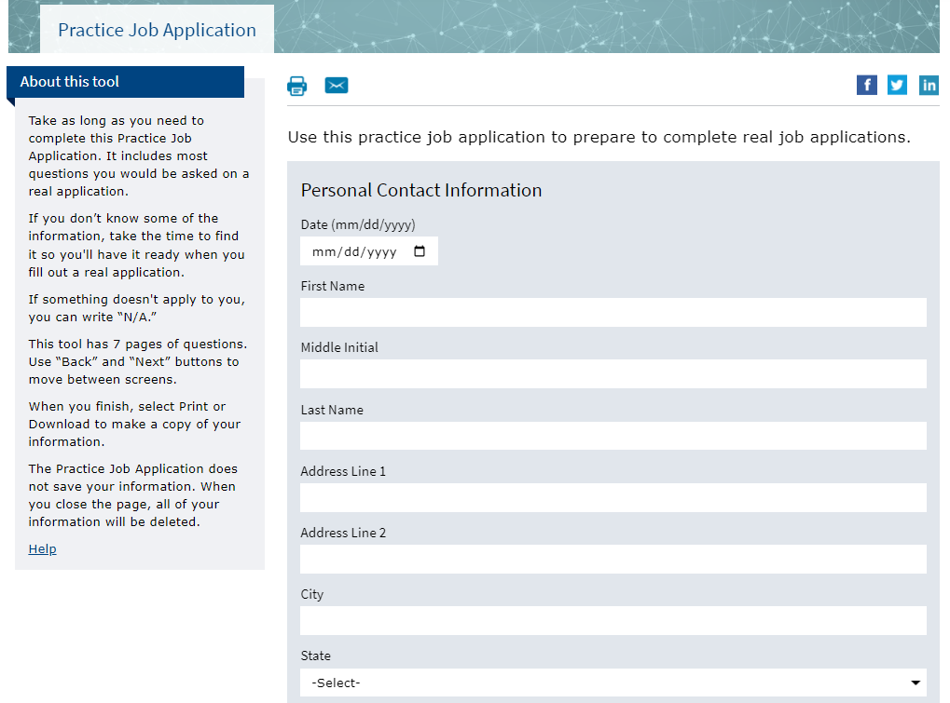
Practice Job Application

Slide 35
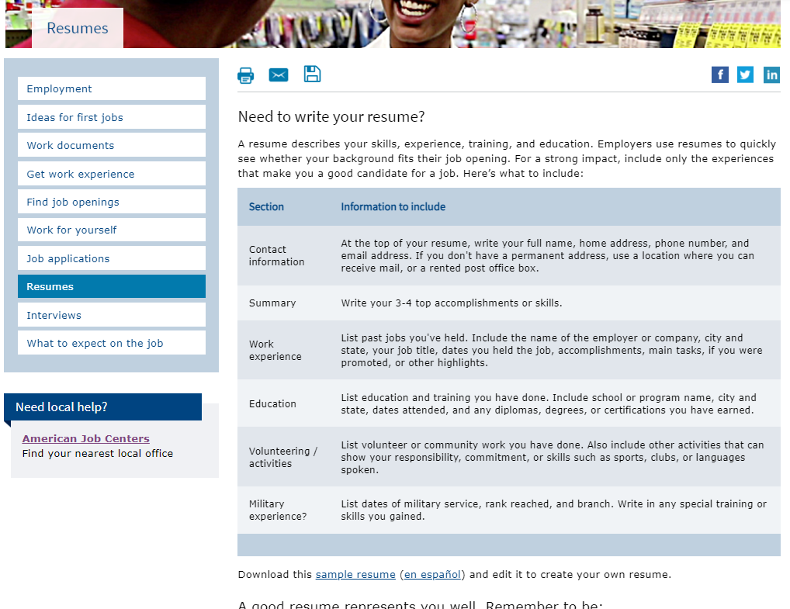
Resumes

Slide 36
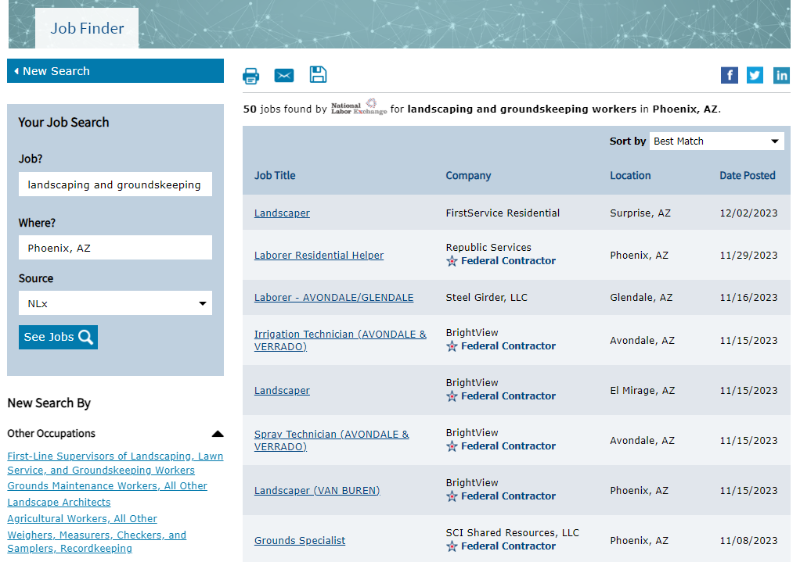
Job Finder

Slide 37
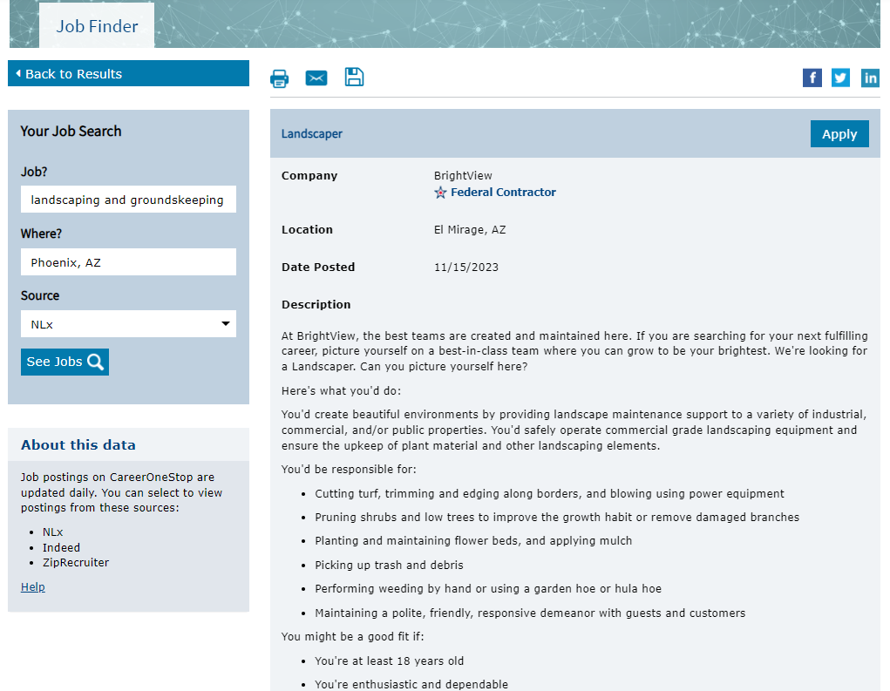
Job Finder Detail Page

Slide 38
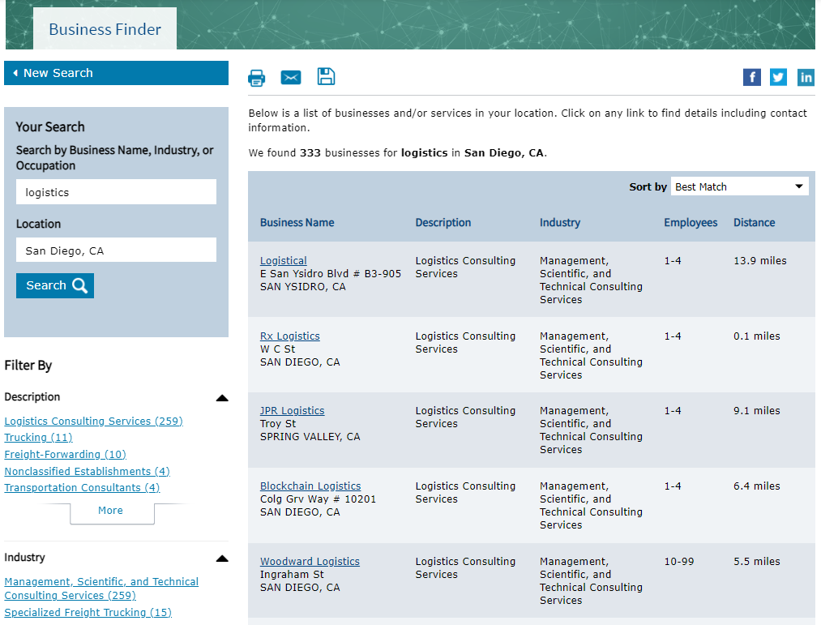
Business Finder Results Page

Slide 39
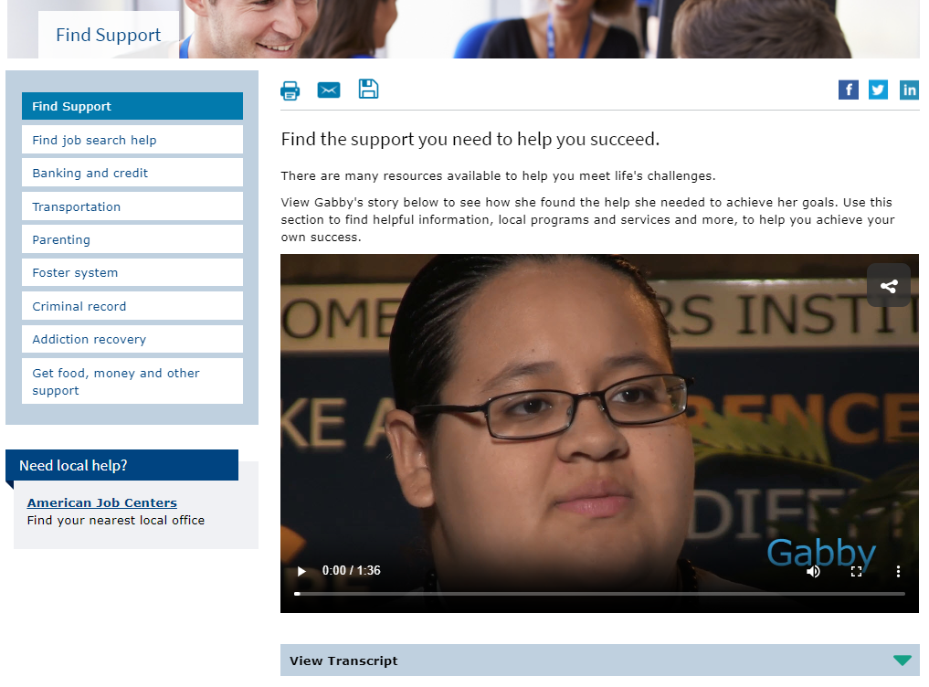
Find Support

Slide 40
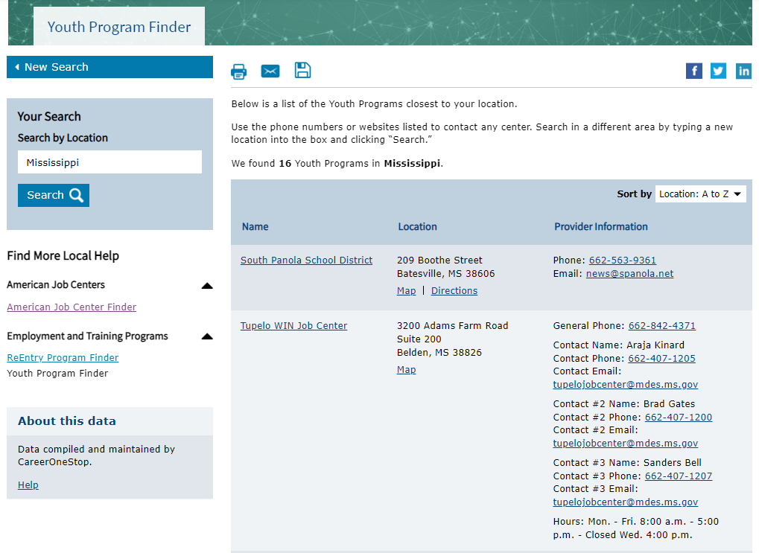
Youth Program Finder

Slide 41
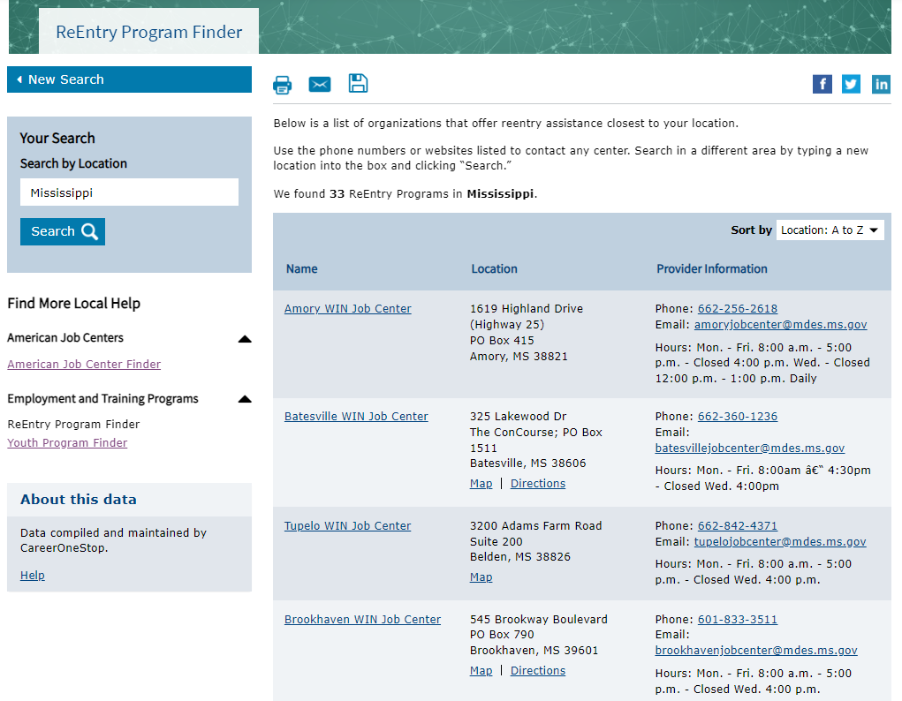
ReEntry Program Finder

Slide 42
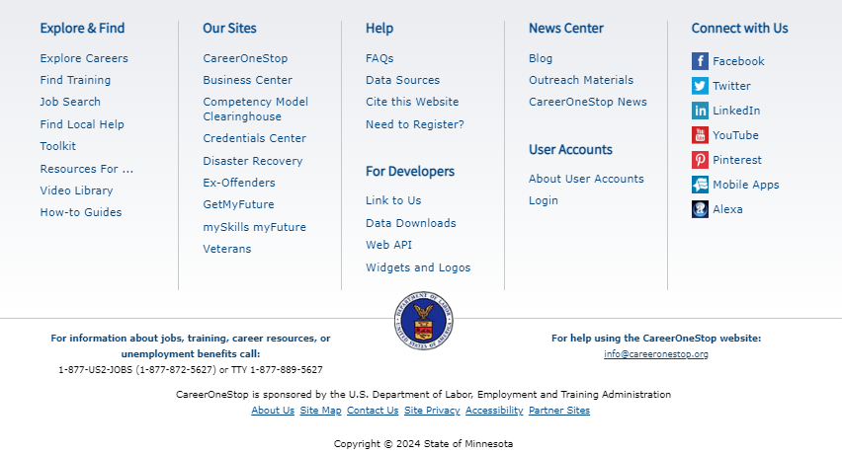
Footer

Slide 43
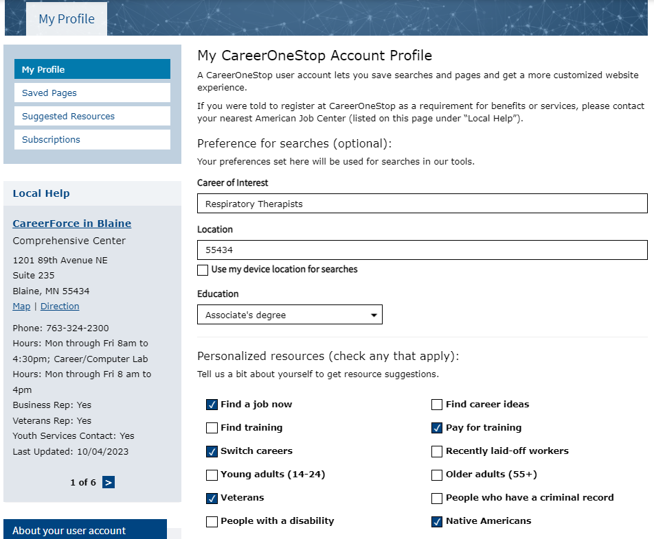
User Accounts

Slide 44
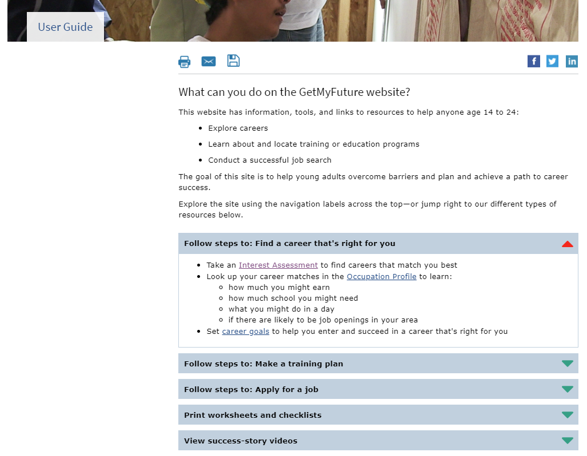
User Guide

