Slide 1


New Users of CareerOneStop

Slide 2

“This has been amazing! I have so under utilized this resource. Not any more! Thanks so much!”

Slide 3


Agenda
What is CareerOneStop?
CareerOneStop Content & Tools
Questions

Slide 4
Mission
To deliver integrated, easy-to-understand workforce information that helps job seekers, students, workers, workforce intermediaries, and employers
develop their capacity and make sound economic decisions.

Slide 5
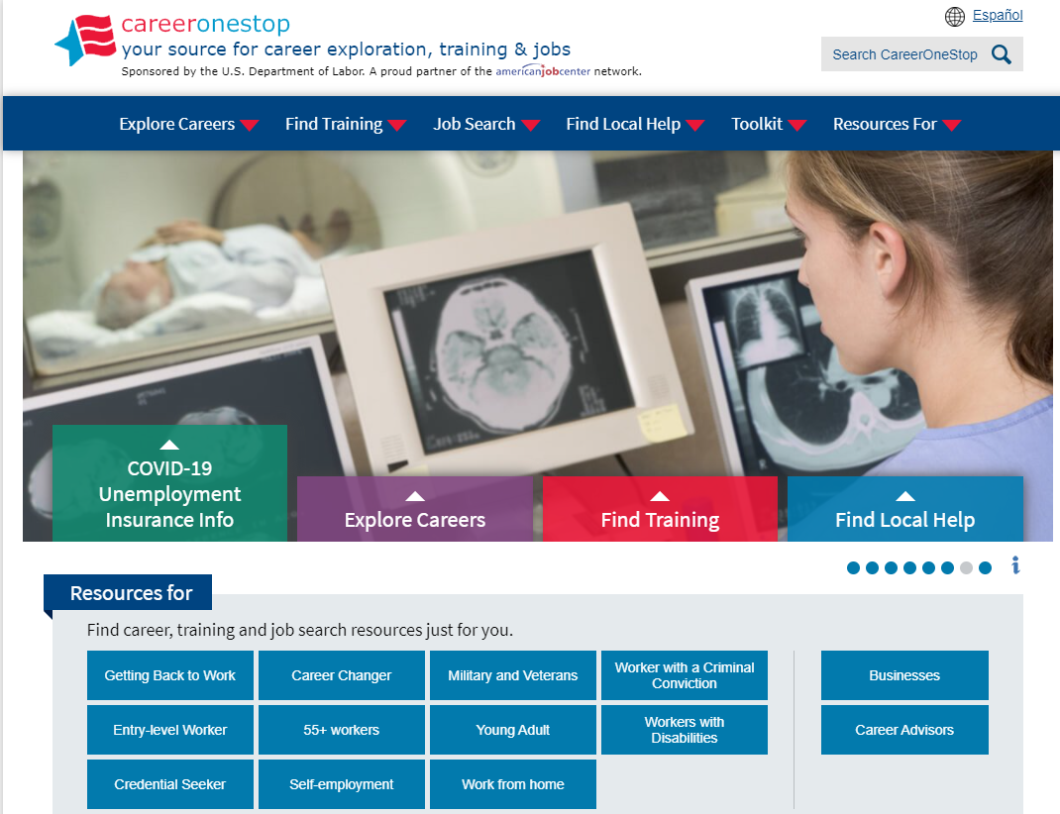

CareerOneStop
CareerOneStop is sponsored by the U.S. Department of Labor, Employment and Training Administration

Slide 6
Contact Information
Tricia Dahlman
Operations & Outreach Manager, CareerOneStop
Patricia.Dahlman@state.mn.us
Julie Remington
Content Strategist, CareerOneStop
Julie.Remington@state.mn.us

Slide 7
Questions

Slide 8
Screenshots

Slide 9
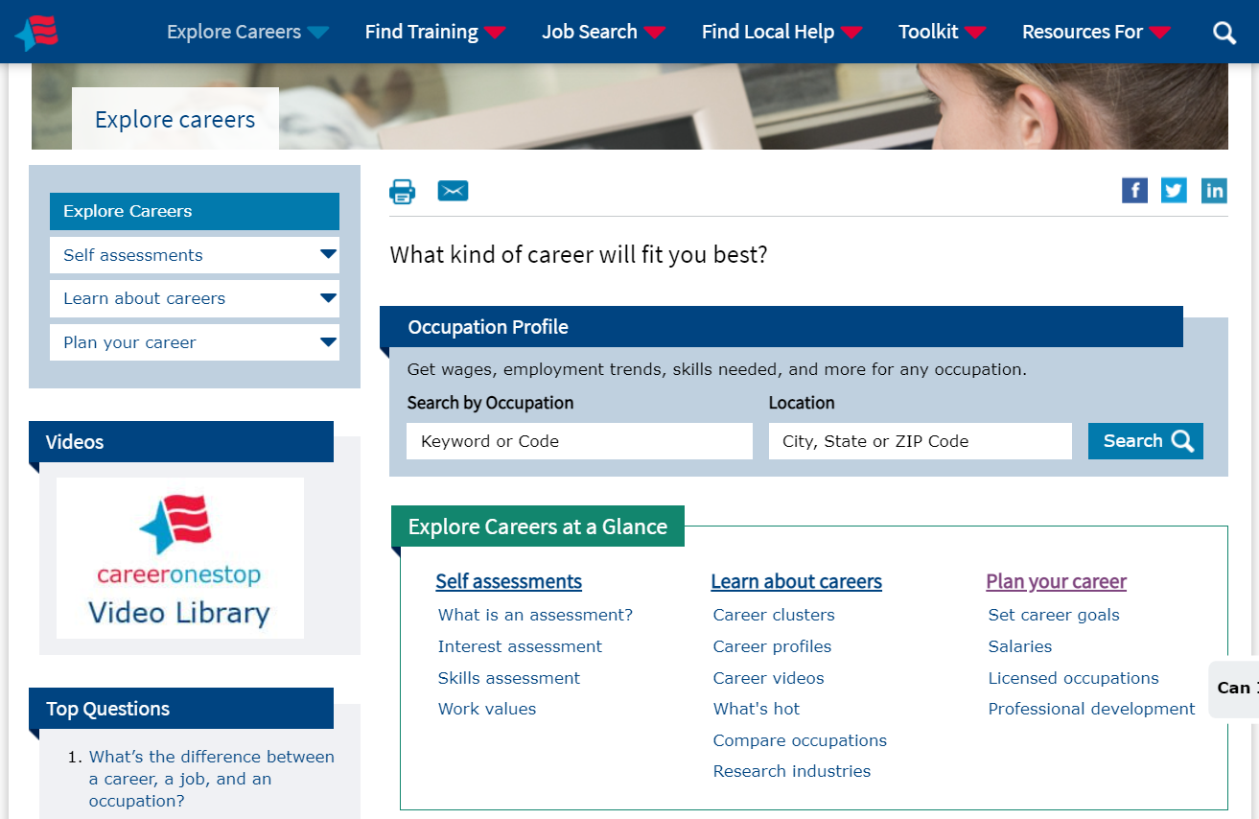
Explore Careers

Slide 10
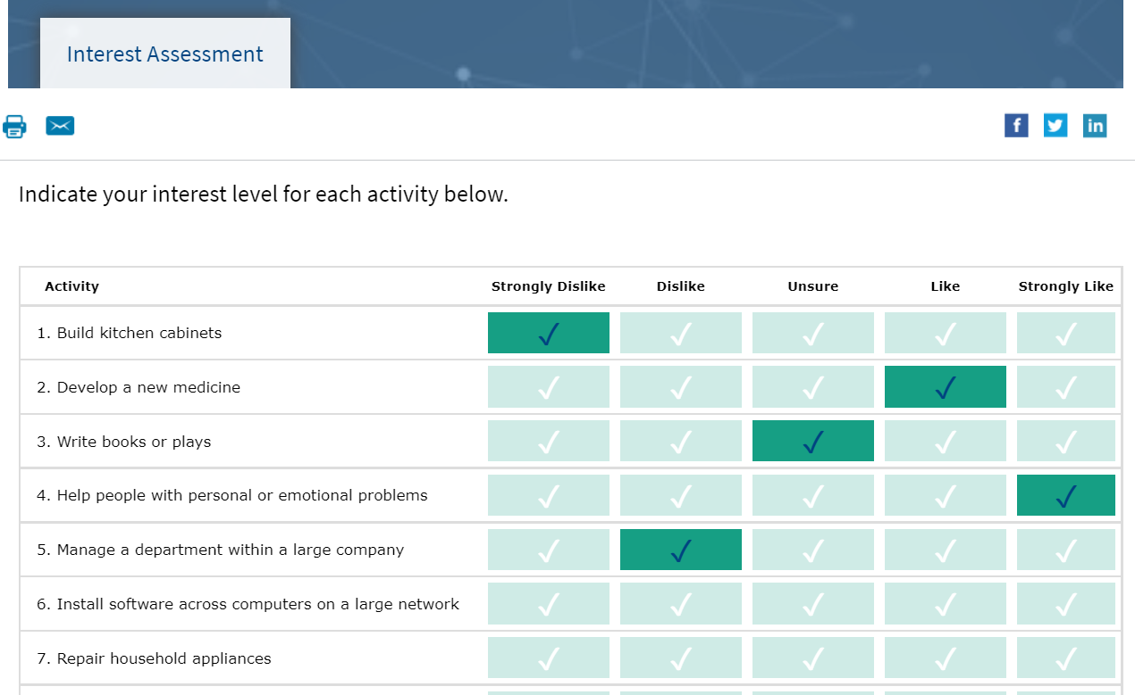
Interest Assessment

Slide 11
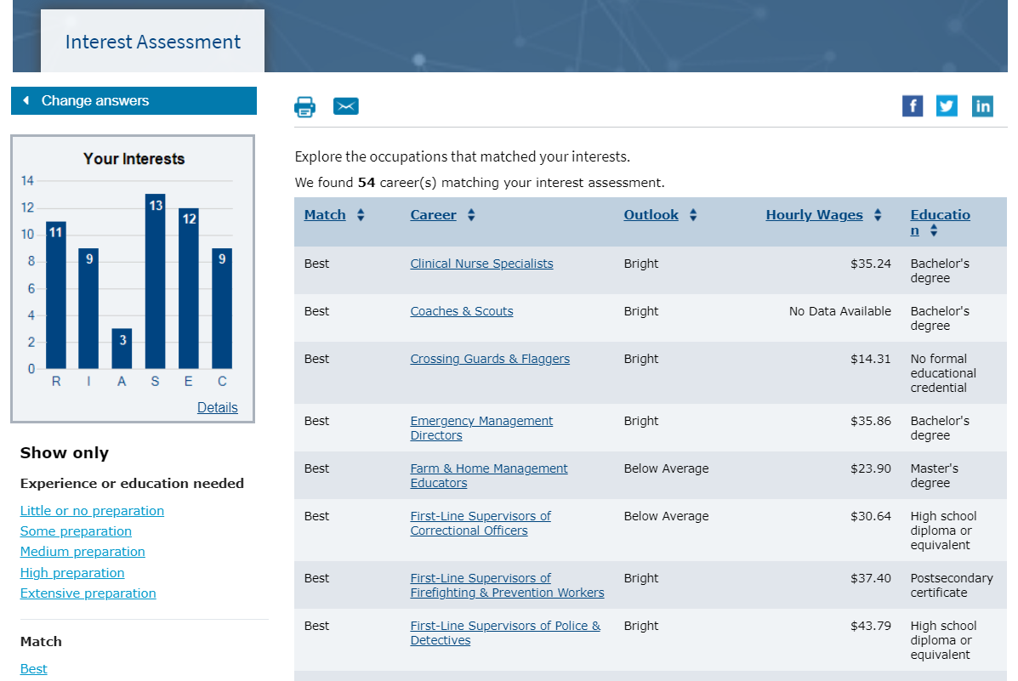
Interest Assessment Results

Slide 12
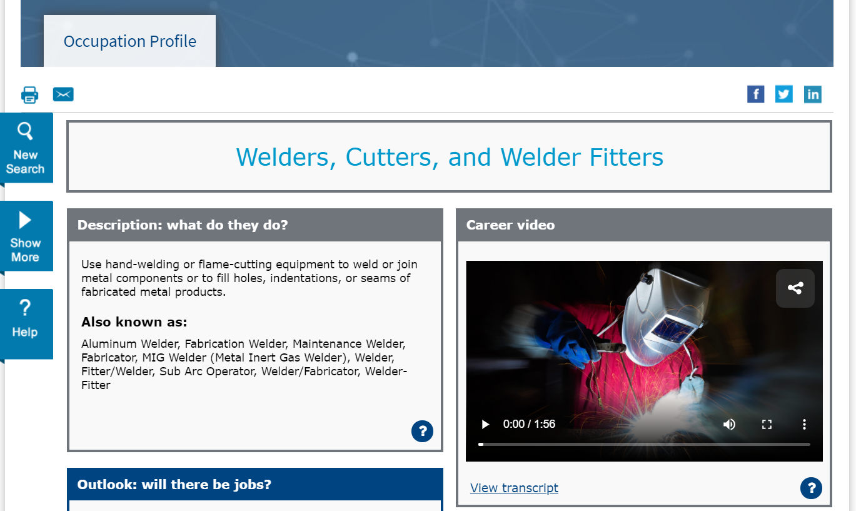
Occupation Profile

Slide 13
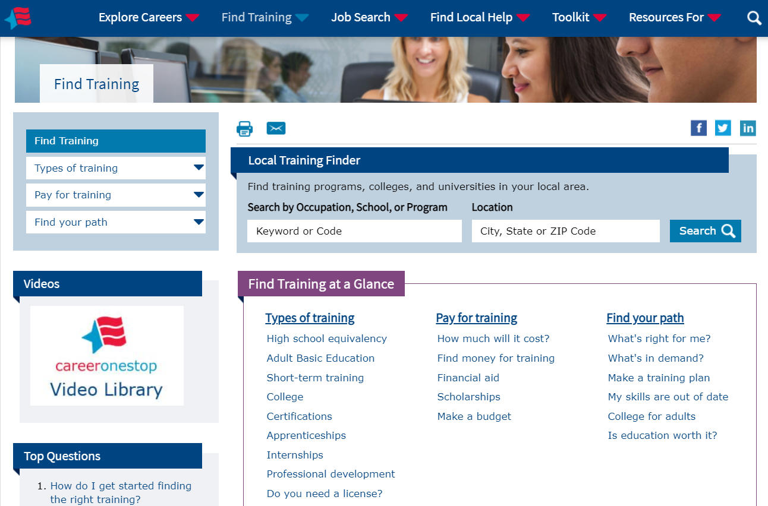
Find Training

Slide 14
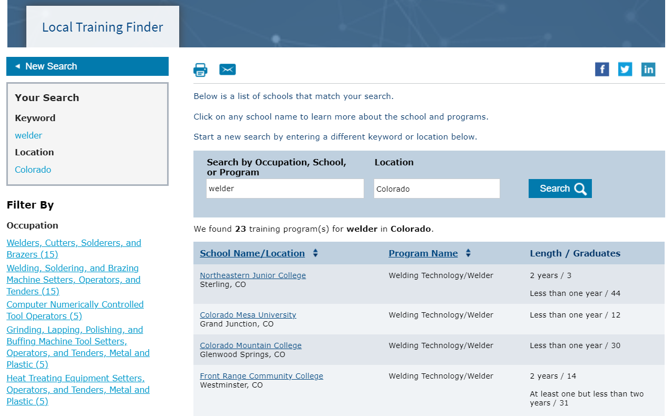
Local Training Finder

Slide 15
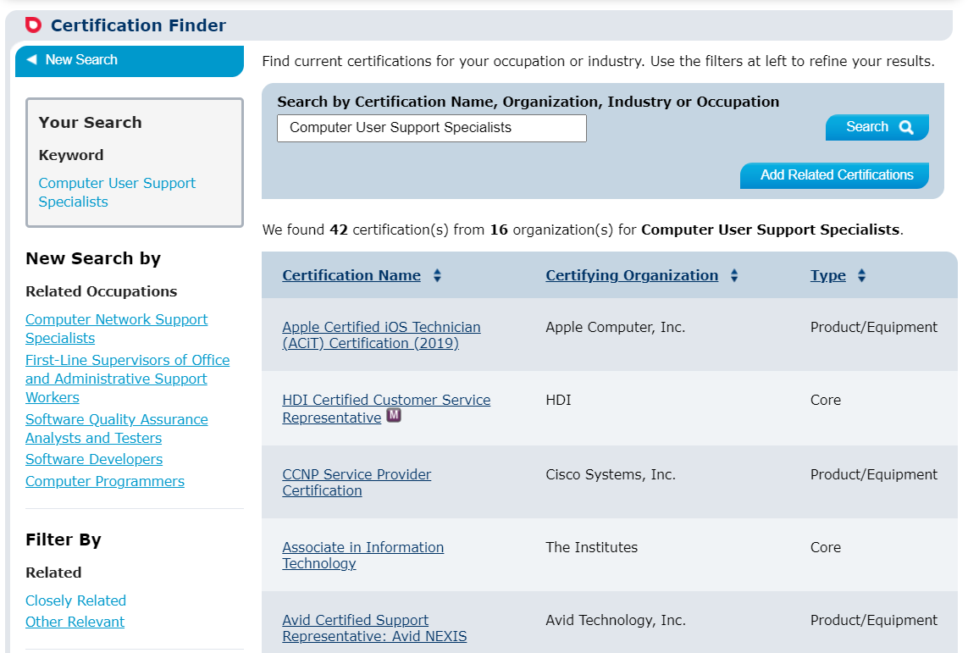
Certification Finder

Slide 16
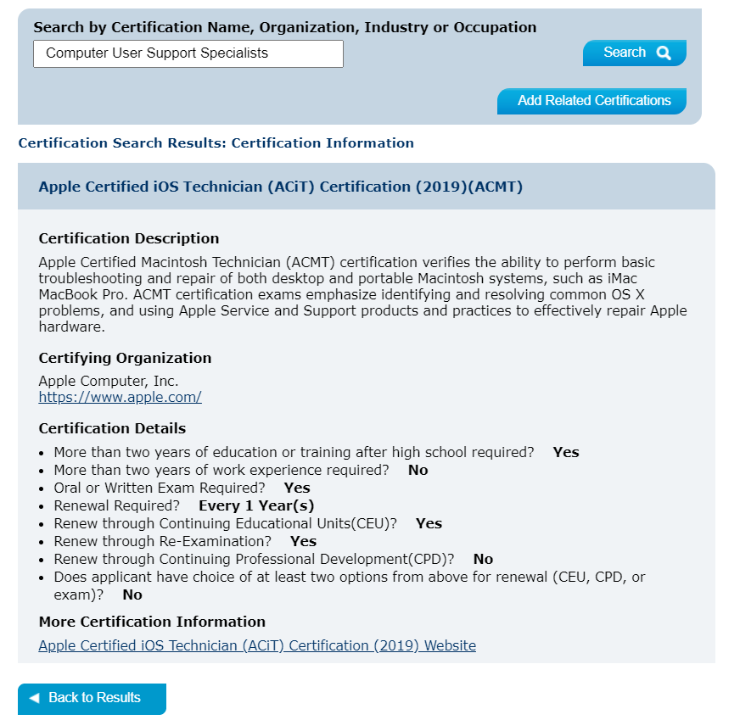
Certification Finder Detail Page

Slide 17
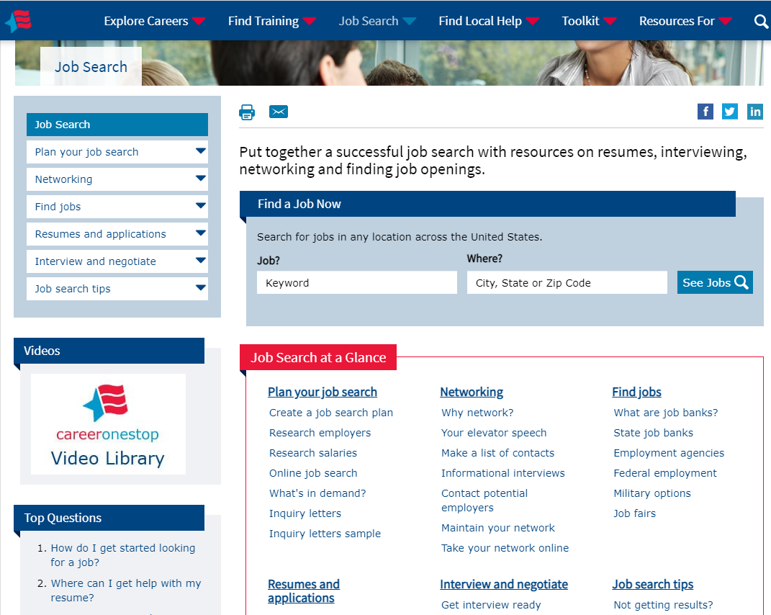
Job Search

Slide 18
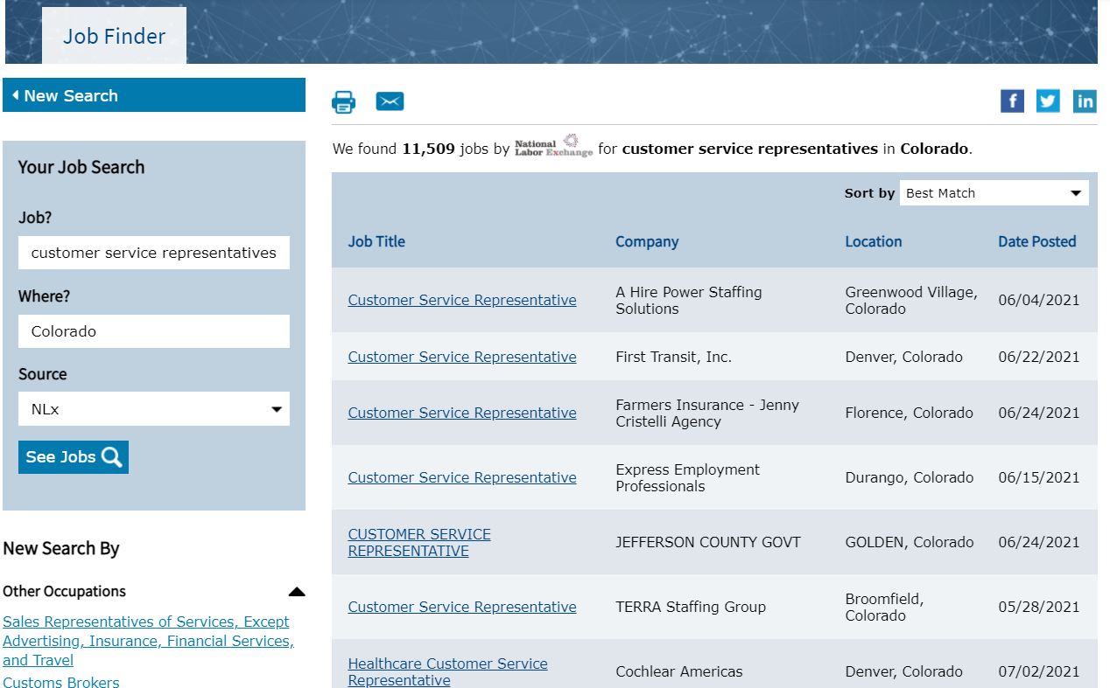
Job Finder

Slide 19
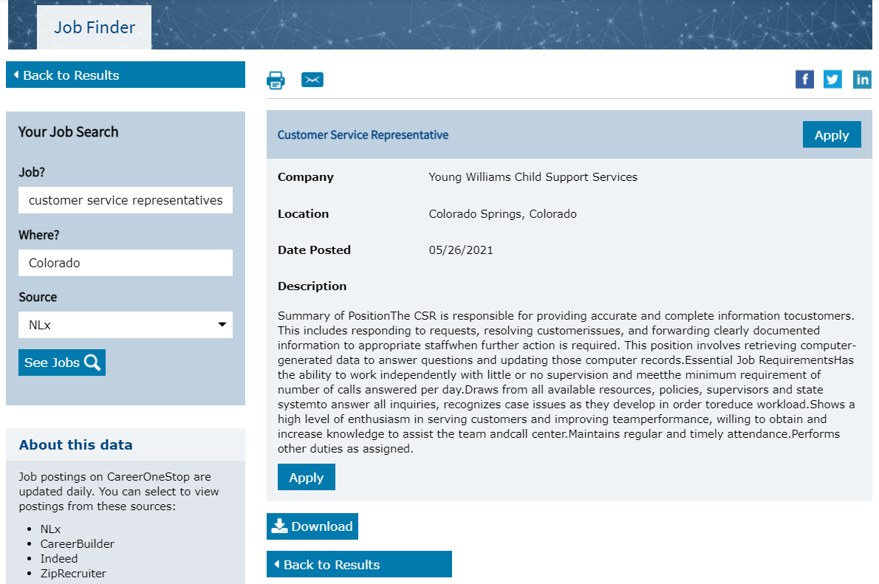
Job Finder Detail Page

Slide 20
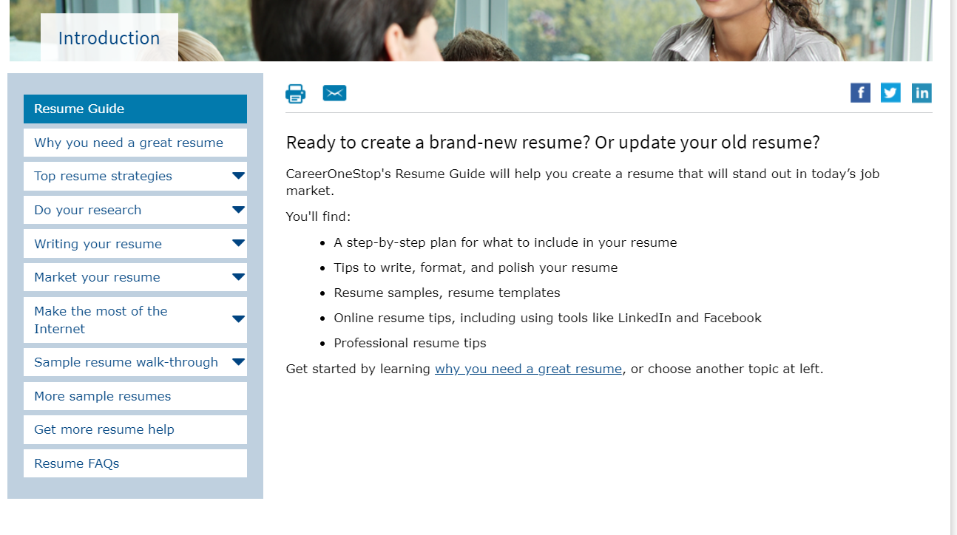
Resume Guide

Slide 21
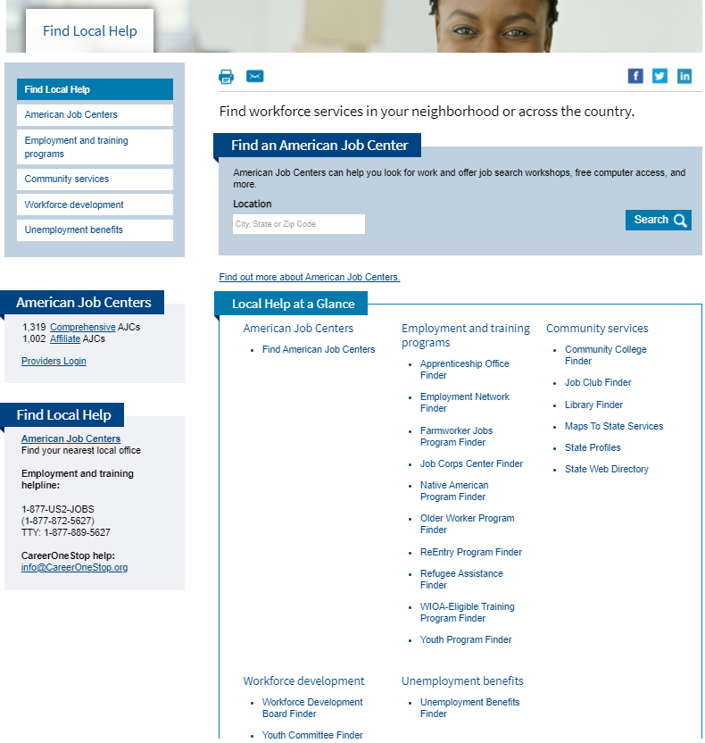
Find Local Help

Slide 22
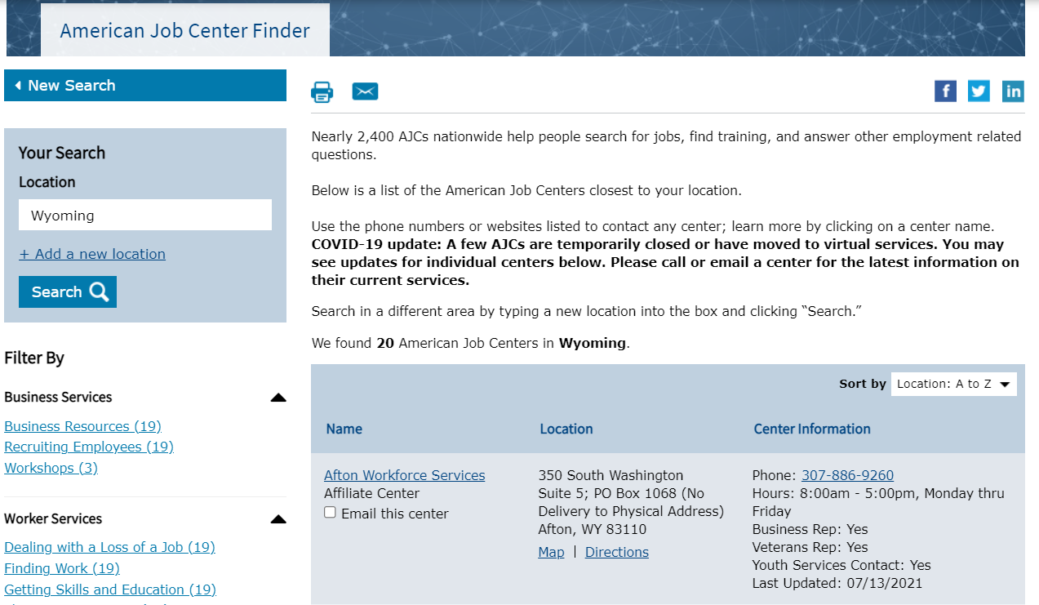
American Job Center Finder

Slide 23
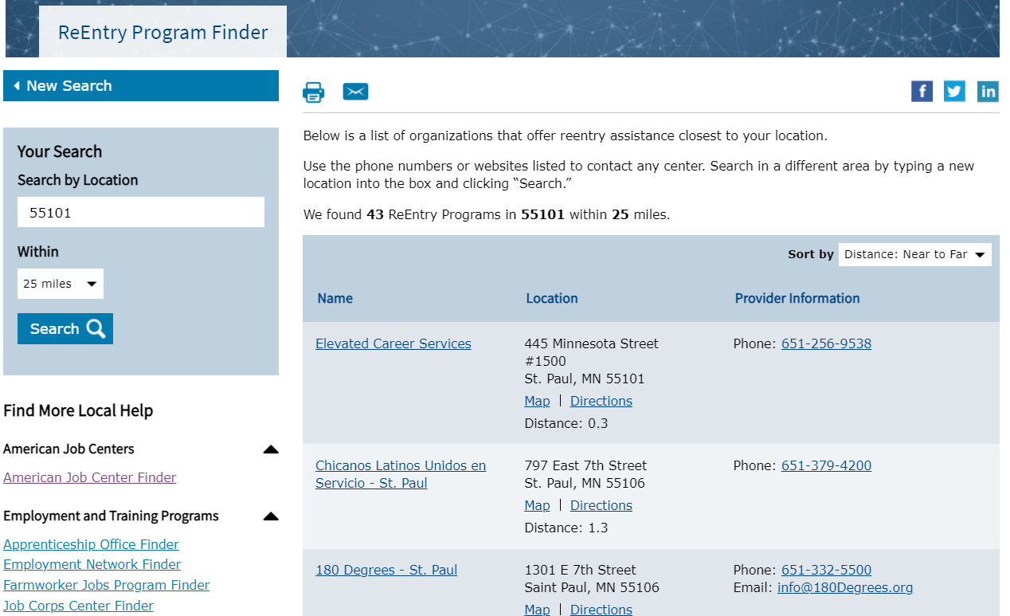
ReEntry Program Finder

Slide 24
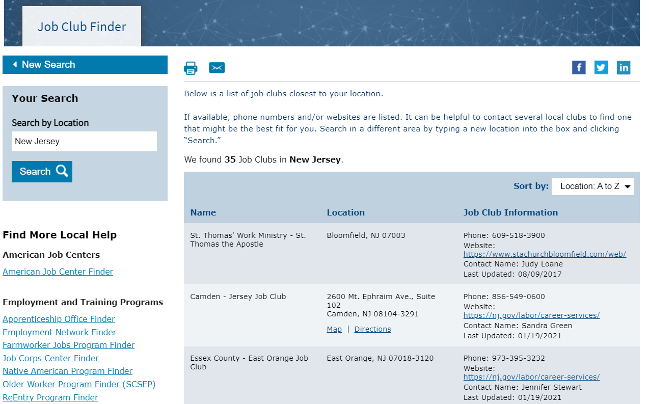
Job Club Finder

Slide 25
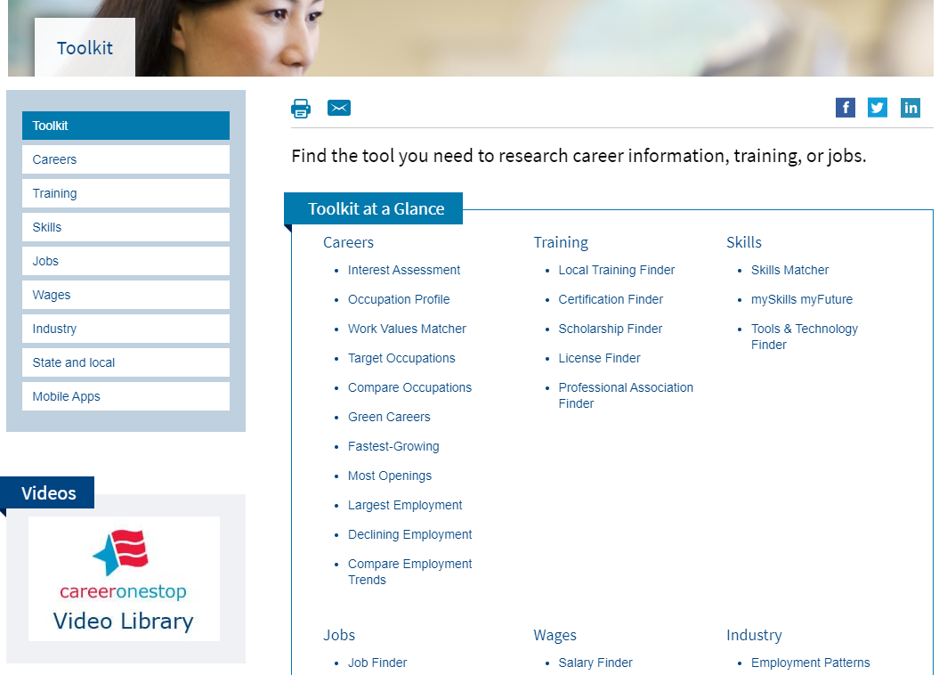
Toolkit

Slide 26
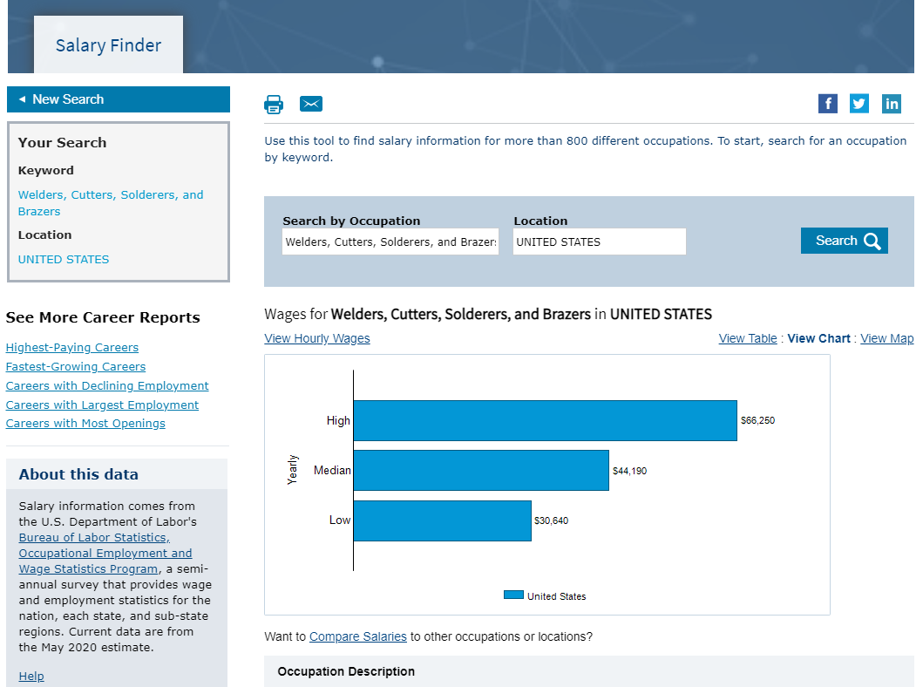
Salary Finder

Slide 27
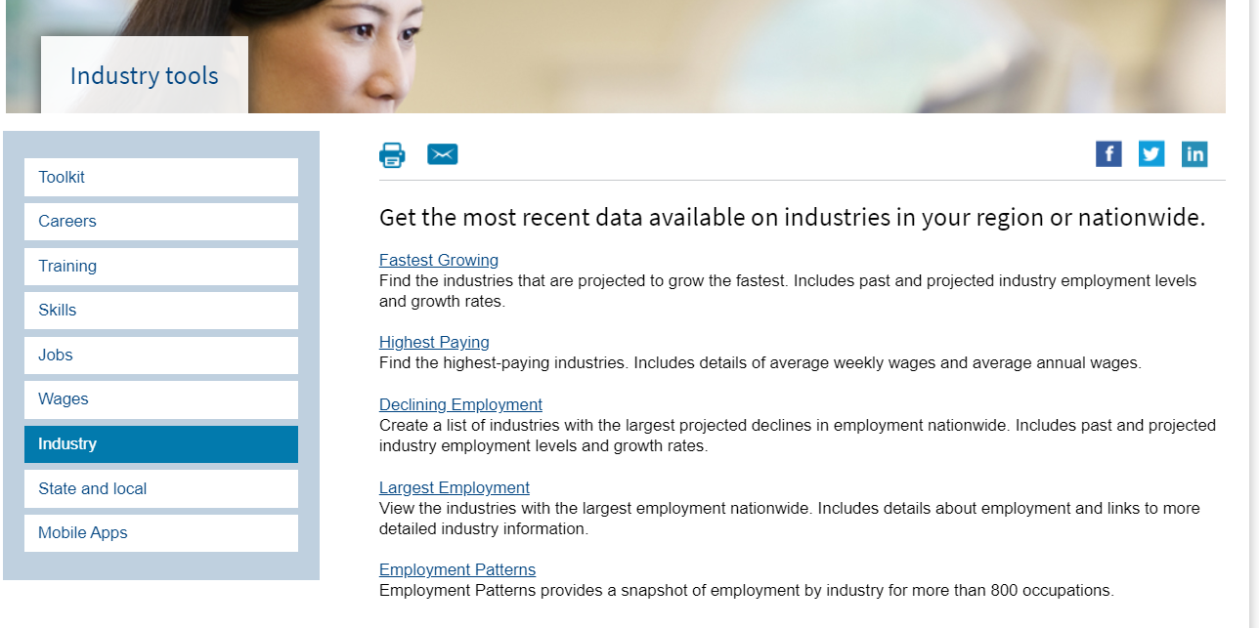
Industry Reports

Slide 28
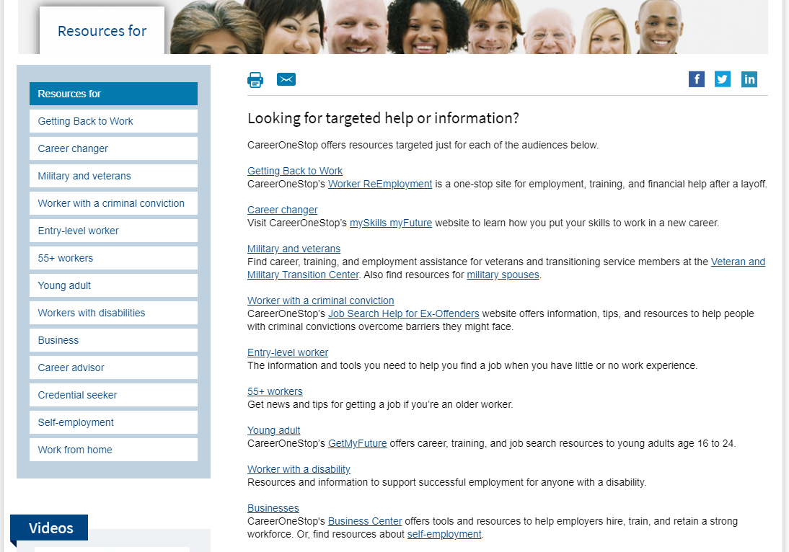
Resources For

Slide 29
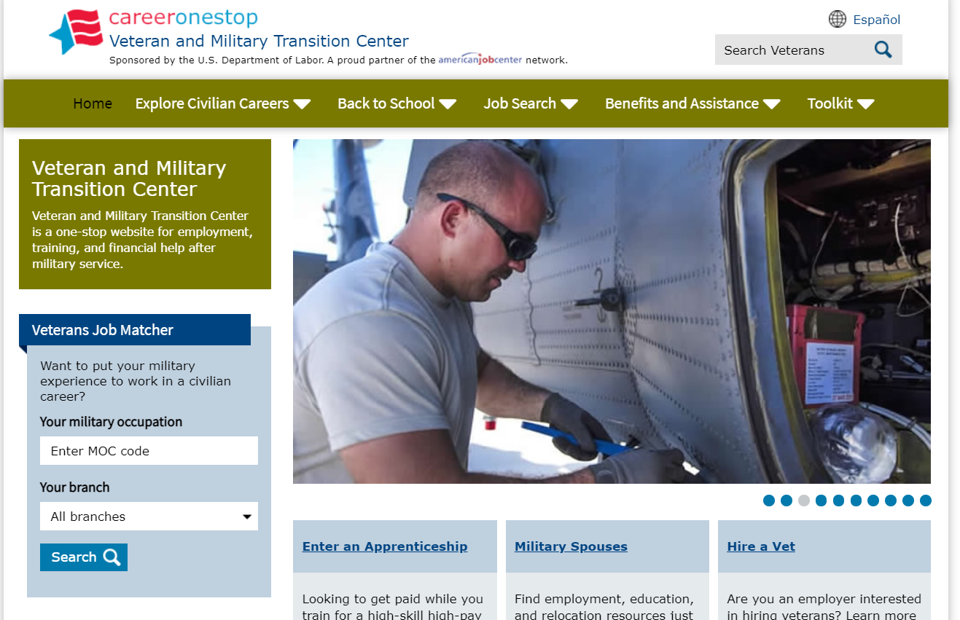
Veteran and Military Transition Center

Slide 30
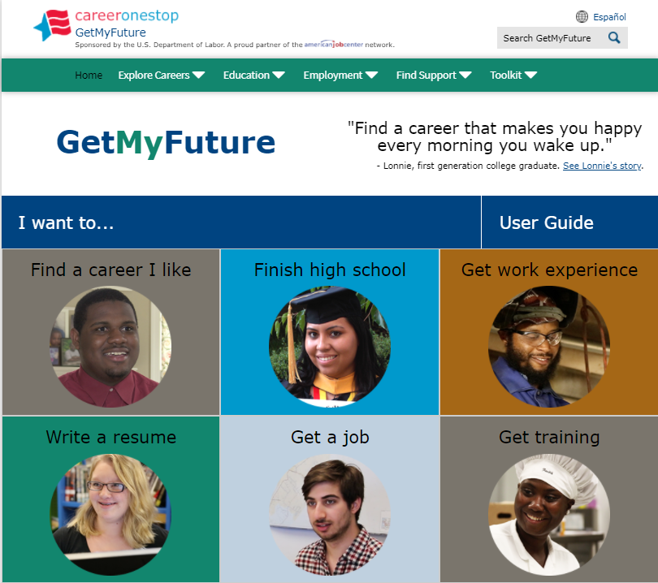
GetMyFuture

Slide 31
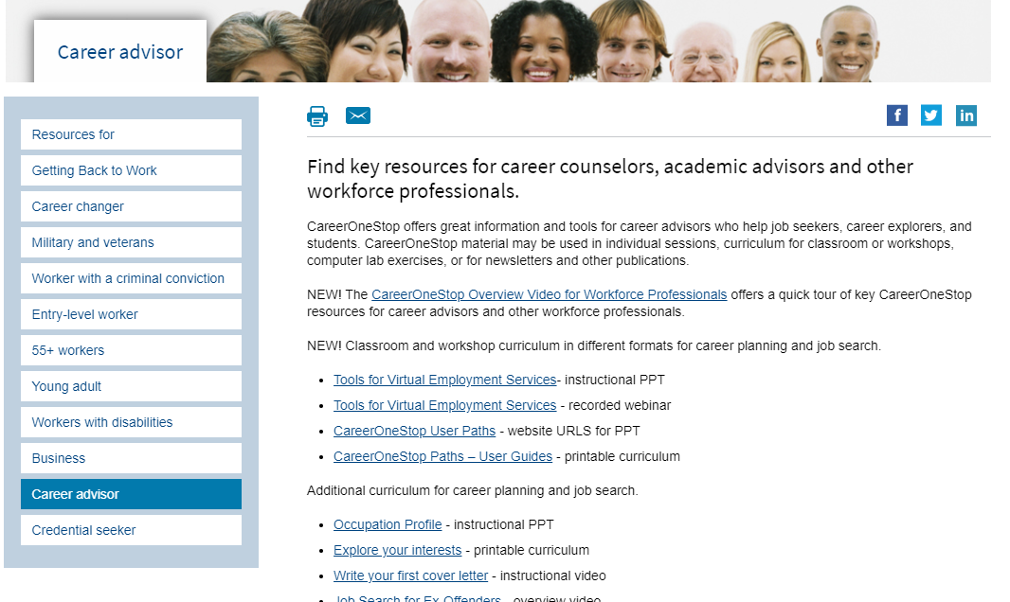
Career Advisor

Slide 32
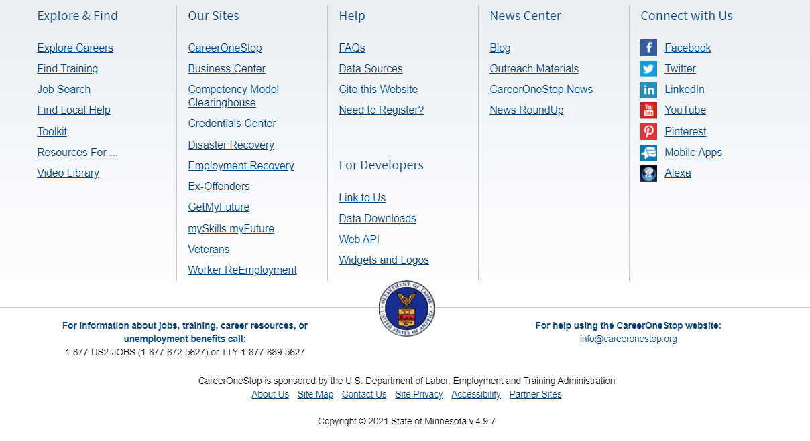
Footer

Slide 33
Poll Question #1
We are always looking for ways to let workforce professionals know about CareerOneStop. Do you have suggestions for ways to let people who work in settings like yours learn about the website?

Slide 34
Poll Question #2
Which customer group would you like more detailed resources and information about?
K-12 students
Youth or young adult job seekers
College students
Job seekers
Laid-off workers
Career changers
Persons seeking a work-related credential
Veterans or transitioning service members
Persons with a criminal conviction
Older workers
Persons who have a disability
Businesses
Other

