Slide 1
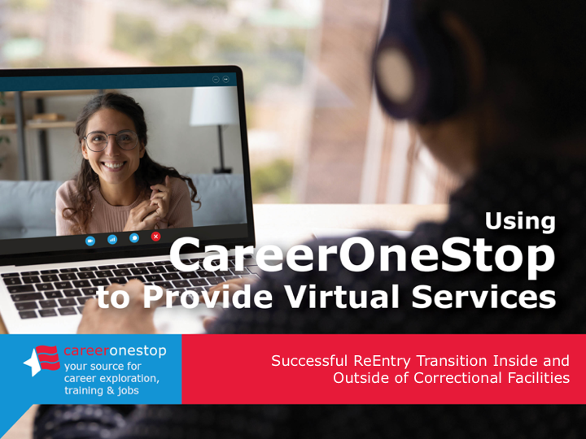

Reentry
Successful ReEntry Transition Inside and
Outside of Correctional Facilities

Slide 2
Challenge
One in three Americans has a criminal record that can be a barrier to employment and career advancement. Meanwhile, employment services to assist with a successful reentry transition continue to move to virtual delivery.

Slide 3

Agenda
Brief CareerOneStop Overview
User Path:
Successful Reentry Transition
Questions

Slide 4
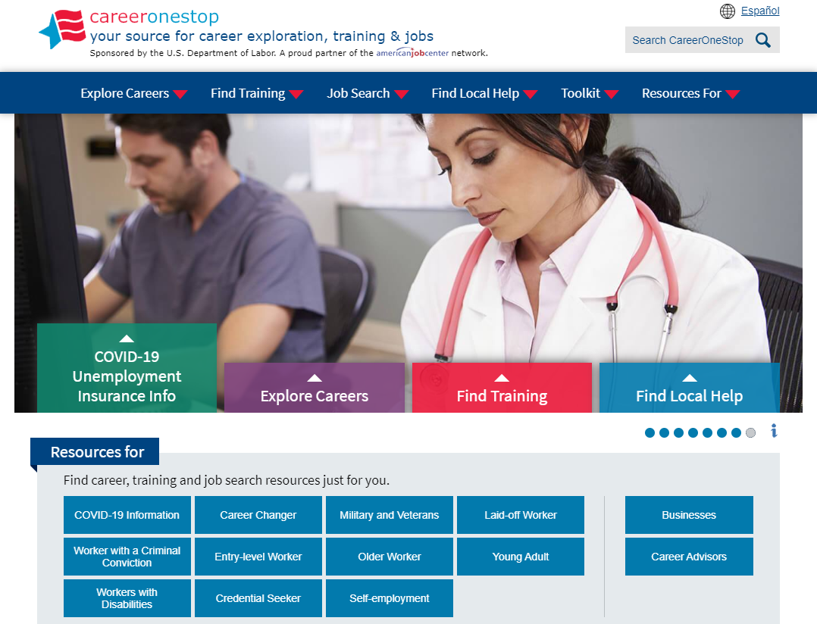

CareerOneStop
CareerOneStop is sponsored by the U.S. Department of Labor, Employment and Training Administration

Slide 5
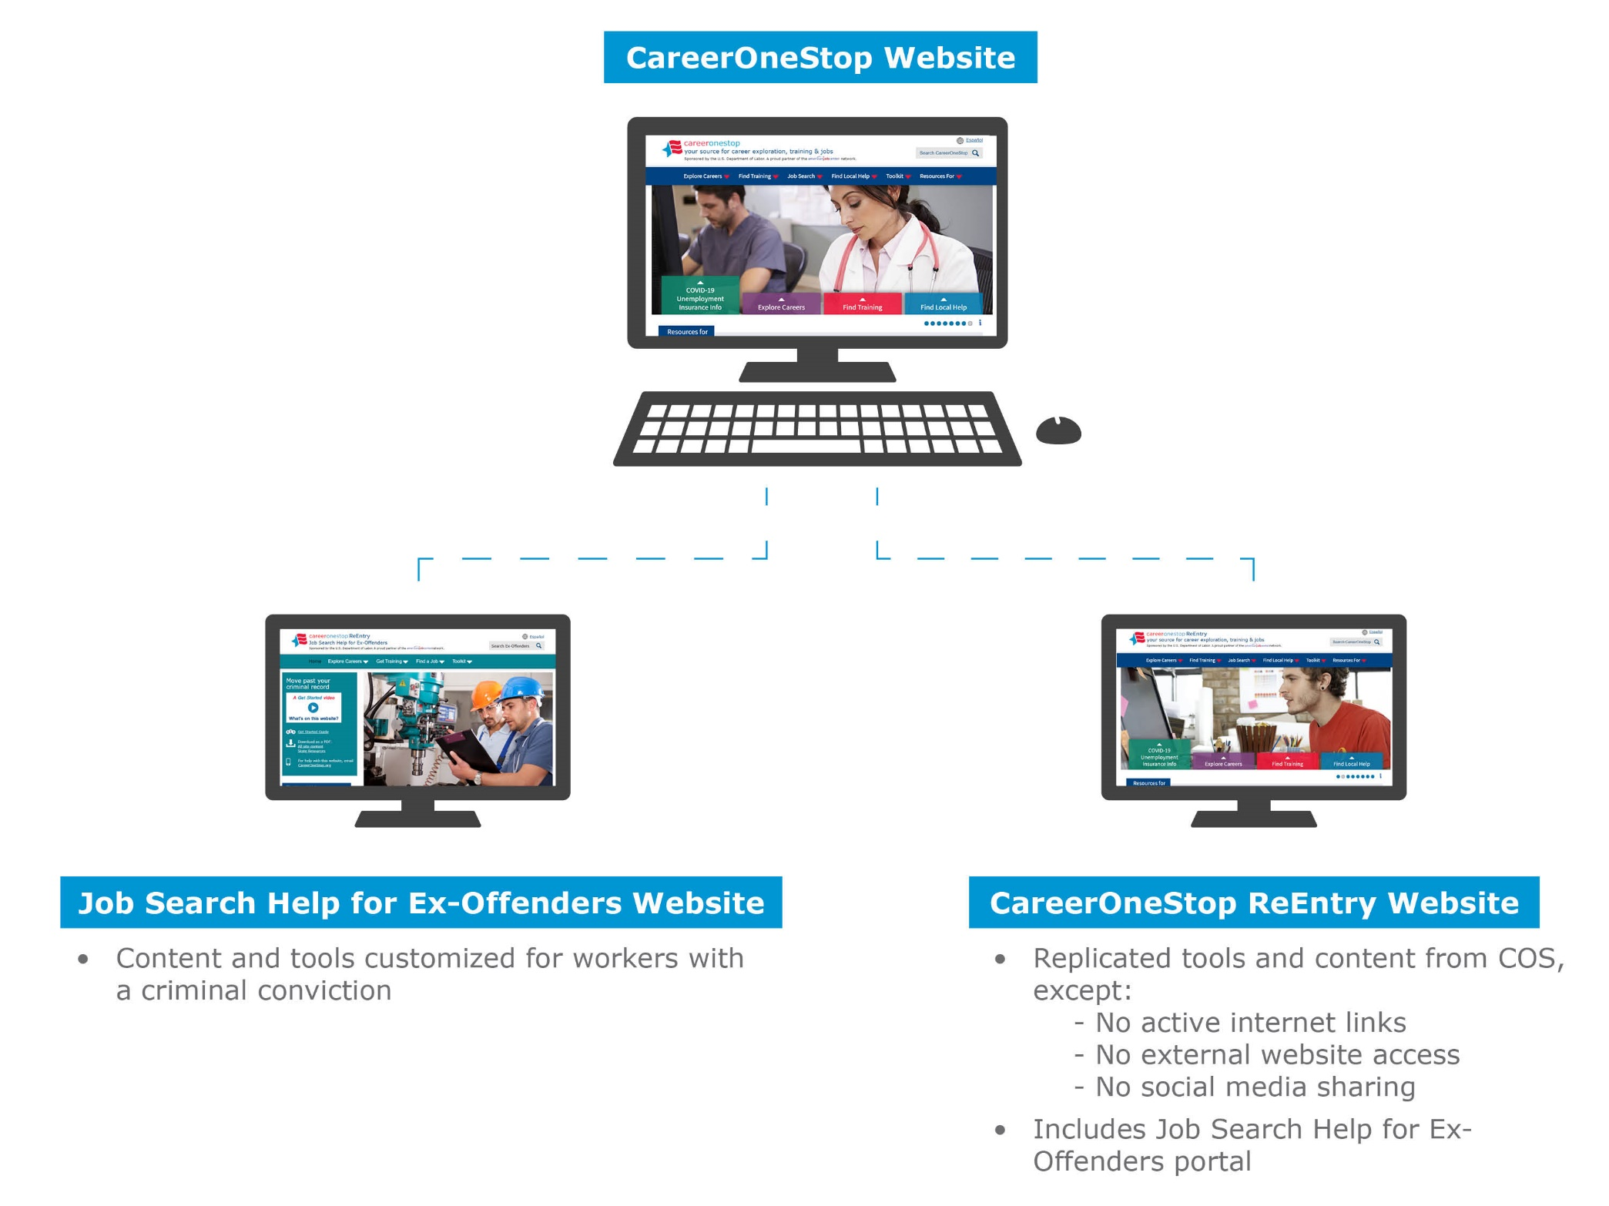
Websites

Slide 6

CareerOneStop ReEntry

Slide 7
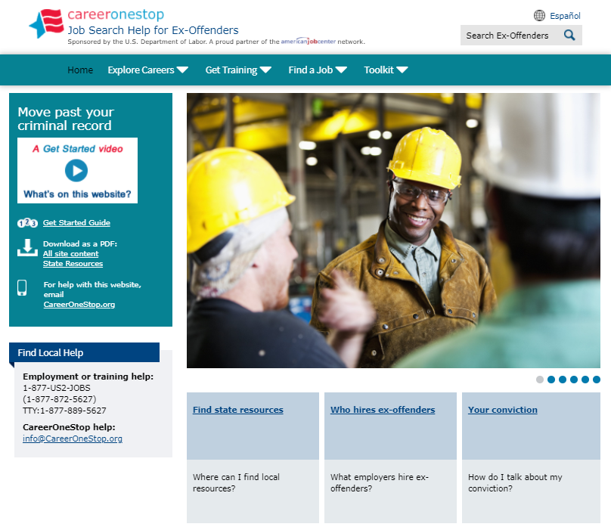
Job Search Help for Ex-Offenders

Slide 8
Path: Successful Reentry Transition
Goal
Using CareerOneStop inside facilities: Plan ahead for a meaningful, stable career after reentry transition.
In the community: Use Job Search Help for Ex-Offenders to focus on an effective career and job search.
Objectives
Assess needs and identify community resources to support stability after transition.
Explore career options and choose a career direction.
To plan a longer-term career goal, explore education and training and set goals.
Prepare for a job search.
Conduct a job search.
Find in-person support and resources for your job search.

Slide 9
Path: Successful Reentry Transition Key Resources
Key Resources
CareerOneStop website
www.CareerOneStop.org
Job Search Help for Ex-Offenders website
CareerOneStop.org/ExOffender
_
_

Slide 10
Contact Information
Tricia Dahlman
Business Technology Manager, CareerOneStop
Patricia.Dahlman@state.mn.us
Julie Remington
Content Strategist, CareerOneStop
Julie.Remington@state.mn.us
_
_

Slide 11
Questions

Slide 12
Screenshots

Slide 13
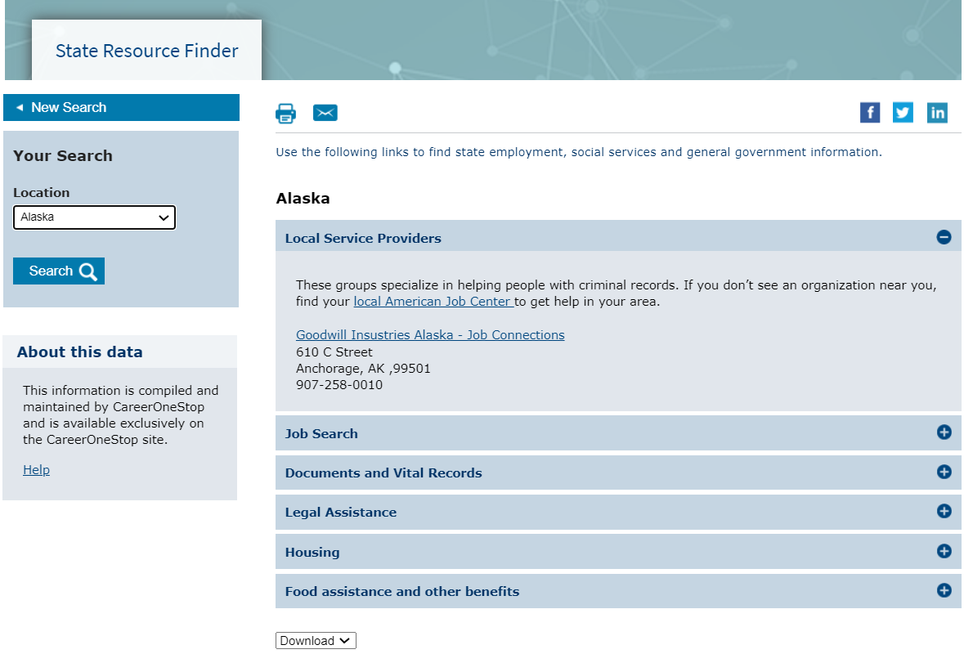
State Resource Finder

Slide 14
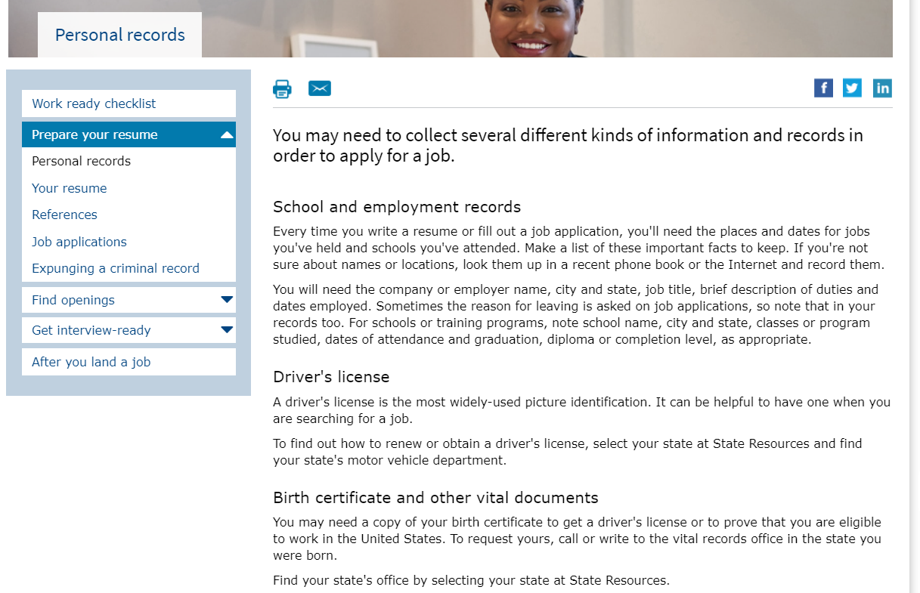
Personal Records

Slide 15
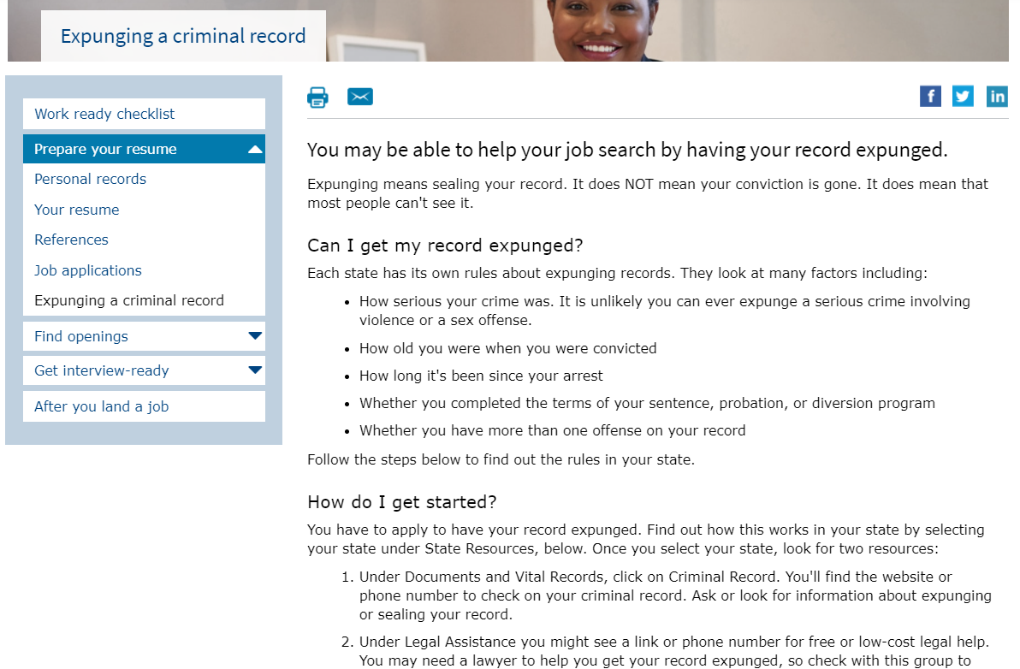
Expunging a Criminal Record

Slide 16
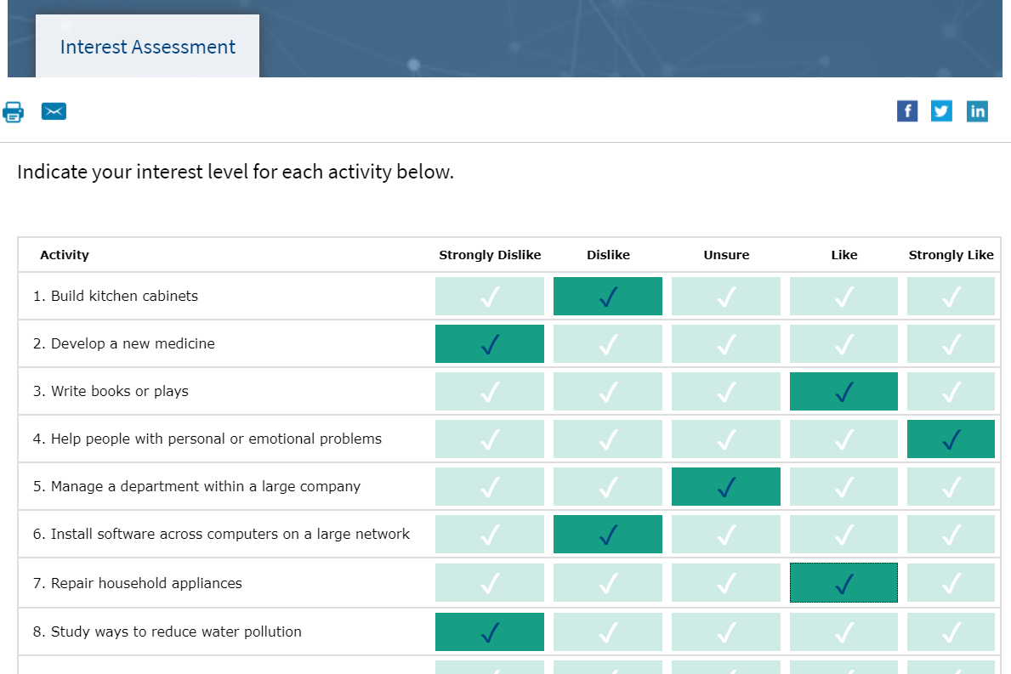
Interest Assessment

Slide 17
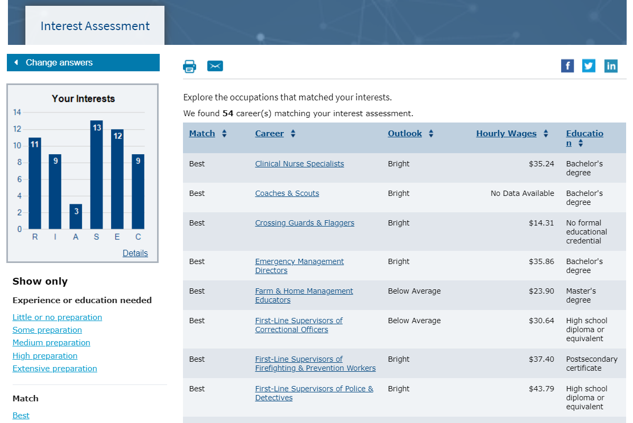
Interest Assessment Results

Slide 18
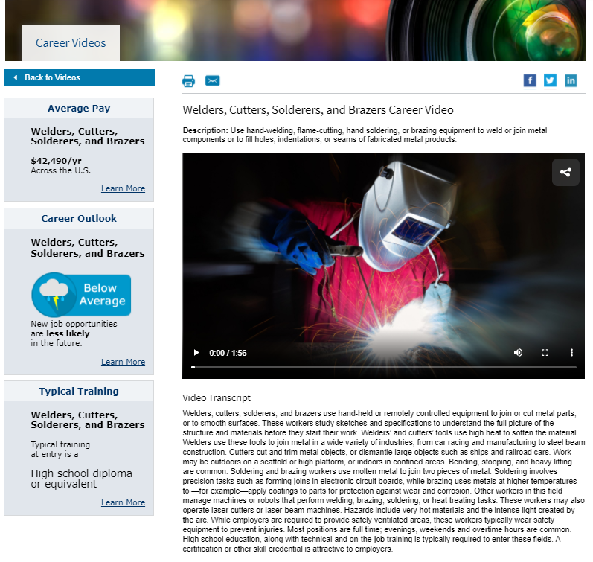
Career Videos

Slide 19
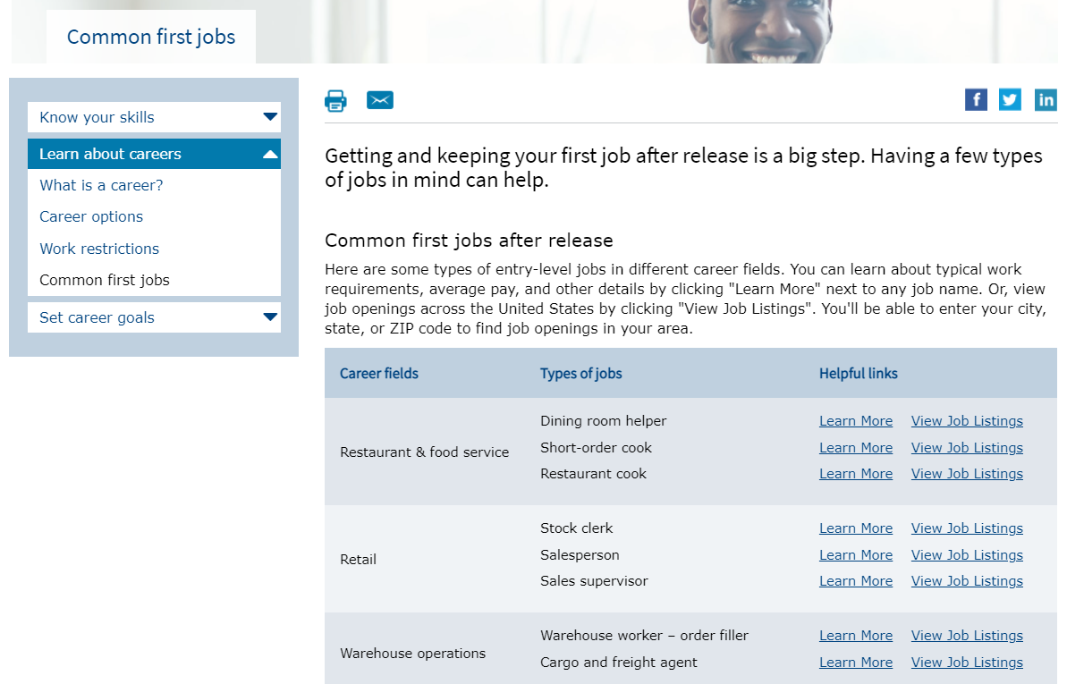
Common First Jobs

Slide 20
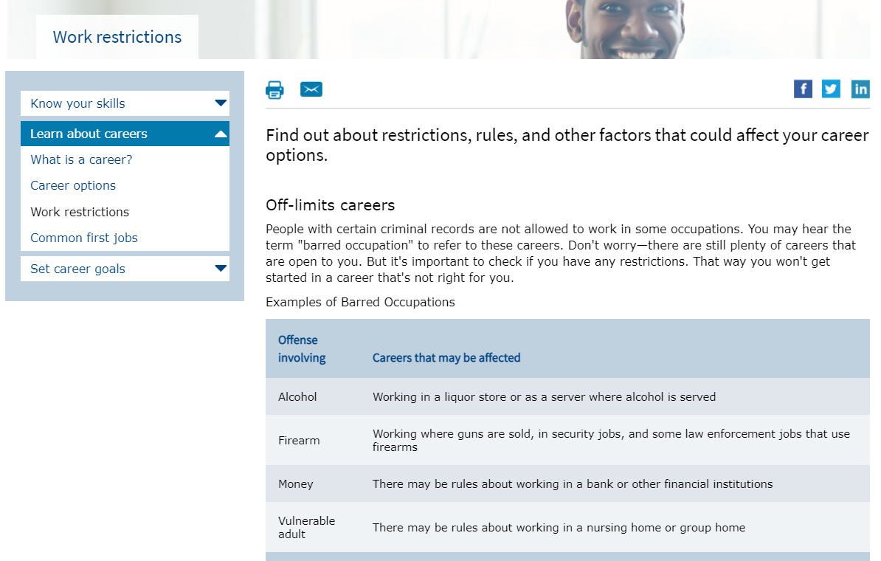
Work Restrictions

Slide 21
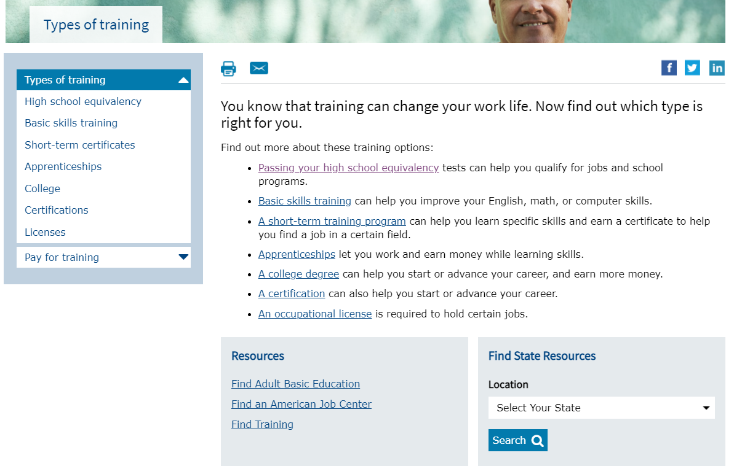
Types of Training

Slide 22
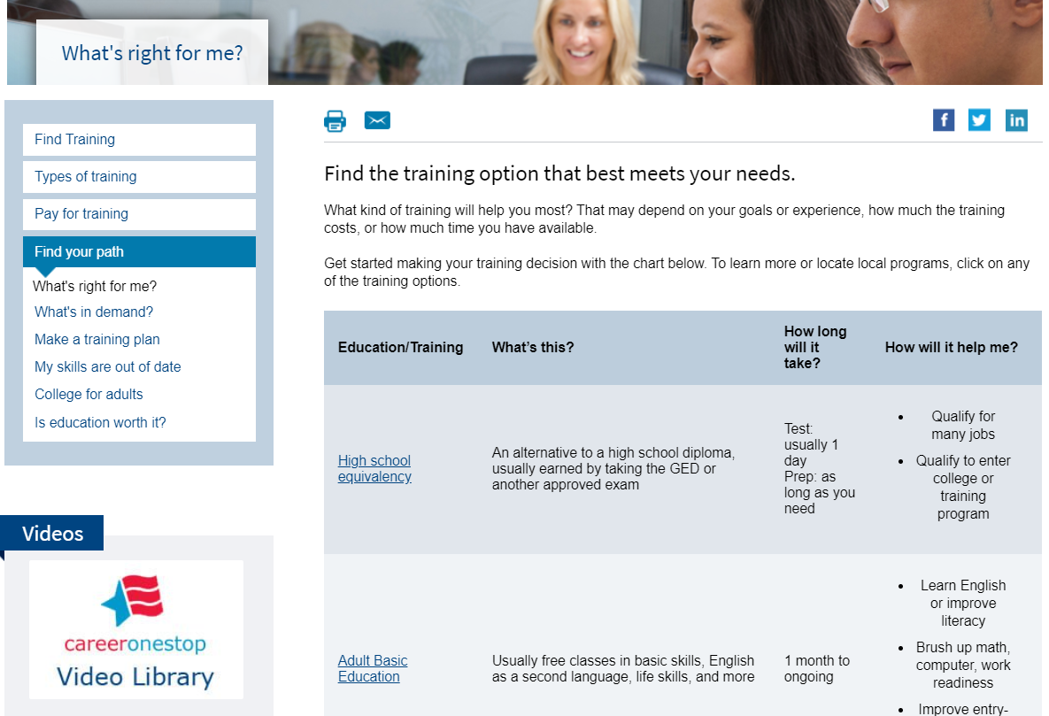
What’s Right for Me?

Slide 23
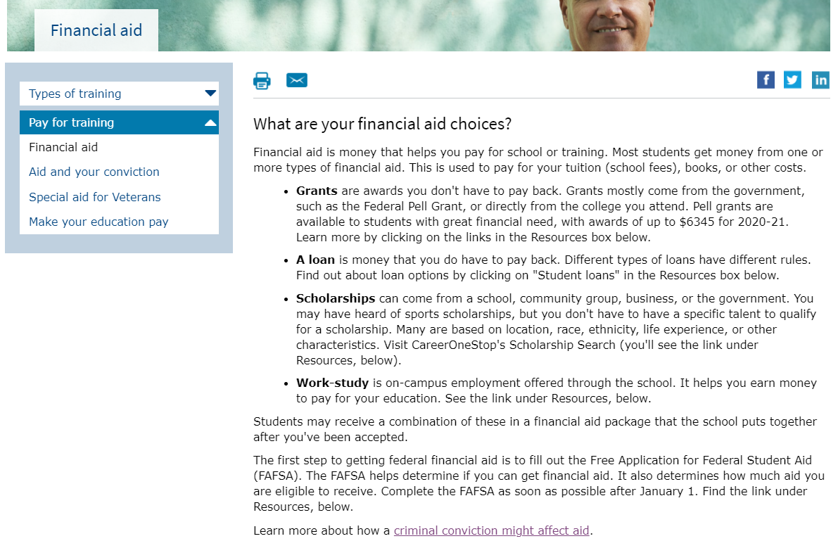
Financial Aid

Slide 24
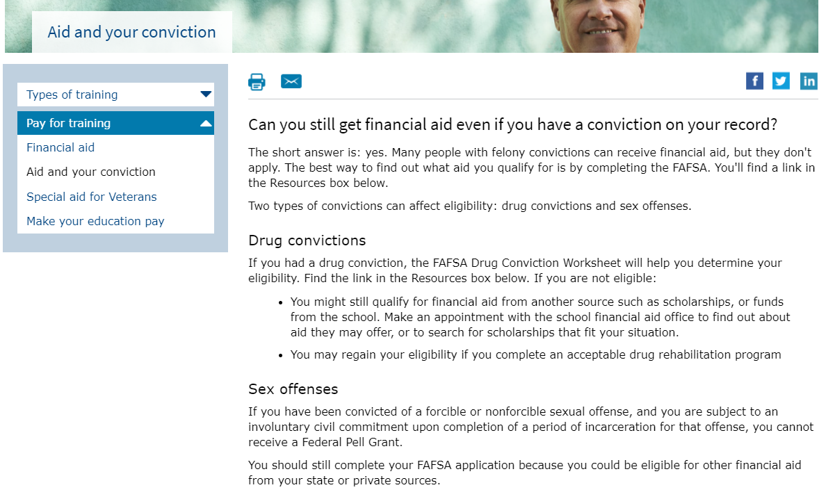
Aid and Your Conviction

Slide 25
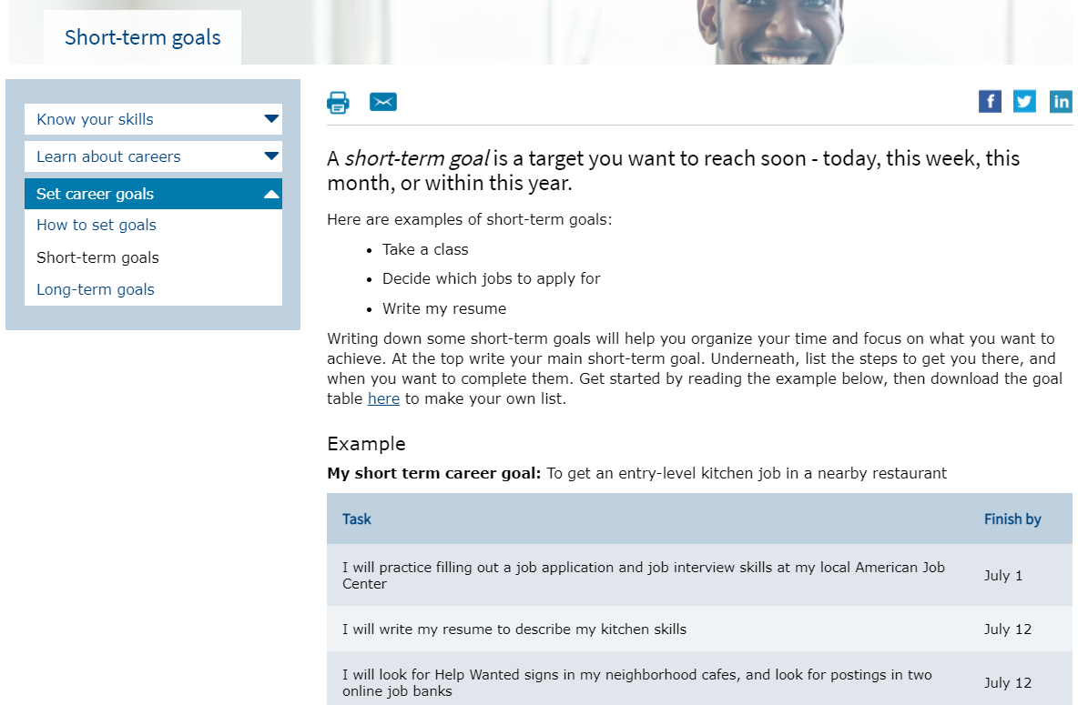
Short-term Goals

Slide 26
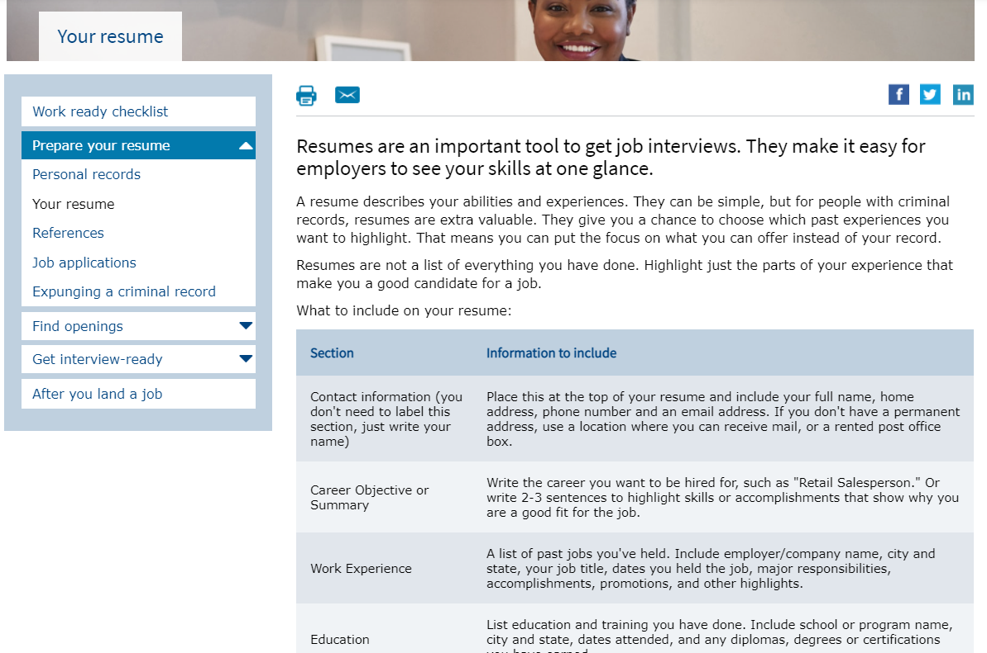
Your Resume

Slide 27
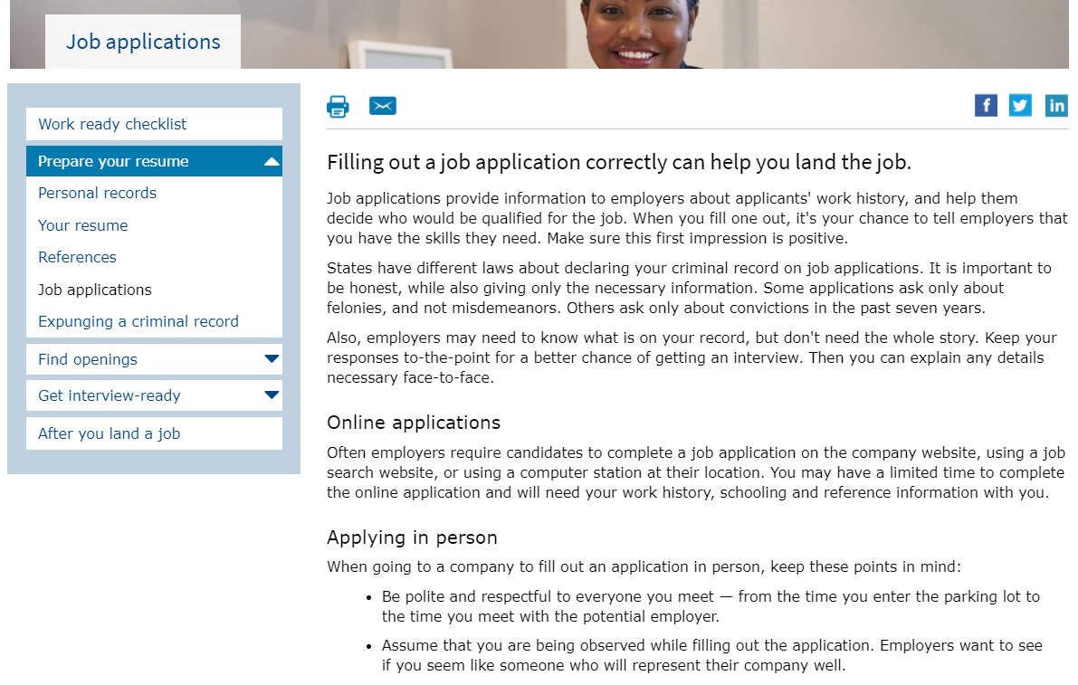
Job Applications

Slide 28
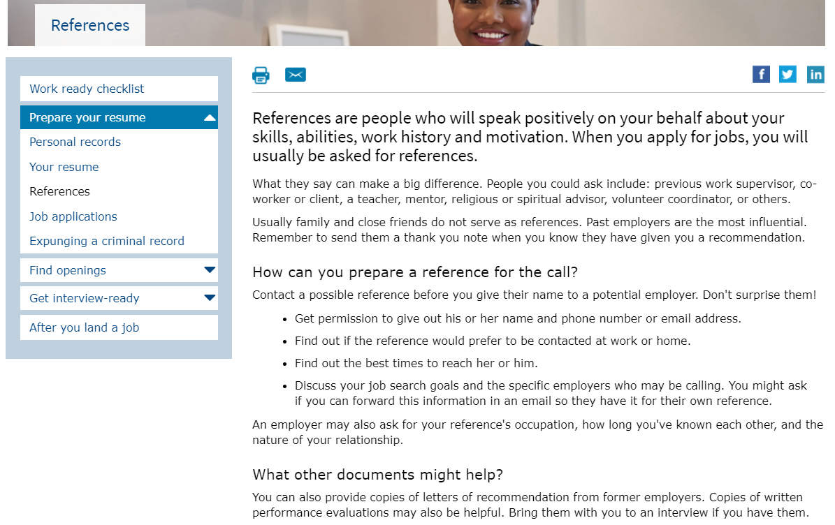
References

Slide 29
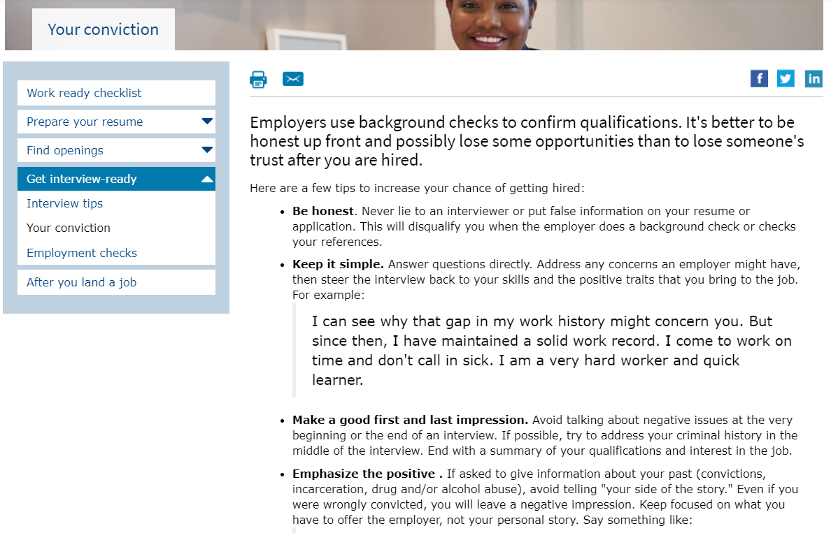
Interviews: Your Conviction

Slide 30
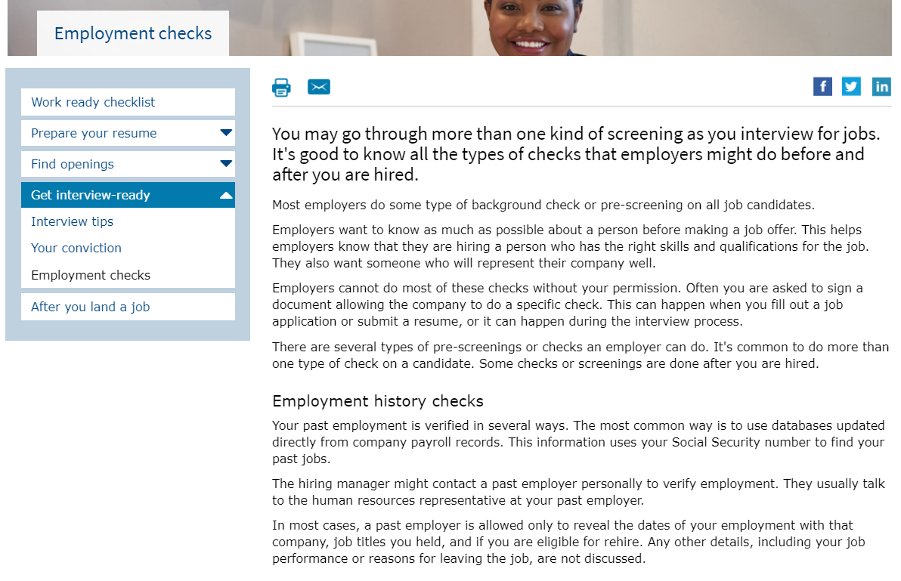
Employment Checks

Slide 31
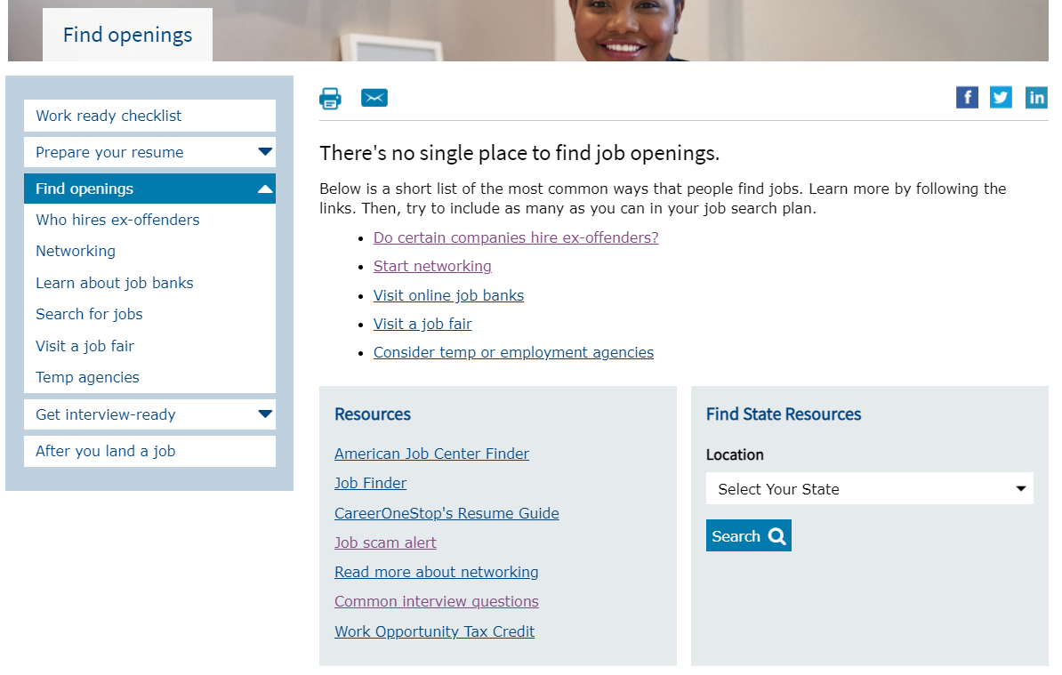
Find Openings

Slide 32
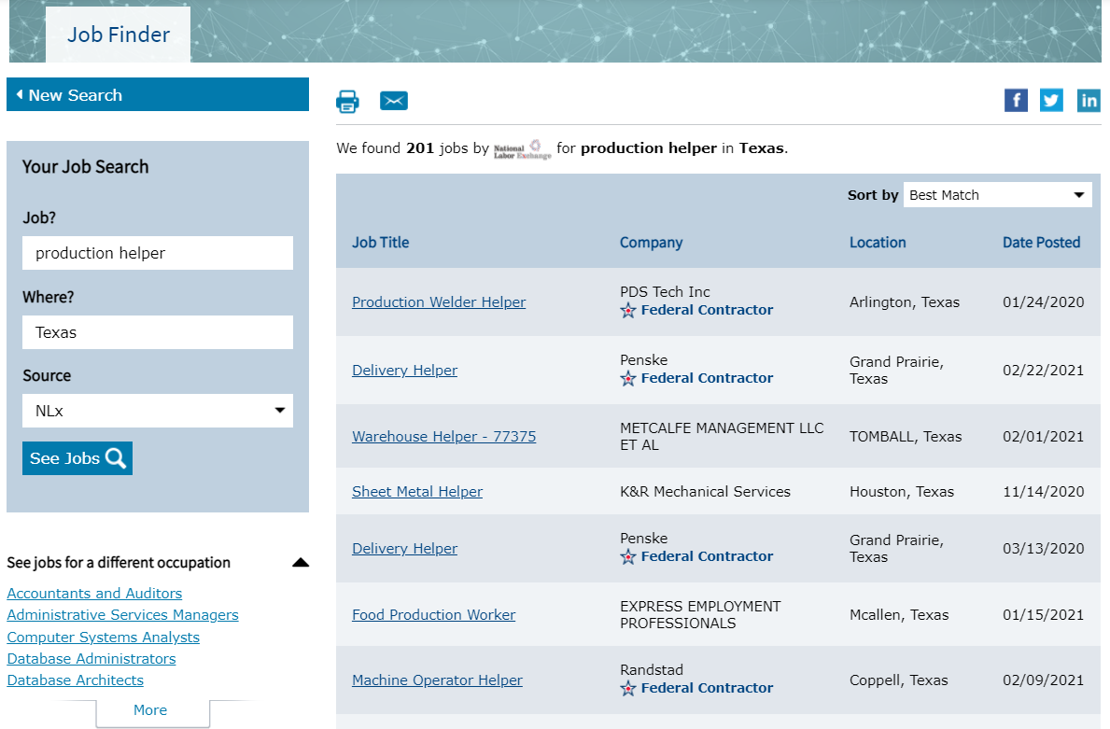
Job Finder: Results

Slide 33
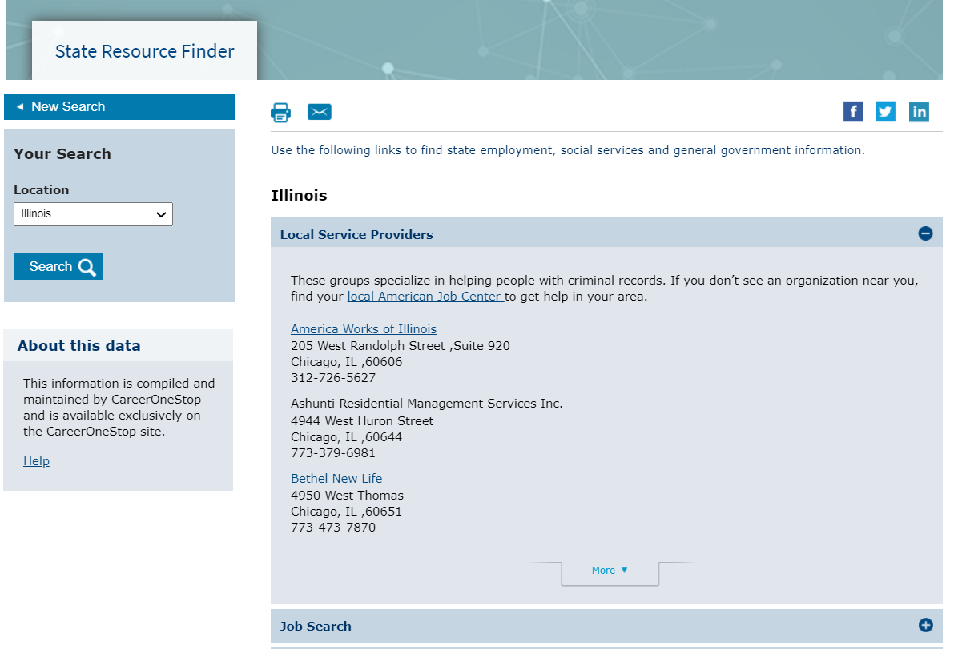
Local Service Providers

