Slide 1
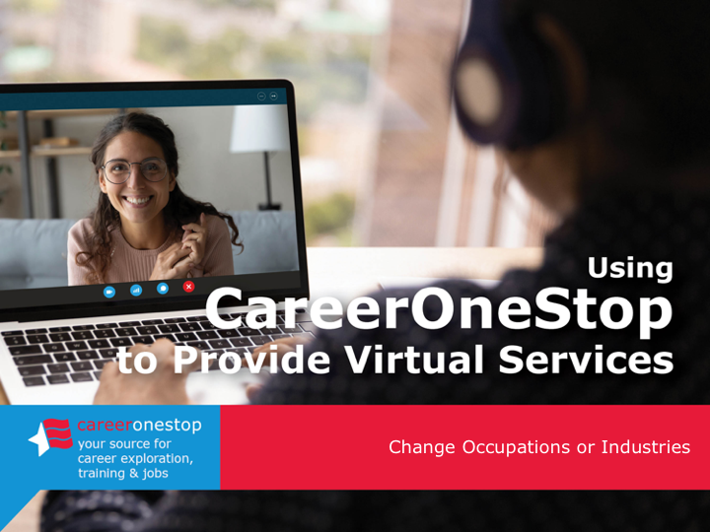

Using CareerOneStop to Provide Virtual Services
Change Occupations or Industries

Slide 2
Challenge
Many employment services transitioned to online formats since in-person employment counseling sites closed or reduced their hours, at the same time that demand for services has grown.

Slide 3

Agenda
Brief CareerOneStop overview
User Path:
Change Your Occupation or Industry
Questions

Slide 4
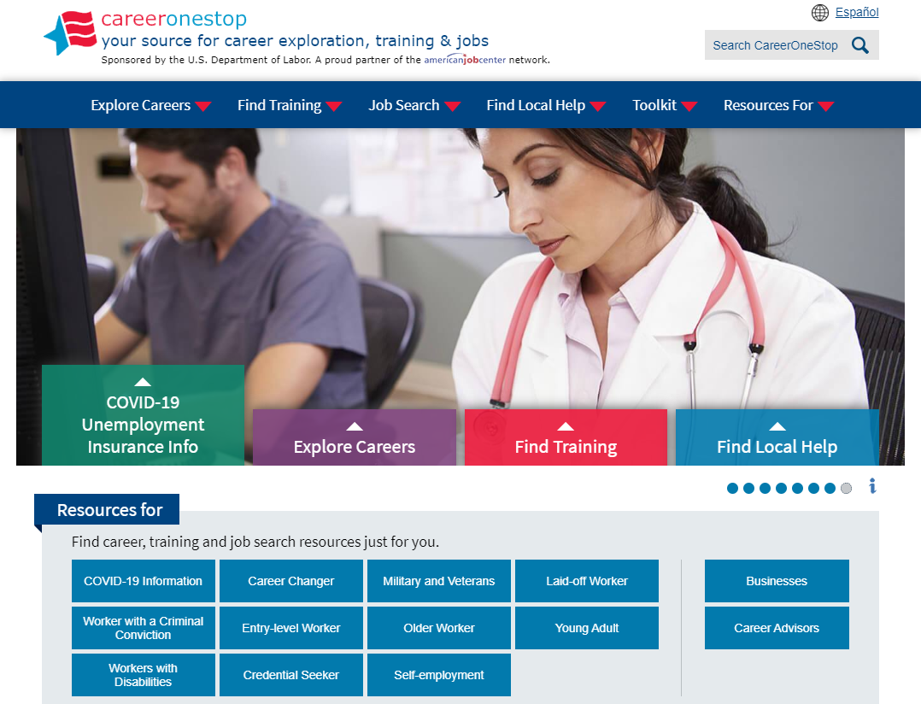

CareerOneStop
CareerOneStop is sponsored by the U.S. Department of Labor, Employment and Training Administration

Slide 5

Customer Needs
What benefits and other forms of assistance are available to me?
I need short term, immediate employment
I need a longer-term career plan
I just graduated from college, what do I do?
What options are available to develop new skills or knowledge?

Slide 6
Path: Change Your Occupation or Industry
Goal
Make a plan to change your occupation or industry. Take career assessments, research occupations that interest you, and target your resume and networking to the field you select.
Objectives
Take the Skills Matcher to identify occupations based on your skills.
Use mySkills myFuture to generate new career options related to previous experience.
Review in-demand careers and industries.
Conduct 2-3 informational interviews. Select 1-2 occupations for your job search.
Create or update your resume to reflect your targeted occupations.
Craft an elevator speech to promote your qualifications.
Update social media profiles to reflect your job search goals.
Use the Business Finder to identify 3-4 local employers to target
for networking.
Find 2 professional associations on Professional Association Finder
to contact and join.

Slide 7
Key Resources
Key Resources
CareerOneStop
  www.CareerOneStop.org
    Skills Matcher
    Career and Industry Reports
    Informational Interviews
    Resume Guide
    Elevator Speech
    Social Media
    Business Finder
    Professional Association Finder
mySkills myFuture
www.mySkillsmyFuture.org
    Career Matches
_
_

Slide 8
Contact Information
Tricia Dahlman
Business Technology Manager, CareerOneStop
Patricia.Dahlman@state.mn.us
Julie Remington
Content Strategist, CareerOneStop
Julie.Remington@state.mn.us
_
_

Slide 9
Questions

Slide 10
Screenshots

Slide 11
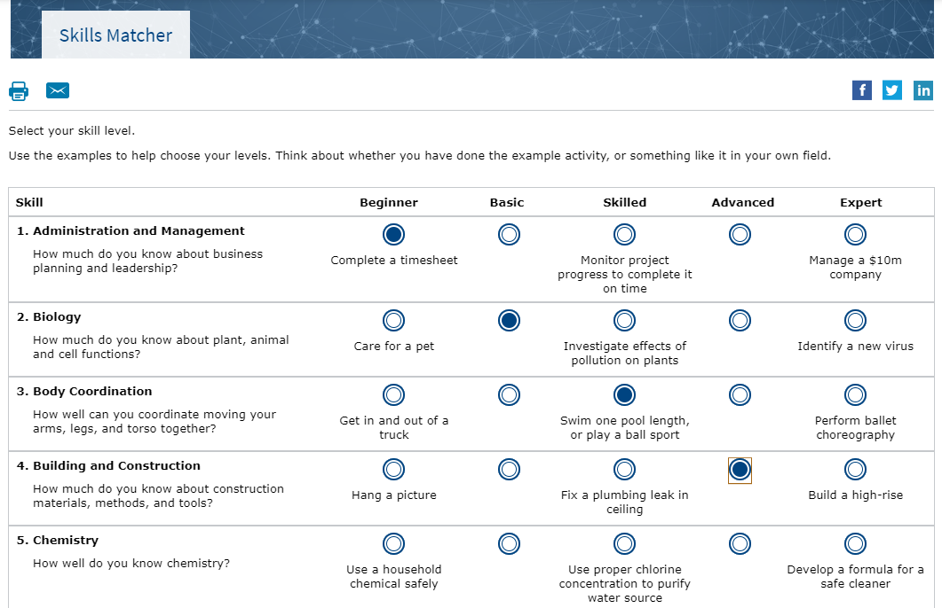
Skills Matcher

Slide 12
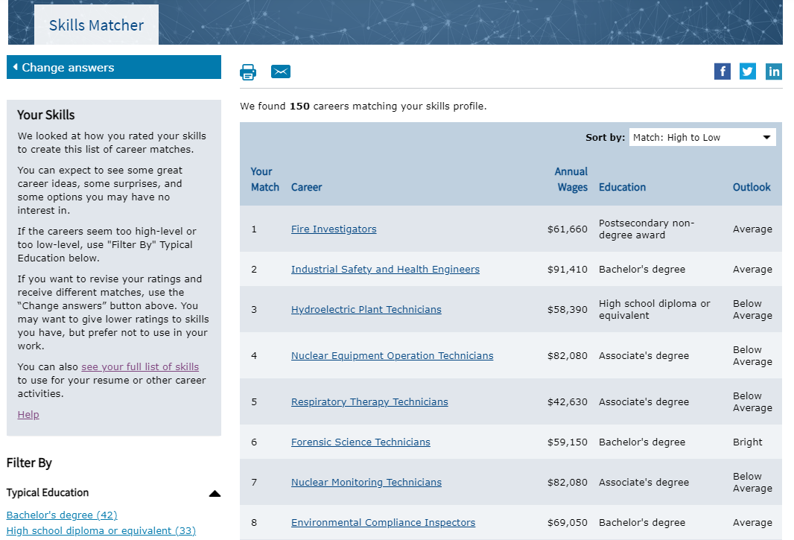
Skills Matcher Results

Slide 13
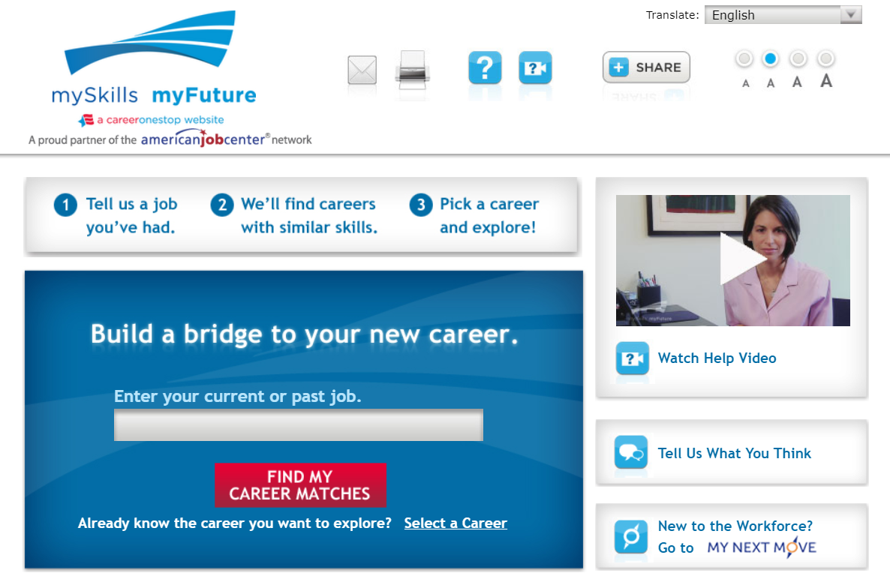
mySkills myFuture

Slide 14
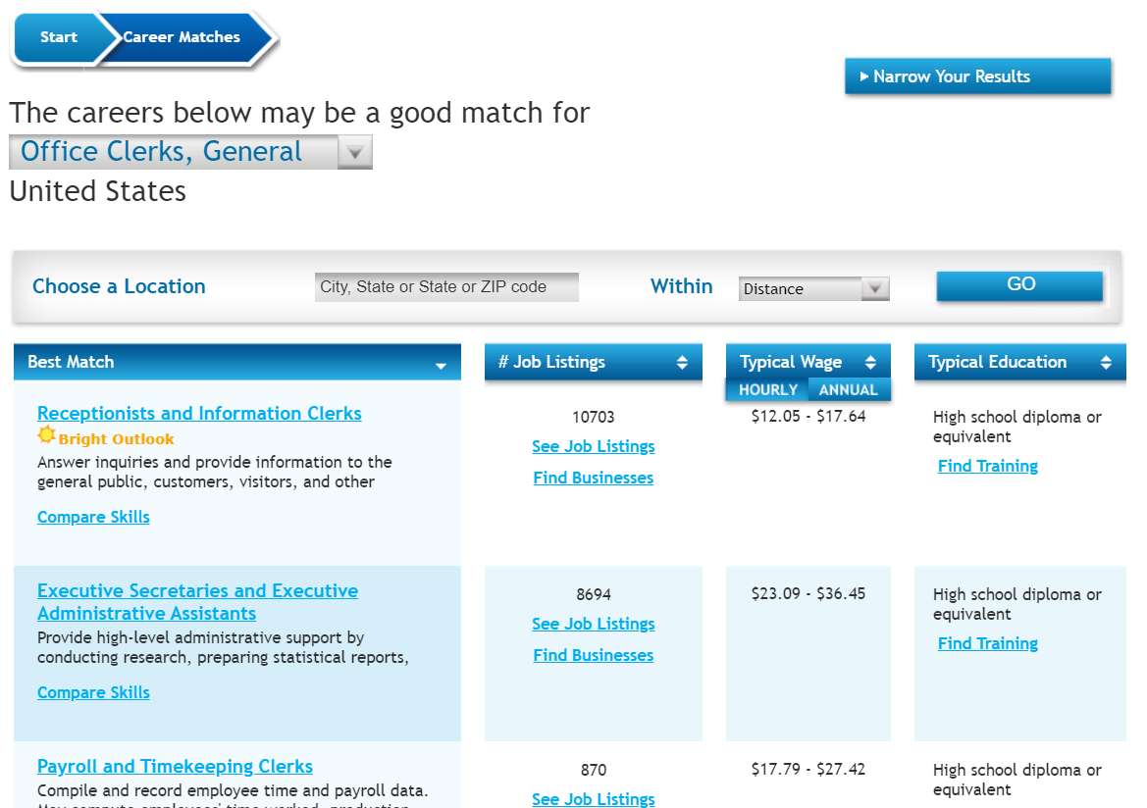
mySkills myFuture: Career Matches

Slide 15
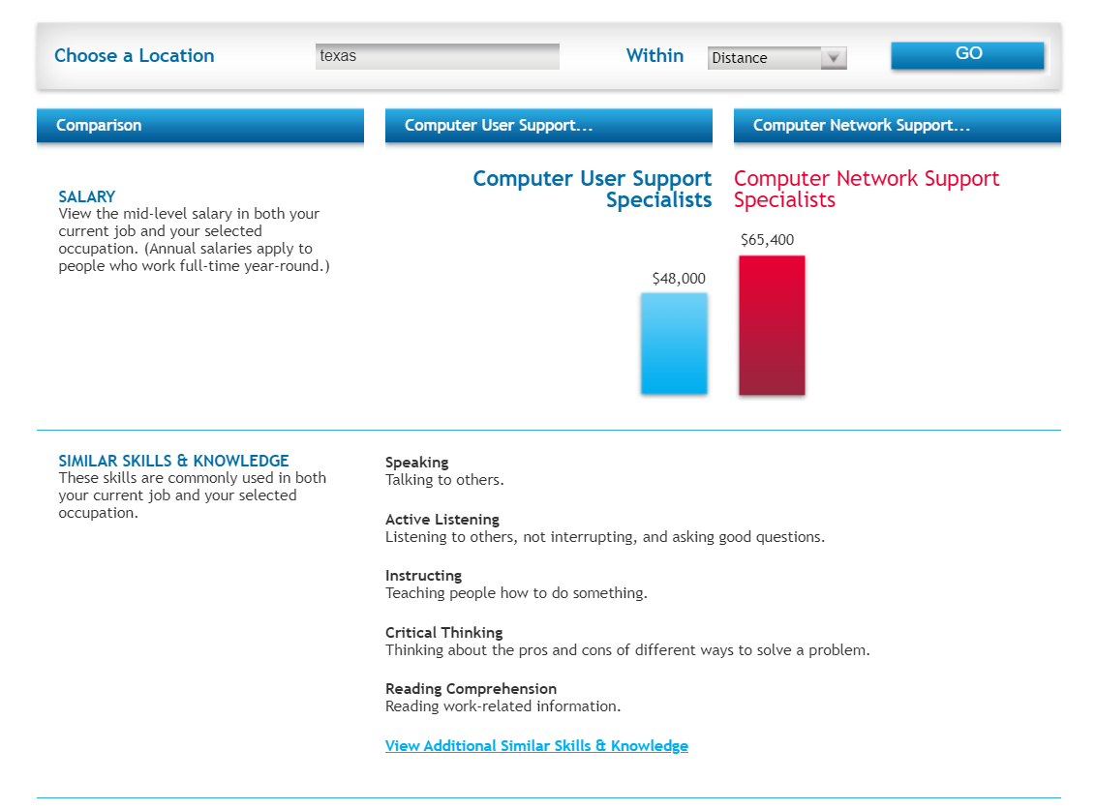
mySkills myFuture: Compare Skills

Slide 16
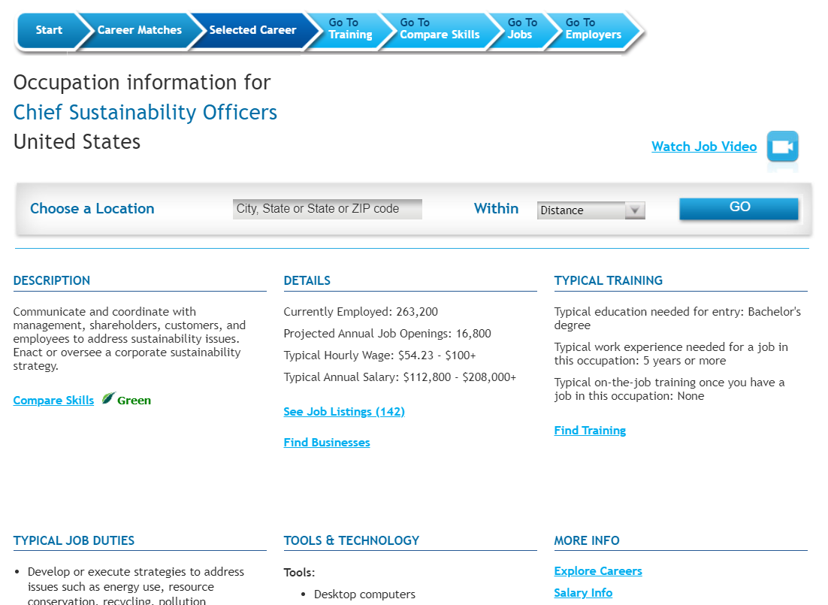
mySkills myFuture: Career Profile

Slide 17
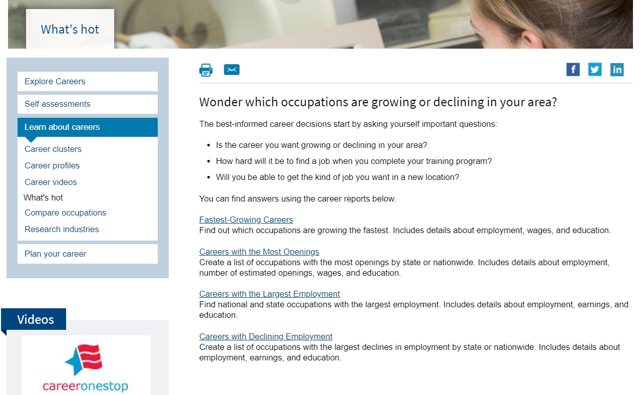
Career Reports: What’s hot?

Slide 18
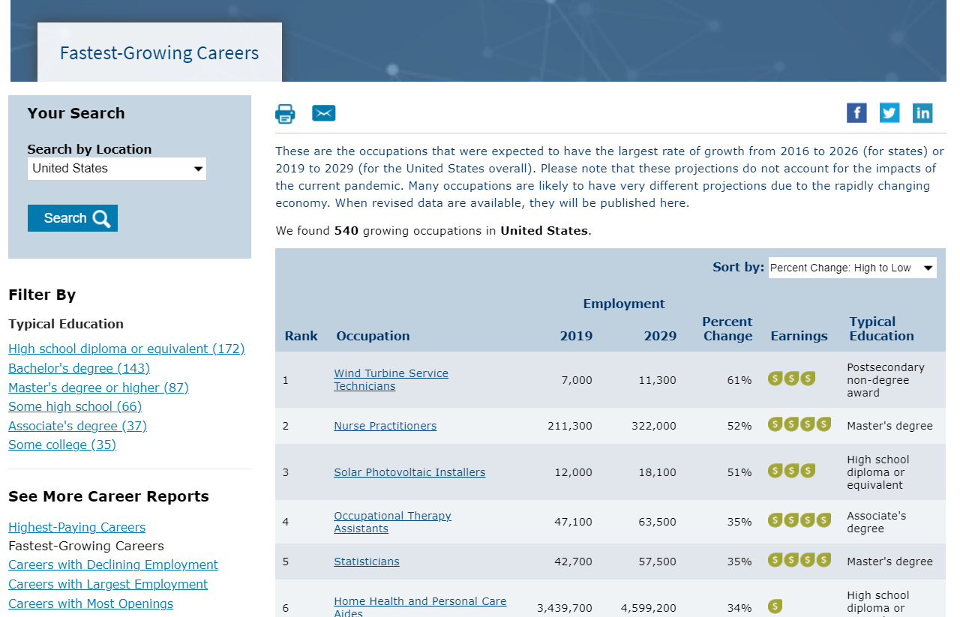
Fastest-Growing Careers

Slide 19
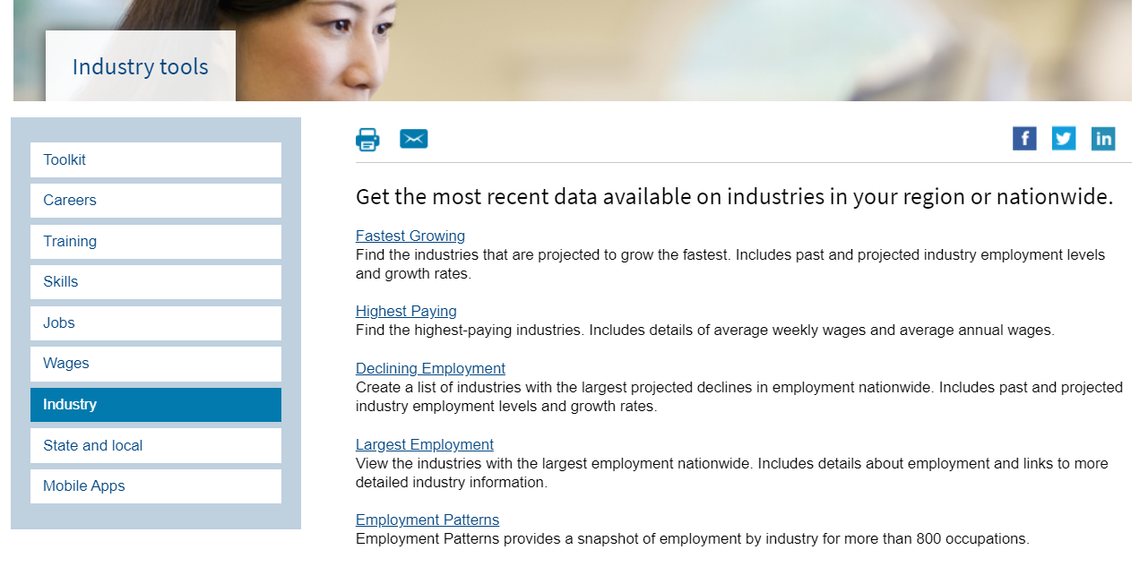
Industry Reports

Slide 20
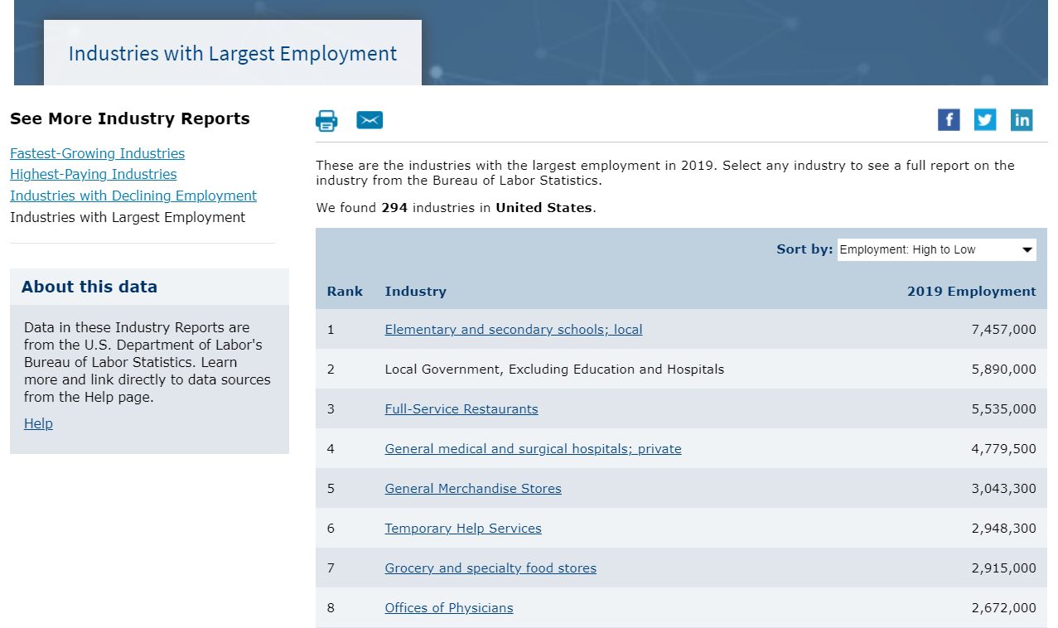
Industries with Largest Employment

Slide 21
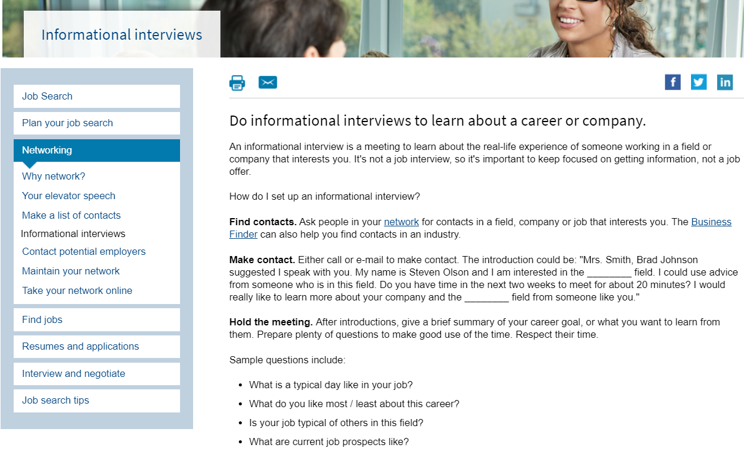
Informational Interviews

Slide 22
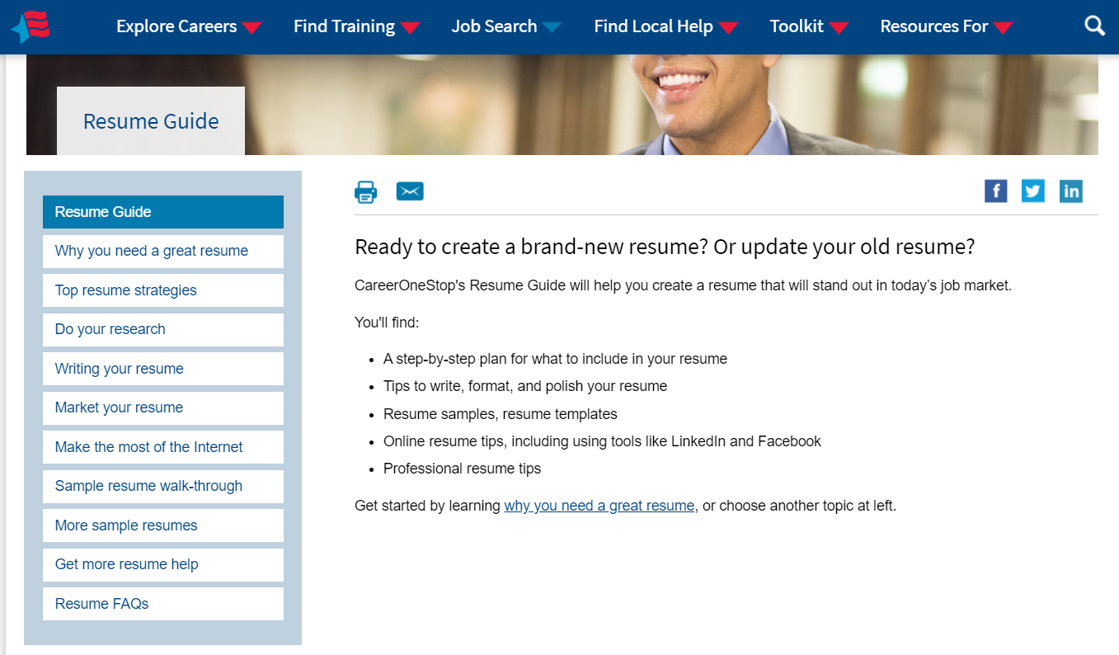
Resume Guide

Slide 23
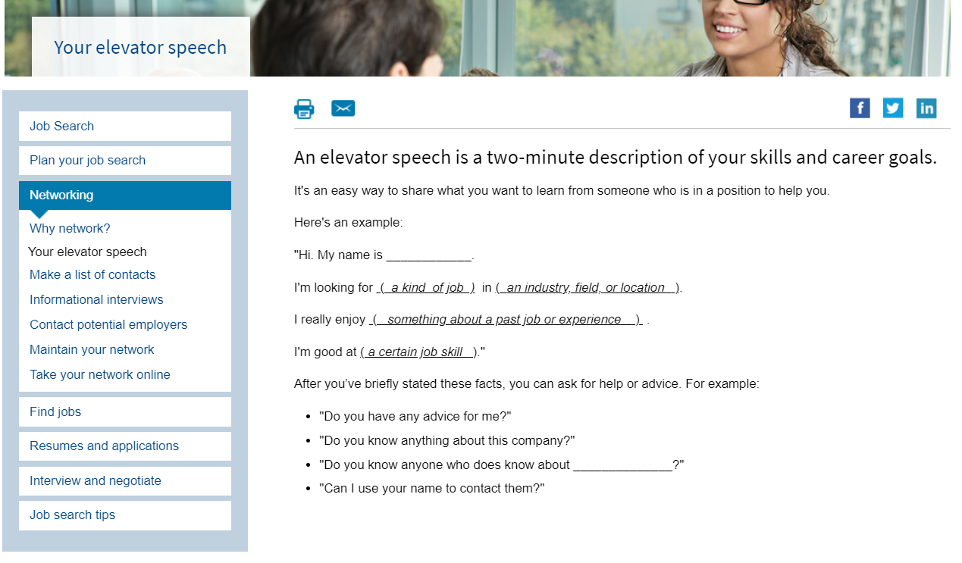
Elevator Speech

Slide 24
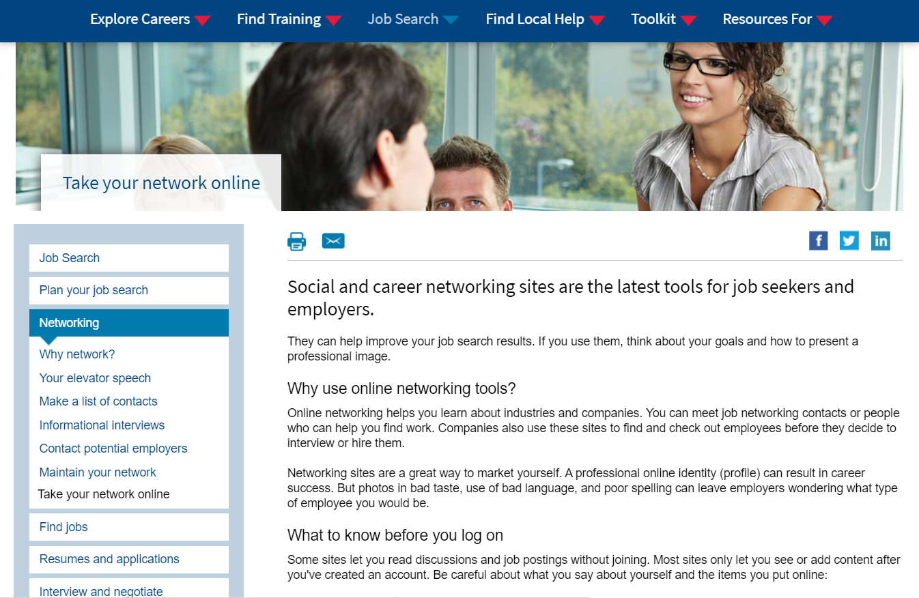
Social Media / Network Online

Slide 25
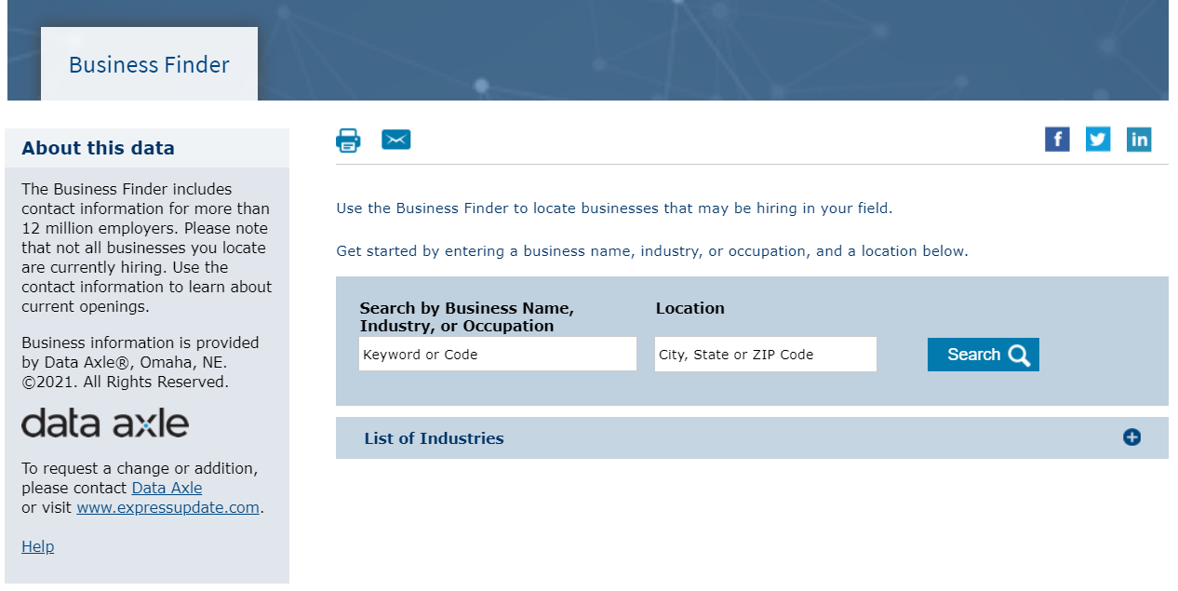
Business Finder

Slide 26
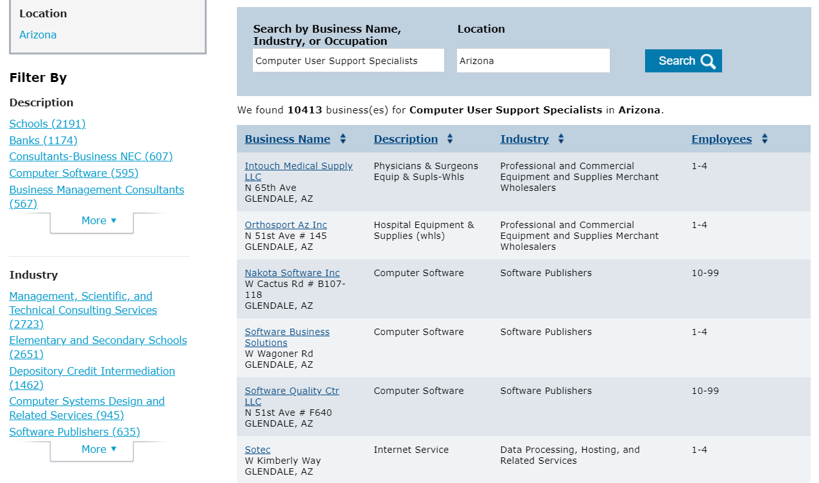
Business Finder Results Page

Slide 27
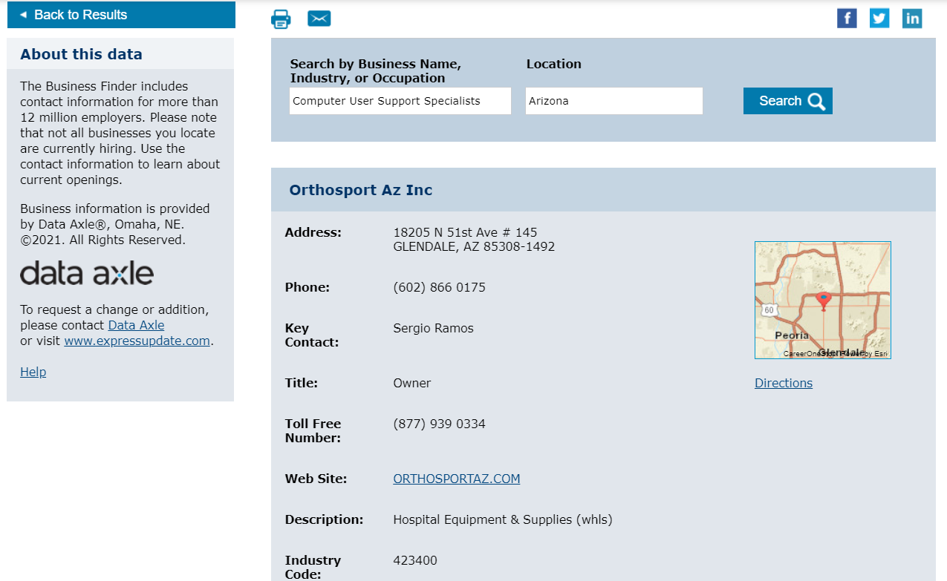
Business Finder: Detail Page

Slide 28
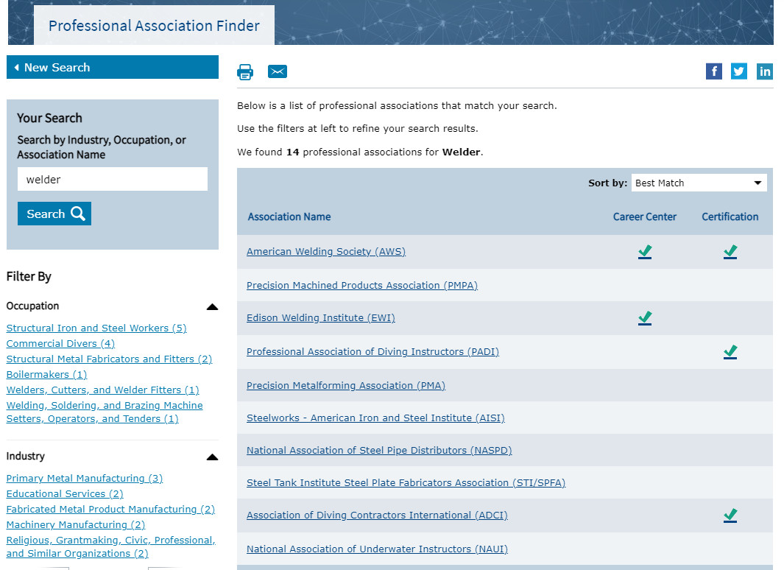
Professional Association Finder

Slide 29
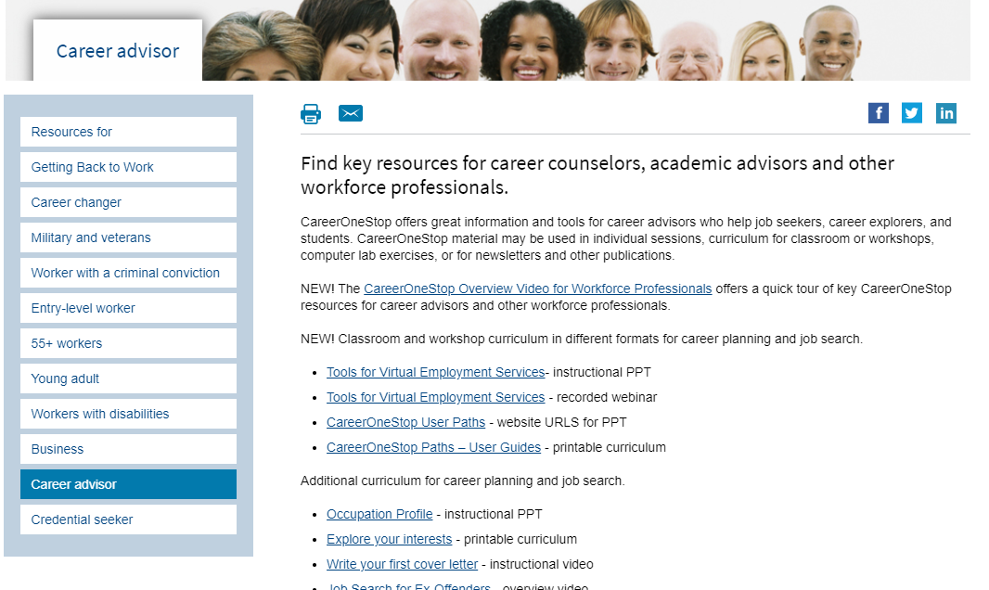
Career Advisors

