Slide 1
For Presenters:
Presentation Overview and Goals
The following presentation provides sample slides and talking points for individuals to use as a guide when presenting the Engineering Competency Model to a variety of audiences. This slide deck and corresponding talking points are comprehensive and should be used as a guide. Presenters should tailor the presentation to meet time restrictions and the needs of their specific audiences. The talking points included throughout are intended to provide the speaker with multiple options/suggestions for how to communicate the information presented according to their preferences, goals, and intended audience.
Objectives
Build awareness for the work that engineers do and their impact on society.
Encourage current and prospective engineering students to build the industry’s pipeline of qualitied professionals.
Communicate the essential skills/abilities for engineers to possess to succeed and advance in the profession.
Promote additional ways educators, associations and other influential audiences can share/promote or build on the Engineering Competency Model.
Target Audiences
Introductory Presentation:
  Current and prospective engineering students
  General audiences
Advanced Presentation:
  High school teachers and guidance counselors
  Engineering professors and faculty
  Engineering mentors, advocates, and champions
  Engineering association staff/members
  Other advanced audiences
Notes:
If someone has questions about the Engineering Competency Model, please refer him/her to the Competency Model Clearinghouse webpage, www.careeronestop.org/CMC/engineering.

Slide 2
STUDENT/INTRODUCTORY AUDIENCE PRESENTATION
(SLIDES 3-14)

Slide 3
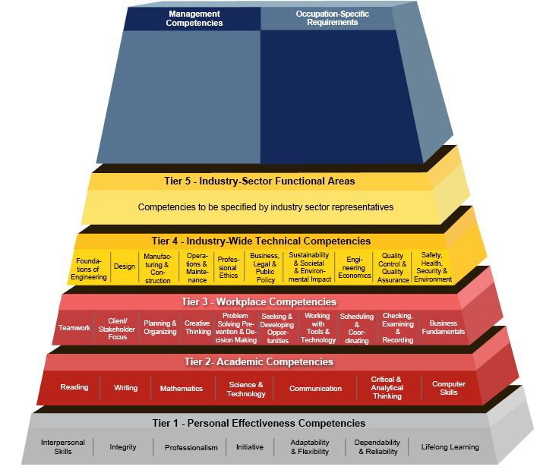
A Look Inside The
Engineering Competency Model
A joint initiative of the
engineering industry and academic community and the
United States Department of Labor, Employment and Training Administration
Notes:
If someone has questions about the Engineering Competency Model, please refer him/her to the Competency Model Clearinghouse webpage, www.careeronestop.org/CMC/engineering.

Slide 4

Impact of Engineering
Engineers solve the world’s
fundamental and most complex challenges.
Notes:
Engineers solve the world’s fundamental and most complex challenges – serving as the driving force in inventing, designing, building, improving, and sustaining the systems and structures we rely on.
The impact of engineers’ work is global: building our infrastructure to get us where we need to go, designing our energy systems to power our lives, and connecting the world’s networks to increase our productivity.
Thanks to the work of engineers, our roads and bridges are safer, our cars are more dependable, our food supply is safer and we are more globally connected than ever before.

Slide 5

Increasing Demand for Engineers
The engineering field is growing…
8.3%
Industry growth between 2016 & 2026
will provide over
139,300
new job openings
…and the nation needs more engineers to harness their capabilities to
build and sustain a better world.
Source: BLS 2016-2026 employment projections, http://www.bls.gov/emp
Notes:
The engineering field is growing, and the nation needs more engineers to harness their capabilities to build and sustain a better world.
According to projections from the U.S. Bureau of Labor Statistics, the engineering field will grow by 8.3% between 2016 and 2026, resulting in over 139,000 job openings due to growth and net replacements during that period.
Representatives from engineering societies and associations and the U.S. Department of Labor (DOL) developed an Engineering Competency Model to serve as a guide for the development of the engineering workforce to help America meet this demand.
Source: BLS 2016-2026 employment projections, http://www.bls.gov/emp

Slide 6



Meeting the Demand
Now is the time to develop the engineer of the future:
an individual ready and able
to rise to the challenge of meeting this industry demand.
To accomplish this goal, the U.S. Department of Labor, Employment and Training Administration worked with
subject matter experts from industry, education and government to develop the
Engineering Competency Model
Notes:
Now is the time to develop the engineer of the future: an individual ready and able to rise to the challenge of meeting this industry demand.
To accomplish this goal, the U.S. Department of Labor, Employment and Training Administration (ETA) and engineering subject matter experts from industry and education developed the Engineering Competency Model.
The model defines the skills required for current and aspiring engineers to advance and succeed.
Similar to the systems they build, engineers themselves have essential elements, or competencies, that are important to the performance of a dynamic and adaptable professional.

Slide 7
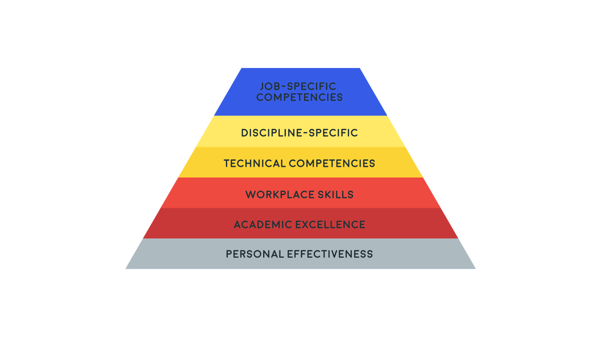
Competency Model
Notes:
Here is a general depiction of a competency model. It has a pyramid-like shape with different tiers. Each tier is made up of various competencies.
A competency is the capability to apply a set of related knowledge, skills, and abilities (KSAs) to successfully perform work tasks in an industry or field.
The model is designed to establish a consistent guideline for the profession, uniting the engineering industry around common competencies that are essential for success.
The model is intended for use by industry leaders, employers, human resource professionals, educators, workforce professionals and career counselors, as well as current and future engineers.
[Background for Presenter:
The model is intended for use by:
Industry leaders, employers and human resource professionals, to identify skill needs and assess competencies and performance
Educators/academics, to inform the development of competency-based curricula and training
Workforce professionals and career counselors, to develop resources for career exploration and guidance
Current and future engineers, to gain a clear understanding of the skills and abilities necessary to enter, advance and succeed in the industry]

Slide 8
Engineering Competency
Model
Notes:
Here is a detailed image of the Engineering Competency Model.
The Engineering Competency Model is a four-tier model. The tiers encompass the personal, academic, workplace and technical competencies that are common to the engineering profession, no matter whether you are engaged in mechanical, electrical, civil, or any other discipline of engineering.
A fifth tier can be added to identify discipline-specific competencies. This has not been completed for the Engineering Competency Model.
Tier 6, a final optional tier, is divided into two areas: competencies needed for management and for occupation-specific requirements for a particular position within the engineering profession.
The graphic shown here lists the different competencies within each tier. For example, interpersonal skills is shown as a personal effectiveness competency.

Slide 9

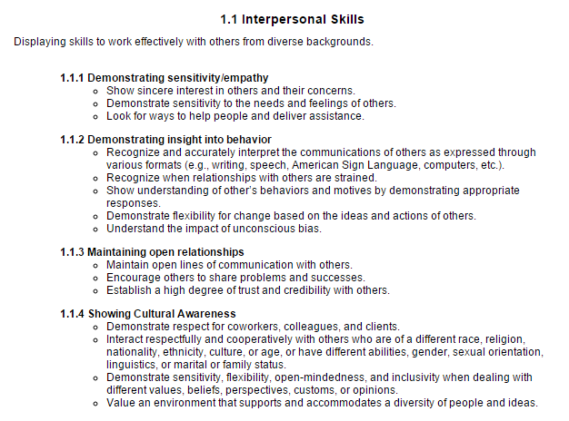
Engineering Competency Model
Notes:
The online model has more detailed explanations of each of those competencies. For example, the details behind the interpersonal skills competency are shown on this slide. I encourage you to go online to view these: www.careeronestop.org/CMC/engineering

Slide 10
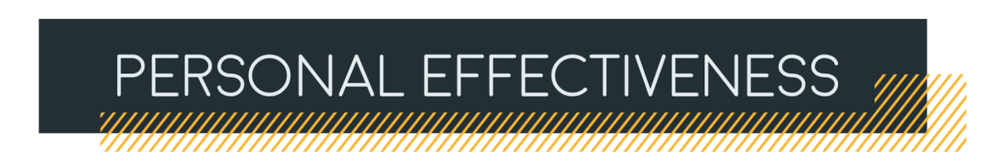



Core Competencies: Tiers 1 and 2
Tier 1
Lifelong Learning
Adaptability & Flexibility
Dependability & Reliability
Interpersonal Skills
Initiative
Integrity
Professionalism
Tier 2
Mathematics
Writing
Computer Skills
Reading
Critical & Analytical Thinking
Communication
Science & Technology
Notes:
The base of the model consists of Tiers 1-3, which represent the non-technical and work readiness skills that most employers demand.
Tiers 1 and 2 are shown here. Tier 1 encompasses personal effectiveness competencies and Tier 2 contains academic competencies.
First and foremost, effective engineers are effective people. Personal effectiveness competencies such as Interpersonal Skills, Integrity, Professionalism, Initiative, Adaptability and Flexibility, Dependability and Reliability, and an interest in Lifelong Learning are essential qualities engineers need to advance and succeed professionally.
Next is Tier 2 – Academic Competencies. Academically, engineers must be highly competent in the areas of math and science and technology, and possess computer and critical and analytical thinking skills. Reading, writing, and communication skills are necessary as well.
By combining these skills, engineers are equipped to think critically about the systems problems they need to solve, and to convey these ideas to varying audiences through numerous technology platforms.

Slide 11

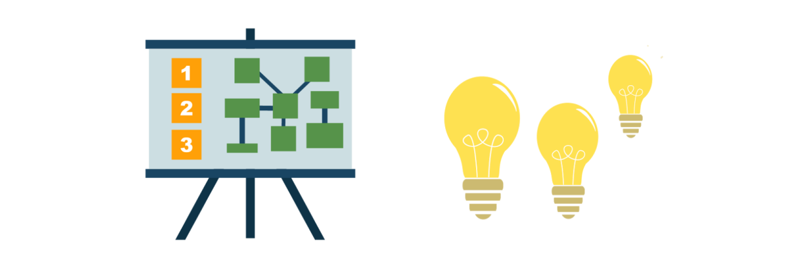
Workplace Competencies: Tier 3
Tier 3
Seeking & Developing Opportunities
Planning & Organizing
Scheduling & Coordinating
Working with Tools & Technology
Checking, Examining, & Recording
Client/ Stakeholder Focus
Business Fundamentals
Teamwork
Creative Thinking
Problem Solving, Prevention &
Decision Making
Notes:
Once engineers have demonstrated themselves to be competent and effective personally and academically, they must then apply these skills professionally in the workplace using competencies that are included in Tier 3. Engineers are team players that employ business fundamentals with internal collaborators and external clients and stakeholders.
Engineers approach on-the-job challenges with solutions – working with tools and technology, and leveraging project management skills and keen attention to detail to achieve a project’s desired results.
In the workplace, effective engineers leverage their planning and organizational skills and creative thinking ability to approach challenges with solutions.

Slide 12
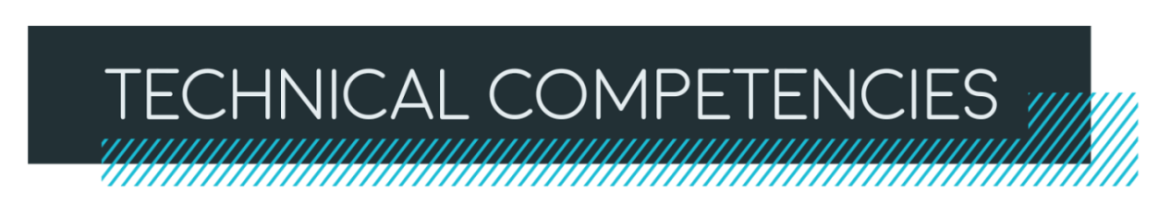

Industry-Wide Technical Competencies: Tier 4
Tier 4
Professional Ethics
Design
Quality Control & Quality Assurance
Foundations of Engineering
Safety, Health, Security, & Environment
Manufacturing
& Construction
Engineering Economics
Business, Legal, & Public Policy
Operations & Maintenance
Sustainability & Societal & Environmental Impact
Notes:
Tier 4 highlights essential industry-wide competencies.
From the office to the field, engineers’ technical competencies are key. Engineers practice the foundations of engineering – overlaying industry-wide knowledge with discipline-specific expertise, while maintaining a continual focus on the pillars of engineering design, quality, sustainability, security, and professional ethics. Manufacturing and construction; operations and maintenance; business, legal and public policy; engineering economics; and quality control and assurance are additional vital industry-wide competencies.
As mentioned earlier, we consider this a "Tier 4" model, which means that it addresses industry-wide requirements that are common to all sectors of engineering. It does not go into the requirements unique to specific branches of engineering, which is why there is no Tier 5 at this time.

Slide 13





Engineering Outcomes
When engineers apply these fundamental skills in their daily work, they design, improve, and sustain
the systems and structures we rely on.
DEPENDABLE INFRASTRUCTURE
Sustainable Power
GLOBALLY
CONNECTED
NETWORKS
SAFE FOOD AND WATER SUPPLY
Become an engineer, and you too can help to solve the world’s problems competently and with confidence.
Notes:
How can we meet the demand for more engineers? By inspiring people – smart, effective people – that want to work in a profession where they are empowered to solve the world’s challenges using a unique set of personal, academic, and technical skills.
When engineers apply these fundamental skills in their daily work, they design, improve, and sustain the systems and structures we rely on. As a result, our roads and bridges are safer, our cars are more dependable, our food and water supplies are healthier, and we are more globally connected than ever before.
By leveraging this integrated system of core engineering competencies, we are building high caliber engineers of the future that will equip the industry to amplify its growing impact.
Become an engineer, and you too can help to solve the world’s problems competently and with confidence.

Slide 14


DO YOU HAVE WHAT IT TAKES TO ENGINEER OUR FUTURE?
Visit www.careeronestop.org/CMC/engineering
to learn more about the
Engineering Competency Model
This presentation and the development of the model was made possible through the support of the
United Engineering Foundation.
Notes:
Do you have what it takes to engineer our future? Visit the Competency Model Clearinghouse at www.careeronestop.org/CMC/engineering to learn more about the Engineering Competency Model and access additional resources related to the model.
This presentation and the development of the model was made possible through a grant by the United Engineering Foundation.

Slide 15
ADVANCED AUDIENCE PRESENTATION
(Slides 16-35)
Note: Many slides within this presentation are considered optional and should be tailored to meet the needs of your audience.

Slide 16
A Look Inside The
Engineering Competency Model
A joint initiative of the
engineering industry and academic community and the
United States Department of Labor, Employment and Training Administration
Notes:
If someone has questions about the Engineering Competency Model, please refer him/her to the Competency Model Clearinghouse webpage, www.careeronestop.org/CMC/engineering.

Slide 17
Impact of Engineering
Engineers solve the world’s
fundamental and most complex challenges.
Notes:
Engineers solve the world’s fundamental and most complex challenges – serving as the driving force in inventing, designing, building, improving, and sustaining the systems and structures we rely on.
The impact of engineers’ work is global: building our infrastructure to get us where we need to go, designing our energy systems to power our lives, and connecting the world’s networks to increase our productivity.
Thanks to the work of engineers, our roads and bridges are safer, our cars are more dependable, our food supply is safer and we are more globally connected than ever before.

Slide 18
Increasing Demand for Engineers
The engineering field is growing…
8.3%
Industry growth between 2016 & 2026
will provide over
139,300
new job openings
…and the nation needs more engineers to harness their capabilities to
build and sustain a better world.
Source: BLS 2016-2026 employment projections, http://www.bls.gov/emp
Notes:
The engineering field is growing, and the nation needs more engineers to harness their capabilities to build and sustain a better world.
According to projections from the U.S. Bureau of Labor Statistics, the engineering field will grow by 8.3% between 2016 and 2026, resulting in over 139,000 job openings due to growth and net replacements during that period.
Representatives from engineering societies and associations and the U.S. Department of Labor (DOL) developed an Engineering Competency Model to serve as a guide for the development of the engineering workforce to help America meet this demand.
Source: BLS 2016-2026 employment projections, http://www.bls.gov/emp

Slide 19
Meeting the Demand
Now is the time to develop the engineer of the future:
an individual ready and able
to rise to the challenge of meeting this industry demand.
To accomplish this goal, the U.S. Department of Labor, Employment and Training Administration (ETA) worked with
subject matter experts from industry, education and government to develop the
Engineering Competency Model
Notes:
Now is the time to develop the engineer of the future: an individual ready and able to rise to the challenge of meeting this industry demand.
To accomplish this goal, the U.S. Department of Labor, Employment and Training Administration (ETA) and engineering subject matter experts from industry and education developed the Engineering Competency Model.
The model defines the skills required for current and aspiring engineers to advance and succeed.
Similar to the systems they build, engineers themselves have essential elements, or competencies, that are important to the performance of a dynamic and adaptable professional.

Slide 20

The Industry Competency Model Initiative
What is it?
ETA and industry partners collaborate to develop and maintain dynamic models of the foundation and technical competencies that are necessary in economically vital industries and sectors of
the American economy.
www.careeronestop.org/competencymodel/
Notes:
The Industry Competency Model Initiative is part of Employment and Training Administration’s (ETA) effort to create a dynamic, well-trained, competitive workforce. As part of the initiative, ETA works collaboratively with other federal agencies, industry associations, community colleges, and other subject matter experts to develop and maintain competency models for economically vital industries and sectors of the American economy.

Slide 21

















Partners in the Engineering Community
Notes:
As mentioned earlier, the development if the Engineering Competency Model was a joint effort between the U.S. Department of Labor and industry and academic experts. Presented on this slide are the engineering and engineering-related professional societies that were involved in this effort.

Slide 22

Competency Model as a Roadmap
What is a competency?
The capability to apply a set of related knowledge, skills, and abilities to successfully perform functions or tasks.
What is a competency model?
A collection of competencies that together define successful performance in a particular industry or field.
Notes:
How are we defining competencies? And what do we mean by “competency models”? As you can see on the slide, we have some formal definitions. A competency is the ability to apply knowledge, skills, and abilities – KSAs – to perform work tasks in an industry or field. For example, if someone possesses a “Critical and Analytical Thinking” competency, he or she is able to use logic, reasoning, and analysis to address problems.
ETA’s competency models are a convenient way to organize and communicate the competencies needed in a specific industry or profession.

Slide 23
Competency Model as a Resource
Competency Models are a key resource for developing a strong workforce.
How? By…
Identifying specific employer skill needs
Developing competency-based curricula and training models
Developing industry-defined performance indicators, skill standards, and certifications
Developing resources for career exploration and guidance
For?
Industry leaders
Human resources professionals
Educators
Economic developers
Public workforce professionals
Students
Associations
Notes:
Why do we produce competency models? How can they be used to develop a strong workforce?
The national industry and professional models are primarily a resource or tool for developing more specific end products. For example, competency models can be used to identify specific employer skill needs; develop competency-based curricula and training modules; develop industry-defined performance indicators, skills standards, and certifications; and help individuals explore careers.
Because of the many applications of competency models, there are a number of people who may find them useful, including employers and industry leaders, human resource professionals, educators, economic developers, public workforce professionals, students, and associations.

Slide 24
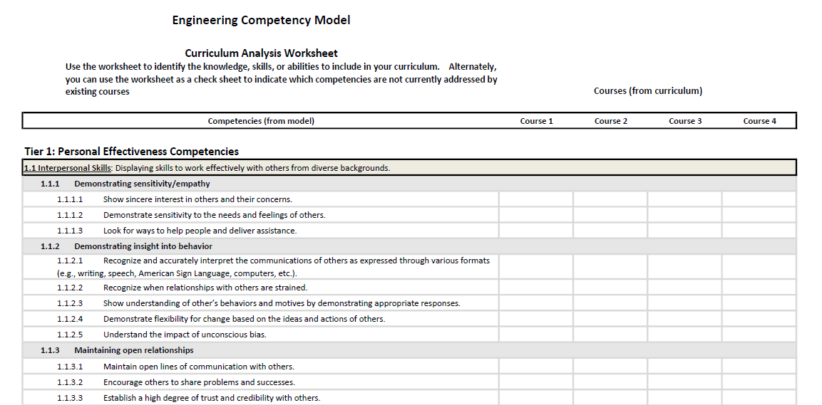
Application of a Competency Model
Competency Models hold practical applications in a variety of settings. Educators, for example, can use the model to identify the knowledge, skills, or abilities to include in curriculum, or as a checklist to indicate which competencies are not currently addressed by existing courses.
Worksheets from the Competency Model Clearinghouse assist in curriculum analysis, like the example below, as well as in employer skill needs analysis, competency gap analysis, and the identification of credential competencies.
Notes:
As an example of a practical application of the model, we’ll explore the Geospatial Competency Model. Geospatial educators across the country were developing and updating curriculum. DOL worked with the GeoTech Center (funded in part by the National Science Foundation) and other subject matter experts to develop a geospatial competency model. The educators then put all of the elements of the model into a spreadsheet, put their courses across the top, and placed checks in the boxes to indicate which competencies were covered in which courses. As a result of this exercise they discovered that there were some competencies that they themselves had identified as essential but that were not covered in any of the courses! There were also competencies covered in multiple courses—which can be fine—but that needed to be examined carefully to make sure an advanced course is building on knowledge in foundational courses and adding to that, rather than repeating it.
As a result of this work, the Competency Model Clearinghouse site now has downloadable worksheets for curriculum development and similar purposes. Every model posted on the site has these resources available.

Slide 25
Developing the Engineering Competency Model
The Process:
Established a collaboration between an industry working group and ETA.
Developed a draft based on the ETA template and a review of extensive background information, including accreditation criteria, Bodies of Knowledge (BOKs) from engineering societies, curricula from academic institutions, and more.
The draft model was reviewed three times by Subject Matter Experts (SMEs) from 8 engineering societies.
Held a stakeholder webinar to gather feedback and input on the draft model.
Conducted a survey to solicit feedback from the engineering community.
Finalized the model via a virtual validation meeting.
Gained endorsement from the engineering representative body.
Finalized the documentation and launched the model.
Notes:
To begin development of the model, the U.S. Department of Labor’s Employment and Training Administration assigned a dedicated research team to oversee the project, and industry organizations provided individuals to serve on a working group. The working group members supplied a vast number of sources of competency information to review, including ABET accreditation criteria, bodies of knowledge from various engineering societies, the Project Lead the Way outline, and curricula and related resources from academic institutions around the country.
The working group also identified subject matter experts from engineering societies representing industry and academia to assist the research team in developing and critiquing the draft model.
Throughout the development of the Engineering Competency Model, the working group sought to gather feedback and input from stakeholders across the engineering community, from educators of future engineers to those who employ engineers. A webinar was held to explain the development process, discuss how the model could be a useful tool for engineering-related societies in the future, and get feedback on the preliminary draft.
The working group also distributed a survey to solicit feedback from the engineering community and gathered input from over 100 engineering leaders. The survey data, analyzed by the DOL team, was considered when updating and revising the model and was part of the agenda for the model validation meeting.
With the assistance of the DOL team, the working group held a model validation meeting with the participating subject matter experts and representatives from other engineering community organizations to gather additional insight and finalize the Engineering Competency Model.
After the final revisions were made, the Engineering Competency Model was endorsed by engineering working group and launched on the DOL’s Competency Model Clearinghouse.

Slide 26
Value of the Engineering Competency Model
Unites the profession around common skills and competencies that are essential for success
Provides a model for industry leaders, employers, and HR professionals to identify skill needs and assess competencies and performance
Informs educators/academics on the development of competency-based curricula and training
Helps workforce professionals/career counselors develop resources for career exploration and guidance
Allows current and future engineers to gain a clear understanding of the skills and abilities necessary to enter, advance, and succeed in the industry
Notes:
The model is designed to establish a more consistent guideline for the profession, uniting the engineering industry around common competencies that are essential for success.
The model is intended for use by:
Industry leaders, employers and human resource professionals, to identify skill needs and assess competencies and performance
Educators/academics, to inform the development of competency-based curricula and training
Workforce professionals and career counselors, to develop resources for career exploration and guidance
Current and future engineers, to gain a clear understanding of the skills and abilities necessary to enter, advance and succeed in the industry

Slide 27
Competency Model
Notes:
Here is a general depiction of a competency model. It has a pyramid-like shape with different tiers. Each tier is made up of various competencies.
A competency is the capability to apply a set of related knowledge, skills, and abilities (KSAs) to successfully perform work tasks in an industry or field.
The model is designed to establish a consistent guideline for the profession, uniting the engineering industry around common competencies that are essential for success.
The model is intended for use by industry leaders, employers, human resource professionals, educators, workforce professionals and career counselors, as well as current and future engineers.
[Background for Presenter:
The model is intended for use by:
Industry leaders, employers and human resource professionals, to identify skill needs and assess competencies and performance
Educators/academics, to inform the development of competency-based curricula and training
Workforce professionals and career counselors, to develop resources for career exploration and guidance
Current and future engineers, to gain a clear understanding of the skills and abilities necessary to enter, advance and succeed in the industry]

Slide 28
Engineering Competency
Model
Notes:
Here is a detailed image of the Engineering Competency Model.
The Engineering Competency Model is a four-tier model. The tiers encompass the personal, academic, workplace and technical competencies that are common to the engineering profession, no matter whether you are engaged in mechanical, electrical, civil, or any other discipline of engineering.
A fifth tier can be added to identify discipline-specific competencies. This has not been completed for the Engineering Competency Model.
Tier 6, a final optional tier, is divided into two areas: competencies needed for management and for occupation-specific requirements for a particular position within the engineering profession.
The graphic shown here lists the different competencies within each tier. For example, interpersonal skills is shown as a personal effectiveness competency.

Slide 29
Engineering Competency Model
Notes:
The online model has more detailed explanations of each of those competencies. For example, the details behind the interpersonal skills competency are shown on this slide. I encourage you to go online to view these: www.careeronestop.org/CMC/engineering

Slide 30
Core Competencies: Tiers 1 and 2
Tier 1
Lifelong Learning
Adaptability & Flexibility
Dependability & Reliability
Interpersonal Skills
Initiative
Integrity
Professionalism
Tier 2
Mathematics
Writing
Computer Skills
Reading
Critical & Analytical Thinking
Communication
Science & Technology
Notes:
The base of the model consists of Tiers 1-3, which represent the non-technical and work readiness skills that most employers demand.
Tiers 1 and 2 are shown here. Tier 1 encompasses personal effectiveness competencies and Tier 2 contains academic competencies.
First and foremost, effective engineers are effective people. Personal effectiveness competencies such as Interpersonal Skills, Integrity, Professionalism, Initiative, Adaptability and Flexibility, Dependability and Reliability, and an interest in Lifelong Learning are essential qualities engineers need to advance and succeed professionally.
Next is Tier 2 – Academic Competencies. Academically, engineers must be highly competent in the areas of math and science and technology, and possess computer and critical and analytical thinking skills. Reading, writing, and communication skills are necessary as well.
By combining these skills, engineers are equipped to think critically about the systems problems they need to solve, and to convey these ideas to varying audiences through numerous technology platforms.

Slide 31
Workplace Competencies: Tier 3
Tier 3
Seeking & Developing Opportunities
Planning & Organizing
Scheduling & Coordinating
Working with Tools & Technology
Checking, Examining, & Recording
Client/ Stakeholder Focus
Business Fundamentals
Teamwork
Creative Thinking
Problem Solving, Prevention &
Decision Making
Notes:
Once engineers have demonstrated themselves to be competent and effective personally and academically, they must then apply these skills professionally in the workplace using competencies that are included in Tier 3. Engineers are team players that employ business fundamentals with internal collaborators and external clients and stakeholders.
Engineers approach on-the-job challenges with solutions – working with tools and technology, and leveraging project management skills and keen attention to detail to achieve a project’s desired results.
In the workplace, effective engineers leverage their planning and organizational skills and creative thinking ability to approach challenges with solutions.

Slide 32
Industry-Wide Technical Competencies: Tier 4
Tier 4
Professional Ethics
Design
Quality Control & Quality Assurance
Foundations of Engineering
Safety, Health, Security, & Environment
Manufacturing
& Construction
Engineering Economics
Business, Legal, & Public Policy
Operations & Maintenance
Sustainability & Societal & Environmental Impact
Notes:
Tier 4 highlights essential industry-wide competencies.
From the office to the field, engineers’ technical competencies are key. Engineers practice the foundations of engineering – overlaying industry-wide knowledge with discipline-specific expertise, while maintaining a continual focus on the pillars of engineering design, quality, sustainability, security, and professional ethics. Manufacturing and construction; operations and maintenance; business, legal and public policy; engineering economics; and quality control and assurance are additional vital industry-wide competencies.
As mentioned earlier, we consider this a "Tier 4" model, which means that it addresses industry-wide requirements that are common to all sectors of engineering. It does not go into the requirements unique to specific branches of engineering, which is why there is no Tier 5 at this time.

Slide 33
Engineering Outcomes
When engineers apply these fundamental skills in their daily work, they design, improve, and sustain
the systems and structures we rely on.
DEPENDABLE INFRASTRUCTURE
Sustainable Power
GLOBALLY
CONNECTED
NETWORKS
SAFE FOOD AND WATER SUPPLY
Become an engineer, and you too can help to solve the world’s problems competently and with confidence.
Notes:
How can we meet the demand for more engineers? By inspiring people – smart, effective people – that want to work in a profession where they are empowered to solve the world’s challenges using a unique set of personal, academic, and technical skills.
When engineers apply these fundamental skills in their daily work, they design, improve, and sustain the systems and structures we rely on. As a result, our roads and bridges are safer, our cars are more dependable, our food and water supplies are healthier, and we are more globally connected than ever before.
By leveraging this integrated system of core engineering competencies, we are building high caliber engineers of the future that will equip the industry to amplify its growing impact.
Become an engineer, and you too can help to solve the world’s problems competently and with confidence.

Slide 34
What Can You Do?
Help build the engineering workforce of the future by:
Adopting the model in your workplace, across your association, or in your classroom
Developing a Tier-5 model to build on the Engineering Competency Model with discipline-specific competencies and technical skills
Sharing the content and value of the model with educators, guidance counselors, administrators, students, and parents to increase awareness and interest in engineering
Strategizing real-world applications for how the model can be leveraged in academic curricula, workplace trainings, and beyond
Providing feedback on the model and its use
Notes:
You can help increase the awareness and impact of the model – a goal that cannot be achieved without support from industry leaders and champions of the model.
Help build the engineering workforce of the future by:
Adopting the model in your workplace, across your association, or in your classroom
Developing a Tier-5 model to build on the Engineering Competency Model with discipline-specific competencies and technical skills
Sharing the content and value of the model with educators, guidance counselors, administrators, students, and parents to increase awareness and interest in engineering
Strategizing real-world applications for how the model can be leveraged in academic curricula, workplace trainings, and beyond
Providing feedback on the model and its use

Slide 35
Help build the engineering
workforce of
the future.
Visit www.careeronestop.org/CMC/engineering
to learn more about the
Engineering Competency Model
This presentation and the development of the model was made possible through the support of the
United Engineering Foundation.
Notes:
Help build the engineering workforce of the future. Visit the Competency Model Clearinghouse at www.careeronestop.org/CMC/engineering to learn more about the Engineering Competency Model and access additional resources related to the model.
This presentation and the development of the model was made possible through a grant by the United Engineering Foundation.

