Slide 1

A Competency Model Approach
Employment and Training Administration
United States Department of Labor

Slide 2
Competency Models
What is a competency?
  The capability to apply a set of related knowledge, skills, and abilities to successfully perform work functions or tasks.
What is a competency model?
  A collection of competencies that together define successful performance in a particular industry or field
  A resource with various uses (not an end-product)
Notes:
How are we defining competencies?
And what do we mean by “competency models”?
As you can see on the slide, we have some formal definitions.
A competency is the ability to apply knowledge, skills, and abilities – KSAs – to perform work tasks in an industry or field.
For example, if someone possesses a “Critical and Analytical Thinking” competency, he or she is able to use logic, reasoning, and analysis to address problems.
ETA’s competency models are a convenient way to organize and communicate the competencies needed in a specific industry sector.

Slide 3
Who Uses Competency Models?
Private Industry Leaders
Trainers and Educators
Human Resources Professionals
Public Workforce Professionals
Economic Developers
Notes:
Because of the many applications of competency models, there are a number of people who may find them useful, including:
Employers and industry leaders,
Trainers and educators,
Human resources professionals,
Public workforce professionals, and
Economic developers.

Slide 4
Why Competency Models?
Competency Models can help…
  Identify and communicate industry needs
  Improve worker training programs
  Develop industry-defined performance indicators
  Develop resources for career exploration
  Provide national/regional framework to inform state certification programs
Notes:
Why do we produce competency models? How can they be used to develop a strong workforce?
The national industry models are primarily a resource or tool for developing more specific end products.
For example, competency models can be used to:
Identify specific employer skill needs,
Inform employee recruitment and development,
Develop and enhance curricula and training programs,
Develop industry defined performance indicators, assessments, and certifications,
Develop resources for career exploration and guidance, and
Provide a national framework to inform state certification programs.

Slide 5
Competency Model Features
Competency Model
National, crosscutting, and industry-wide
Represents broad industry level
Does not describe a standard of performance
Workers do not have every skill at the same level
Notes:
As a result of consultation with industry stakeholders and educators across the country, the models reflect competencies that are national, crosscutting and industry wide.
Because the competencies are at the broad industry level, derived from national input, they may not all be applicable to a particular employer. Users are encouraged to revise and customize the models to address their particular needs.
The competencies do not describe a standard of performance; rather they describe a “baseline” of skills that workers in a particular field should strive to attain and build upon.
It is understood that all workers in a given industry do not have every skill at the same level. Again, the model describes a baseline that workers should strive to attain but naturally abilities and knowledge will vary with the individual and their work role.

Slide 6
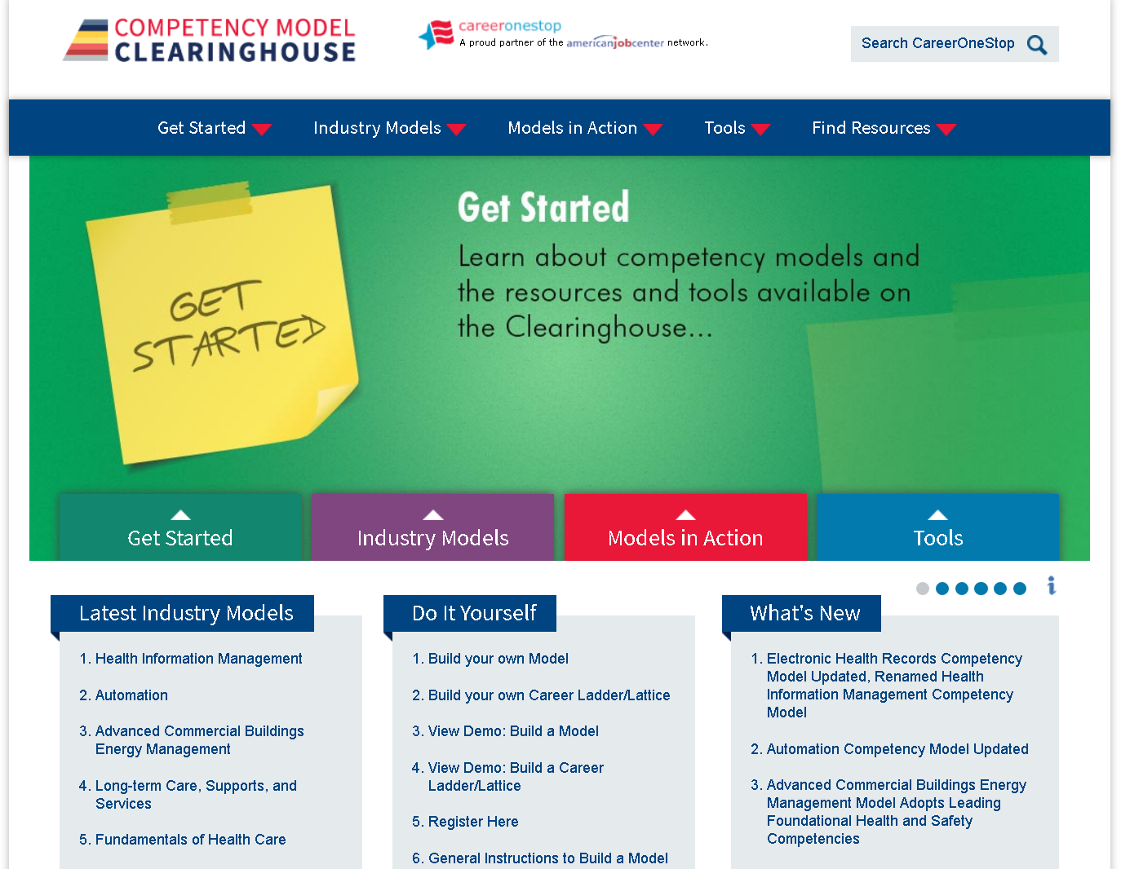
Competency Model Clearinghouse
Notes:
The Competency Model Clearinghouse at https://www.careeronestop/competencymodel/ is the website for accessing all the industry models. It houses 27 unique industry competency models and provides users with a number of helpful resources and tools.

Slide 7
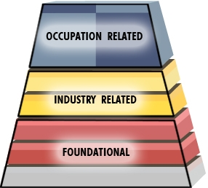
Competency Model Framework
Tier Groupings
Notes:
All of our competency models are created using the pyramid model structure. This pyramidal structure is ETA’s method of displaying related competencies.
The bottom three tiers are the foundational competencies, sometimes referred to as the building blocks, which are based on the Building Blocks Model.
In the yellow part of the pyramid we have the Industry Tiers 4 and 5:
Tier 4 represents cross-cutting industry-wide competencies
Tier 5 represents industry-sector specific competencies
In the blue area at the top are the occupation-specific competencies.
ETA’s models do not address occupation-specific competencies. This information is captured in the O*NET database and is also developed during regional or local customization efforts.

Slide 8
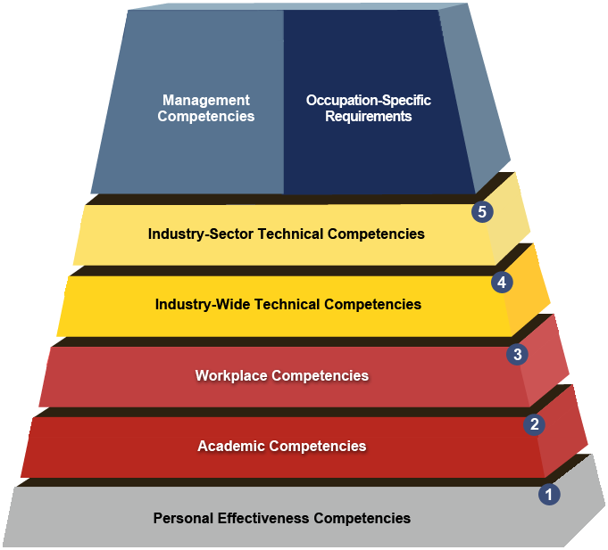
Competency Model Tiers
Tiers
Notes:
Here you can see that there are three foundational tiers:
Personal effectiveness—often called soft skills
Academic competencies
Workplace competencies

Slide 9
Competency Model
Water and Wastewater Competency Model
Notes:
Now let’s look at an example. Let’s review the completed Water and Wastewater Competency Model to demonstrate employer engagement and real data within the tiers.

Slide 10








Model Industry Champions
Notes:
This slide represents the partners and champions the Employment and Training Administration worked with in the development of the Water and Wastewater Competency Model.

Slide 11
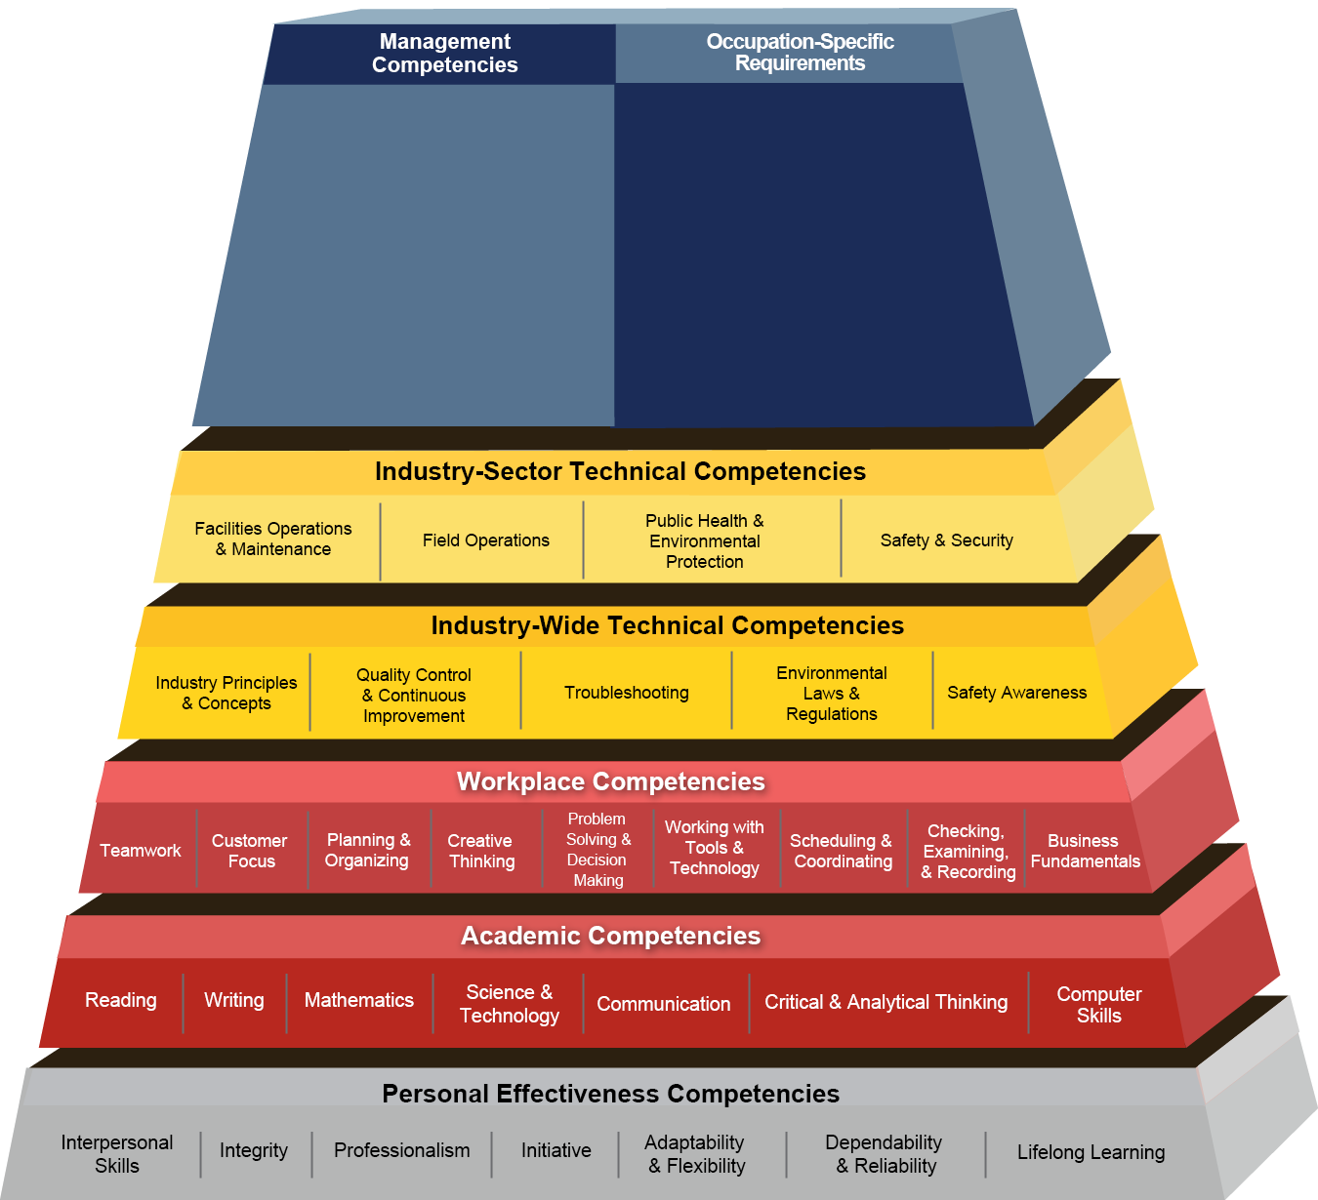
Water and Wastewater Competency Model
Notes:
And here is the water model itself—we will take a closer look at the industry tiers on the next slide.

Slide 12
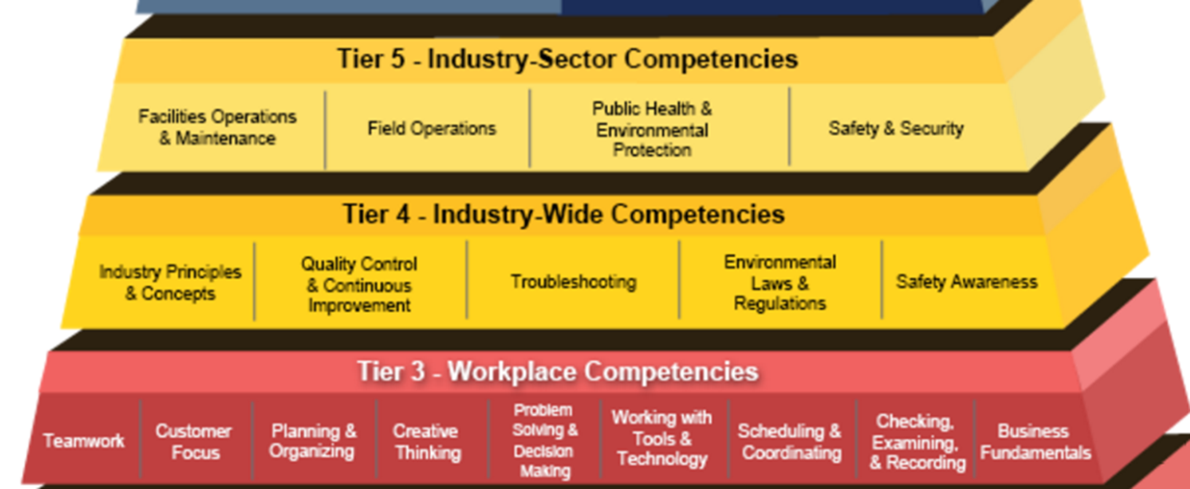
Workforce Content Addressed in Model Update
Automation/Supervisory Control and Data Acquisition (SCADA) Systems
Integrated Water Resources Management
Cybersecurity and Information Security
Decentralized Wastewater Treatment Systems
Environmental Regulations and Laws
Water Resilience
Notes:
Among the concepts that were added or given greater focus in the most recent update of the model are:
Supervisory control and data acquisition (SCADA) systems
Integrated water resources management
Cybersecurity and information security
Not everyone would even think about the role of cybersecurity when it comes to water utilities—but given automated controls and the Internet of Things—cybersecurity is in fact a real concern.
Decentralized wastewater treatment systems
Water resilience

Slide 13
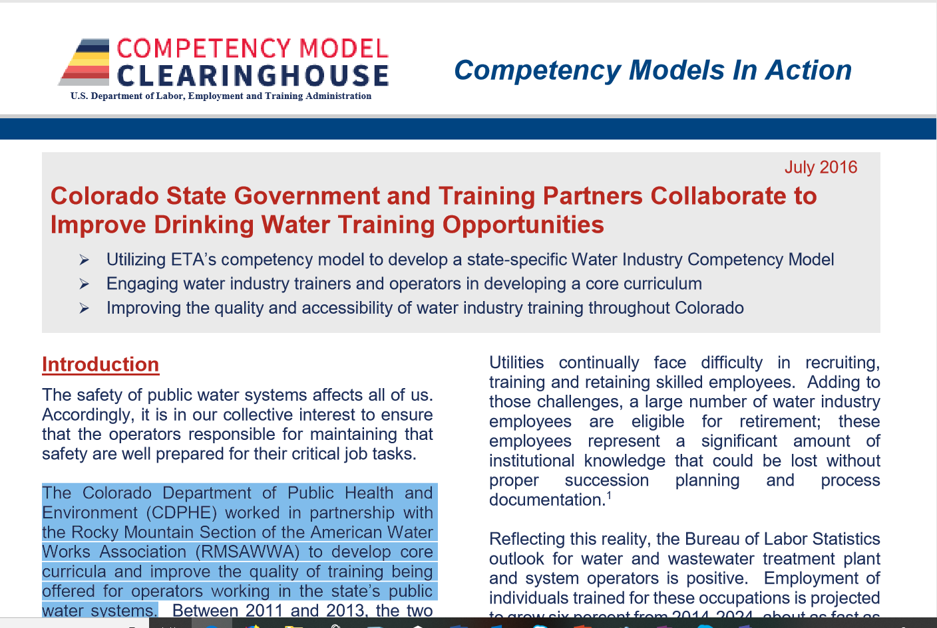
Competency Model In Action- Colorado
Notes:
Let’s talk about how these models are used. The Colorado Department of Public Health and Environment worked in partnership with the Rocky Mountain Section of the American Water Works Association to develop core curricula and improve the quality of training being offered for operators working in the state’s public water systems.
You can find out more about this collaboration on the Models In Action section of the Competency Model Clearing House.
You may access the article at: https://www.careeronestop.org/CompetencyModel/info_documents/water-casesummary.pdf

Slide 14
Competency Model In Action- Colorado
Conducted a Root Cause Analysis to Identify Where State Systems Struggle
Held a series of roundtables
  To bring together water industry training partners
    Community colleges
    Industry organizations,
    Non-profits,
    For-profit training firms
    Government agencies
    Industry operators
With a goal to determine how to improve training for water occupations in the state
Notes:
Those two partners worked together and convened these additional training partners to develop a curriculum to improve training and make it more consistent in areas across the state.

Slide 15
Competency Model In Action- Colorado
Areas of Focus
  Define Core Curriculum
  Identify training gaps
Notes:
Their goal was to define a core curriculum—and to identify and address training gaps in various programs across the state.

Slide 16
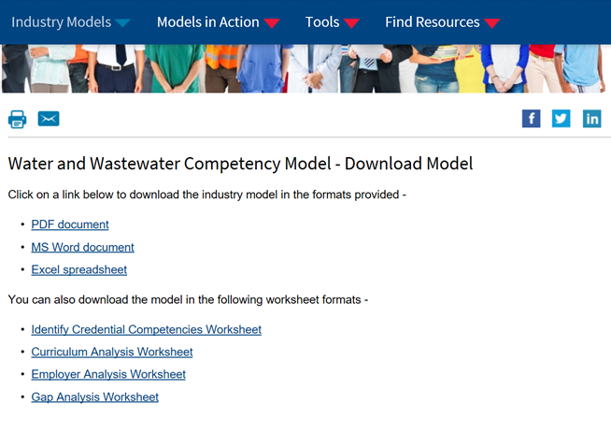
Tools They Used
Notes:
Each competency model has several formats and worksheets available to assist you as you work with industry to customize models and develop training.
This slide shows two worksheets likely used by the Colorado team in their efforts—1) Identify Credential Competencies, and 2) Employer Analysis worksheets.

Slide 17
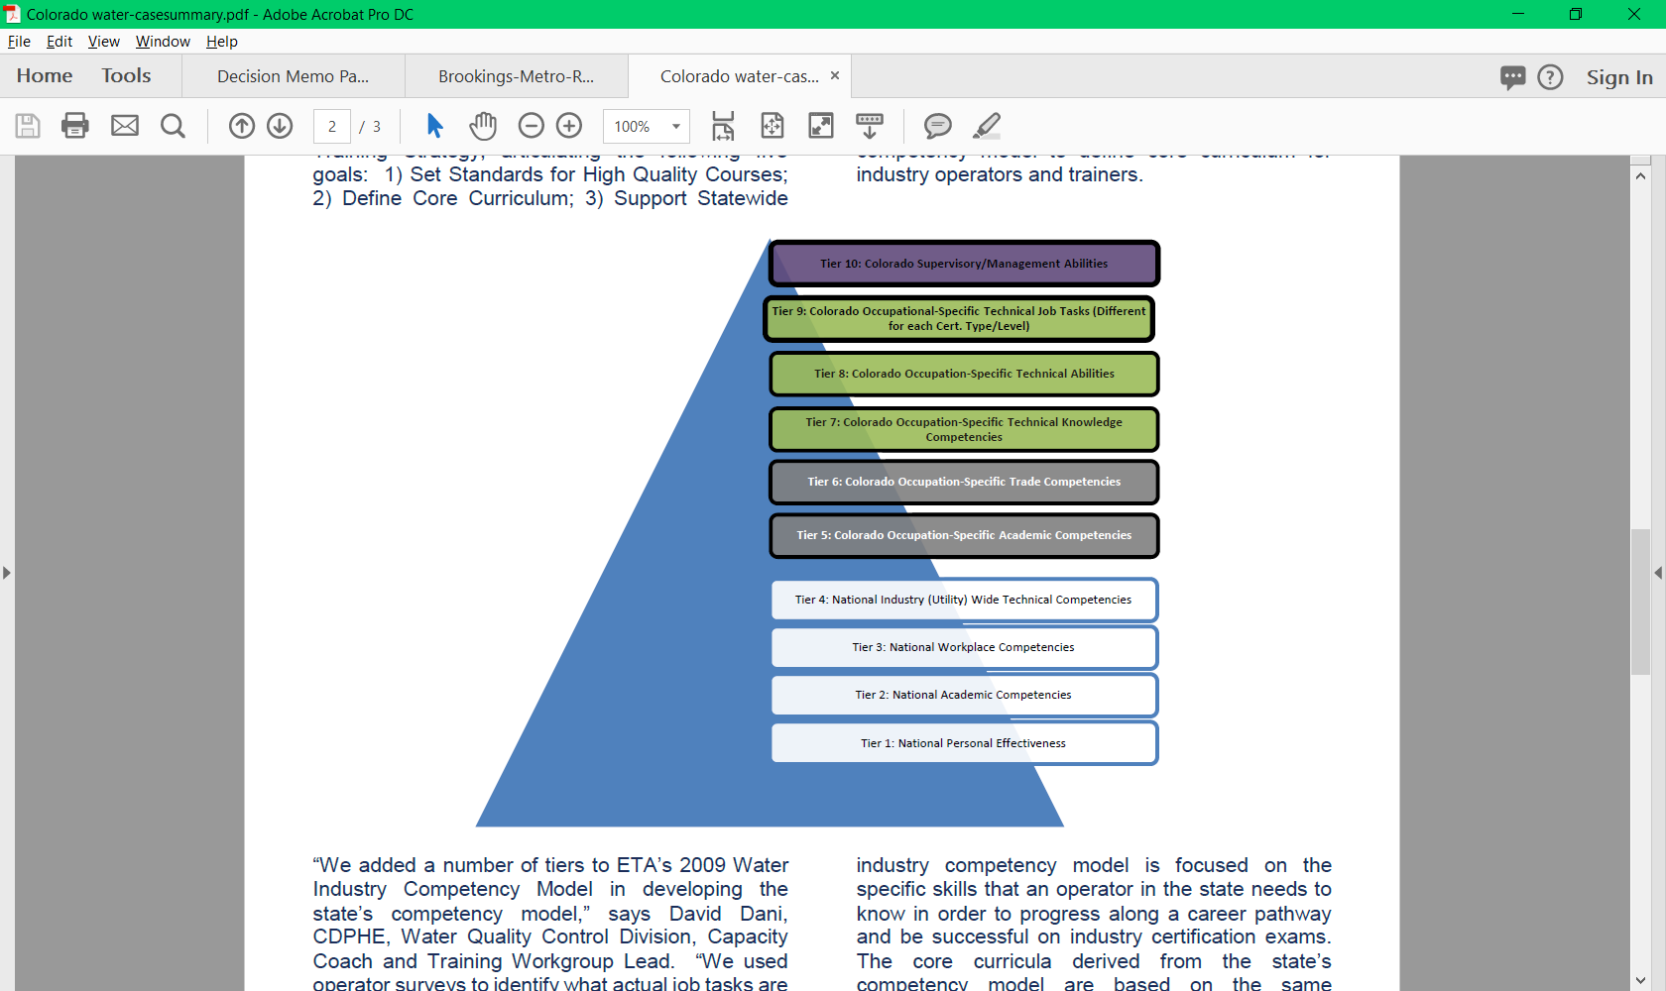
Colorado Customized Model
Notes:
This is a graphic showing how Colorado customized the model and built out three additional tiers including occupational specific Technical Knowledge and Abilities.
They also reviewed all the topics that are covered in industry certification exams to add Occupation-specific Technical Job Tasks for different certification types and levels of responsibility.
As a result of this research, the Colorado model is focused on the specific skills that an operator in the state needs to know in order to progress along a career pathway.
For more information about the Colorado story, I refer you to the Models In Action success story available at https://www.careeronestop.org/CompetencyModel/info_documents/water-casesummary.pdf

Slide 18
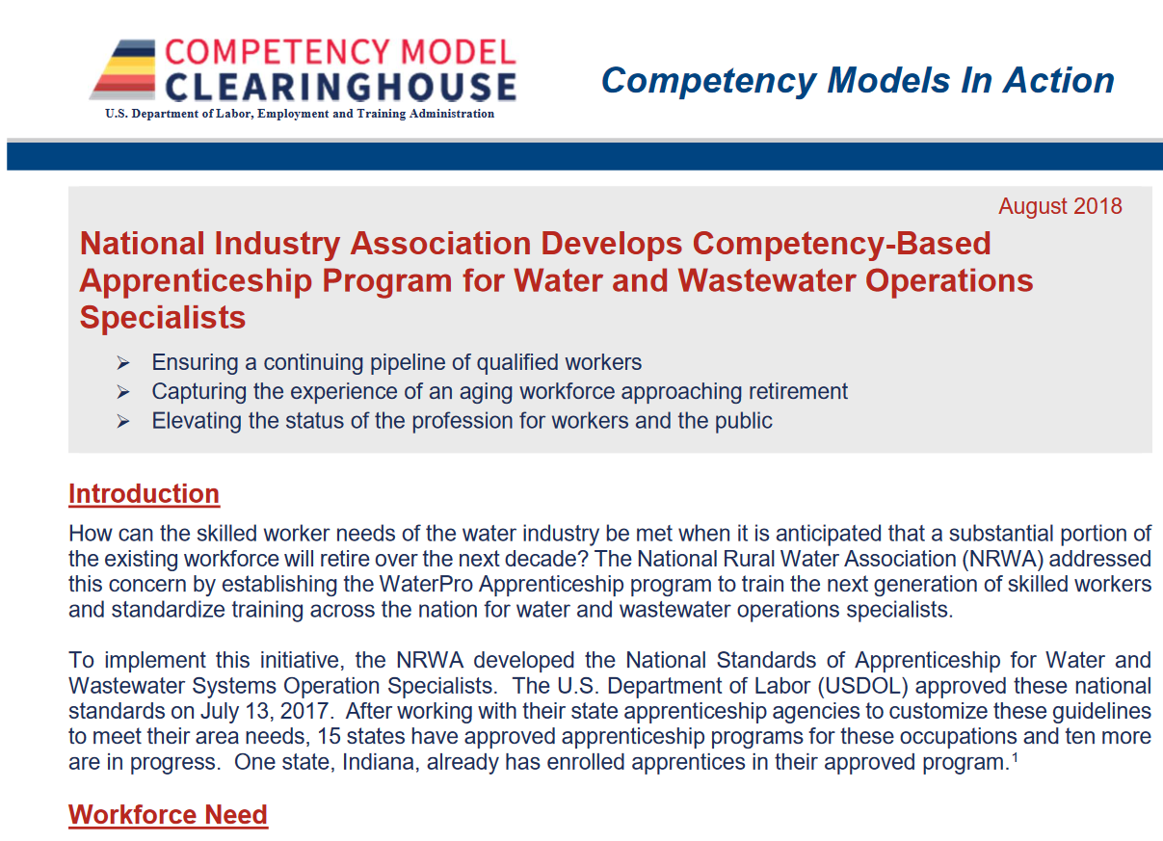
Additional Water and Wastewater Resources
Notes:
For more information about how the Water and Wastewater Competency Model has been used, including to develop an apprenticeship program for water and wastewater operations specialist, view the Models in Action Case Study at: https://www.careeronestop.org/CompetencyModel/info_documents/NRWA-CaseSummary-2018.pdf

Slide 19
Questions & Answers

